Slide 1
EUROMONEY Trade Finance Survey
Results
FEBRUARY 17th 2026
IBD / Corporate

Slide 2
Agenda
Global Ranking
Ranking in Western Europe
Ranking in Central and Eastern Europe (CEE)
Ranking in the Middle East
Digital Trade adoption
​
Source 1 : Euromoney website
Source 2 : Euromoney 2026 Trade Finance Ranking Report

Slide 3
Global Worldwide Ranking
EUROMONEY SURVEY Based on 12,694 CORPORATE responses

Slide 4
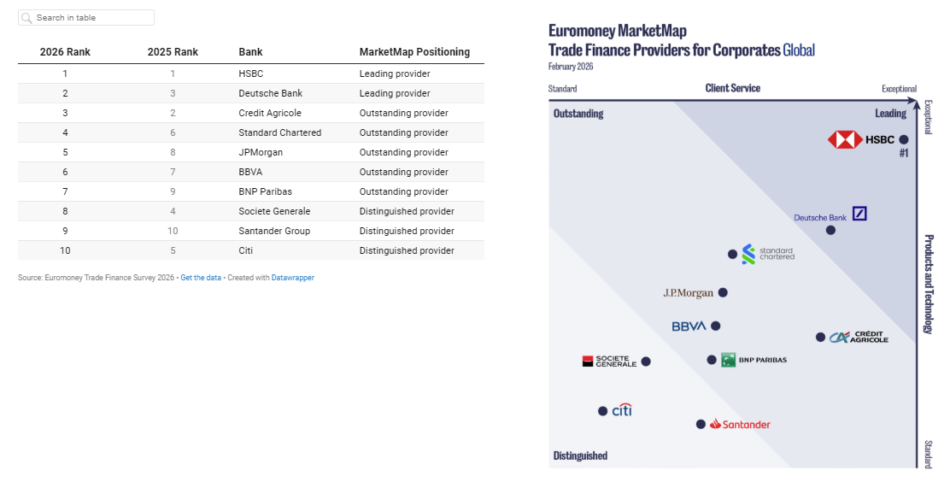
World’s best trade finance providers (1/2)

Slide 5
World’s best trade finance providers (2/2) (Extract from “Euromoney 2026 Ranking Report”)
#1 HSBC
Ranked by corporates as #1 trade finance provider globally, HSBC is valued less for the sheer breadth of its footprint and more for what that breadth enables in practice: operational consistency across markets. Corporate respondents consistently see HSBC’s global presence as a way to reduce complexity rather than add to it. A sector-based approach has become central to how HSBC supports its clients. “We reorganised the trade global team, focused on industry groups,” Vivek Ramachandran, head of global trade solutions at HSBC explains. As trade becomes a board-level lever, he adds, “beyond working capital, CEOs and CFOs are looking at trade as a sales enablement tool, as a risk mitigation tool and as a supply chain resilience tool.”
For globally active corporates, managing trade finance across jurisdictions often means juggling multiple interfaces, escalation paths and documentation practices. HSBC’s perceived strength lies in limiting those internal workarounds, allowing teams to focus on control, visibility and execution rather than exception management. From Ramachandran’s perspective, the value of HSBC Trade Solutions (HTS) platform is structural. A single global instance allows HSBC to support trade activity consistently across markets, now live in 25 countries. “HTS is fully integrated from the client channel all the way through to fulfilment, with one version of data flowing through,” he explains. “Clients are looking for full digital journeys, linked to their systems and embedded in their processes.”
This operational framing comes through in feedback tied to execution quality and digital throughput. A manufacturing corporate operating domestically in Sri Lanka highlights “excellent digital trade finance services, quick processing times and reliable document handling”. A global industrial corporate based in Malaysia echoes this, pointing to HSBC’s “intuitive and secure” online banking, but pairing that with praise for “knowledgeable and responsive” trade staff suggesting that digital capability is most valued when it shortens turnaround time and simplifies issue resolution.
The same theme appears in feedback from larger, cross-border users. A wholesale trade corporate with regional operations in Hong Kong notes that HSBC “supports trade flows efficiently across markets and responds quickly when issues arise”, reinforcing the idea that consistency in execution is as important as product availability.
#2 Deutsche Bank As a leading global trade finance provider, Deutsche Bank is positioned by corporates as a structural partner for complex cross-border trade. Across regions, clients consistently highlight balance-sheet strength, risk expertise and execution discipline rather than product breadth.
In Asia-Pacific, a wholesale trade client in China points to Deutsche’s ability to support domestic and international transactions seamlessly, while a Vietnam-based corporate highlights reliable execution in high-volume environments. In Western Europe, Deutsche is often chosen by HQs as the mandate winner across the region, reflecting its integration within multinational banking structures and its strength in navigating risk, compliance and sanctions. In the US, clients emphasise “industry knowledge, global scope and professional team”, alongside its digital tools. Balance-sheet capacity anchors these relationships, with many respondents using Deutsche as their primary provider, referencing deeper relationships than trade finance.
#3 Crédit Agricole
For Crédit Agricole, corporates consistently rank its trade finance around service quality, advisory depth and relationship continuity across regions. In CEE, clients in Poland highlight execution and flexibility, while clients in jurisdictions such as Ukraine appreciate their advisory capabilities, especially when handling complex transactions. In Western Europe, Crédit Agricole is associated with structured execution and tailored support. Clients across France, Italy and Germany reference strengths in core trade products, but also complex cross-border transactions.
#7 BNP Paribas and #8 Societe Generale, European champions with a strong global trade finance footprint, combine scale with depth of capability. BNP Paribas is consistently associated with product breadth and platform strength. Across Asia-Pacific and Western Europe, clients reference reliability, access to credit and efficient processing, with bank guarantees, credit management and factoring cited as core strengths. Platform quality is a recurring theme, with corporates pointing to strong digital self-service and responsive execution in high-volume environments. Societe Generale’s differentiation is also technology-led. The application of AI to document verification, fraud detection and control across trade workflows improves accuracy and insights. This is reinforced by structured implementation support and a transaction banking framework that embeds sustainability, helping corporates classify and benchmark ESG-linked trade activity as disclosure expectations continue to rise.

Slide 6
Western Europe Ranking

Slide 7
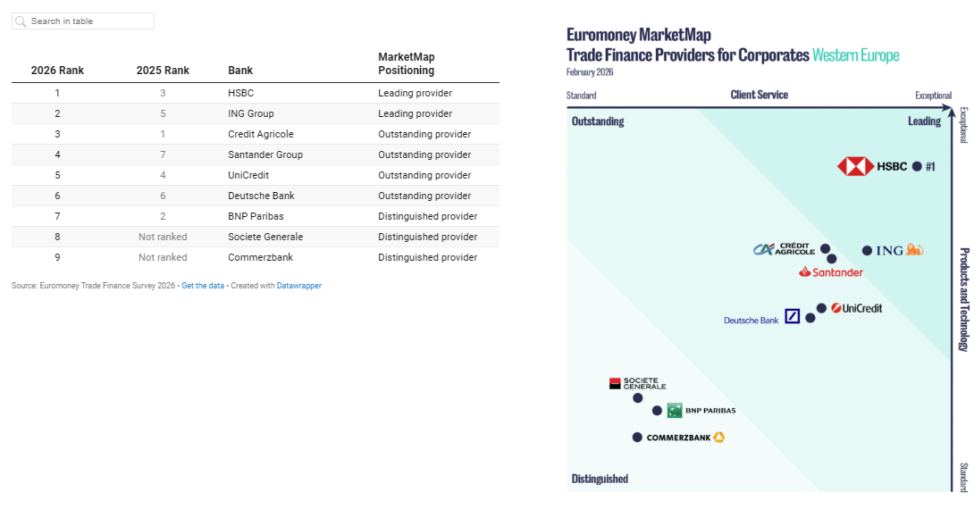
Best trade finance providers in Western Europe (1/4)

Slide 8
Best trade finance providers in Western Europe (2/4) (Extract from “Euromoney 2026 Ranking Report”)
#1 HSBC
At HSBC, corporates emphasise reliability and access to informed decision-makers. A German industrial corporate with domestic operations describes the bank’s strengths as “local contacts, direct customer contact, quick feedback, reliable service”. Speed and clarity of communication recur across responses. A UK-based retail trade corporate notes that HSBC “excels in trade finance and cross-border business banking”, adding that a documentary credit transaction “went through smoothly, ensuring no delays in shipping”. Another European manufacturing corporate highlights “accurate documentation and timely processing”, reinforcing that in trade-heavy sectors, correctness and turnaround time remain decisive.
#2 ING For ING, corporates highlight the trade finance proposition around collaboration and breadth rather than transactional execution alone. Clients in the Netherlands and the UK consistently highlight the bank’s ability to combine a wide range of trade and working-capital solutions with a cooperative service model. A chief financial officer in manufacturing describes ING’s approach as offering “different products, ensuring a fair collaboration”, while a senior financial manager in the Netherlands’ construction sector summarises the experience as “helpful”. Automation and digital tooling also feature in the corporates’ feedback.
#3 Crédit Agricole
At Crédit Agricole, trade finance in Western Europe is associated with advisory depth and structured execution. Clients across France, Italy and Germany consistently reference the bank’s strength in guarantees, LC and complex cross-border arrangements. The bank is recognized also by its ability to offer tailored solutions. A senior corporate executive in Italy highlights the bank’s “readiness to accommodate customer requests”. In transaction-driven situations, risk expertise matters. A chief executive officer in Germany’s financials sector points to “risk appetite, forfaiting and bridge financing”. Digital capability reinforces this proposition. A finance manager in France’s transportation sector highlights the efficiency of LC processing, while others point to rapid response and efficiency in global transactions.
#4 Santander Santander has continued to expand its trade and working-capital franchise across Western Europe through a model that integrates local execution with structured solutions. The bank’s co-founding of Invensa – a platform combining trade finance expertise with alternative credit to provide inventory financing – illustrates a broader shift toward hybrid models that extend beyond traditional bank balance sheets. This approach reflects growing corporate demand for integrated solutions spanning receivables, payables and inventory, particularly in capital-intensive sectors.
#5 UniCredit For UniCredit, corporate feedback highlights service reliability and coordination across borders. “UniCredit operates a matrix model with a global product factory ensuring consistency across markets while allowing local adaptation,” explains Francesca Nenci, global head of trade and corresponding banking, UniCredit.
Clients in Italy and Austria reference dependable execution as a baseline expectation in mature markets. “Our starting point is not the product,” Nenci adds. “We work with the client to understand their liquidity needs and the results they are expecting. Based on that, we propose the best solution, which can be either a trade related one or even another solution offered by the bank.”
A chief executive officer in Austria’s industrials sector points simply to service, while a senior financial manager with regional responsibility in construction highlights communication as a defining strength. In a region where corporates typically work with multiple banks, UniCredit’s value lies in consistency and clarity when managing trade activity across jurisdictions.
Beyond client accolades, Nenci underscores that her business’ progress is reflected not only in sentiment, but in hard metrics: “despite declining trade volumes seen in SWIFT data, UniCredit increased its trade finance penetration. This was the result of our focus on service quality, innovation and digitalization initiatives.”
#7 BNP Paribas BNP Paribas is positioned by corporates around product depth and platform capability. Clients across France, Belgium, Italy, Germany and Spain frequently reference bank guarantees, credit management and factoring as core strengths. Platform quality reinforces this. A finance manager in the construction sector describes BNPP as having “the best platform for handling bank guarantees”, while others highlight responsiveness, advice and availability of confirmations. The bank’s investments in digital self-service tools and automation resonate in a region where efficiency gains matter more than novelty.
#8 Societe Generale At Societe Generale, trade finance differentiation increasingly comes from technology applied to control and insight. AI is used to support document verification, fraud detection and predictive analysis across LC and trade workflows. These tools are paired with structured implementation and training, ensuring adoption translates into operational value. Sustainability is also embedded in the bank’s transaction banking framework, providing corporates with a structured way to classify and benchmark ESG-linked trade activity as disclosure requirements intensify.

Slide 9
Best trade finance providers in Western Europe (3/4) Detail per country
France
Italy
Geography | 2026 Rank | 2025 Rank | Bank
France | 1 | 1 | Credit Agricole
France | 2 | 2 | BNP Paribas
France | 3 | 4 | HSBC
France | 4 | Not ranked | CM-CIC
France | 5 | 3 | Societe Generale
France | 6 | Not ranked | Natixis
Geography | 2026 Rank | 2025 Rank | Bank
Italy | 1 | 1 | Credit Agricole
Italy | 2 | 3 | UniCredit
Italy | 3 | 2 | Intesa Sanpaolo
Italy | 4 | 7 | BPER Banca
Italy | 5 | 6 | Banca Monte dei Paschi di Siena
Italy | 6 | 5 | Banco BPM
Italy | 7 | 4 | BNL

Slide 10
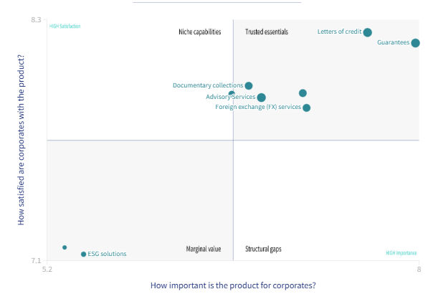
Trade Products: importance vs satisfaction for Corporates based in Western Europe (3/4)
Based on corporates’ assessment, Euromoney introduces the Importance vs Satisfaction Matrix, a visual framework that plots the perceived importance of individual trade products against clients’ satisfaction with current bank offerings, across regions. The matrix provides a clear lens on where banks are meeting expectations and where gaps remain.
Working Capital Solutions

Slide 11
CEE RANKING

Slide 12
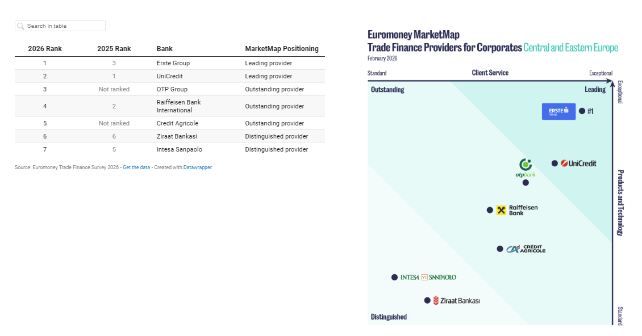
Best trade finance providers in CEE (1/4)

Slide 13
Best trade finance providers in CEE (2/4) (Extract from “Euromoney 2026 Ranking Report”)
#1 Erste Group
At Erste Group, long-standing relationships and flexibility stood out as defining characteristics. Corporates across Croatia and Serbia repeatedly emphasised speed of execution and supportive structuring. An accountant in Croatia’s construction sector highlights execution pace, while a finance manager in the consumer discretionary sector points to the “quality of the service”, underlining the importance of reliability in a volatile operating environment. Flexibility also features prominently. A regional finance manager in Croatia’s information technology sector describes Erste Group as “extremely supportive” when structuring transactions. Relationship continuity reinforces this position. A finance manager in Croatia’s manufacturing sector observes, “we have been working with them the longest”, while a managing director in Serbia’s transportation sector highlights predictability, noting that “the results of potential requests are always known”.
#2 UniCredit For UniCredit, the strength of its CEE franchise lies in local presence combined with regional consistency. “Our model is very clear: we have product at global level, ensuring the same quality and same service level to all our customers,” explains Francesca Nenci, global head of trade and corresponding banking, UniCredit. “People on ground, in the countries, are with clients every day. Then we have a strong back office.”
Clients across Hungary, Romania and Poland point to accessibility and communication as critical factors when managing trade activity. Nenci attributes this to a strong transformation programme: “UniCredit structured its trade finance transformation around three pillars: a digital client interface, internal automation, and process simplification across countries.”
A head of treasury in Hungary’s construction sector highlights communication as decisive. Execution speed and service quality are recurring themes. A chief executive officer in the industrials sector identifies service as the core reason for working with the bank, while others reference UniCredit’s ability to support domestic and cross-border trade through a consistent regional platform. “We deliberately separated high-value advisory from operational processing, building a dedicated trade finance hub in Romania to improve efficiency,” Nenci adds. “We have a very skilled team which we built over the last 10 years.” The message is clear: proximity and responsiveness remain central in fragmented markets
#3 OTP Group At OTP Group, corporate feedback highlights local proximity, execution speed and operational focus. Clients across Serbia, Croatia, Hungary and neighbouring markets consistently reference accessibility. An accountant in Serbia’s manufacturing sector points to “proximity to branches and speed”, underlining the value of local decision-making. Execution quality is reinforced by client focus. A finance director in Serbia’s communications sector notes OTP’s ability to “meet client needs”, while a managing director in agriculture summarises the experience as “efficiency [and] speed”. For more complex requirements, stability matters. A finance manager in Hungary’s manufacturing sector highlights “risk sharing and stability”, alongside a broader product set, reflecting the bank’s role in supporting structured trade flows across the region.
#5 Crédit Agricole
For Crédit Agricole, trade finance in CEE is defined by service quality, advisory depth and relationship continuity. Clients in Poland consistently highlight execution and flexibility. A chief financial officer in manufacturing describes the experience simply as “service”, while a finance manager in construction points to a “flexible approach” to trade financing. Scope and accessibility also feature, with corporates referencing broader financing support and the bank’s role in issuing guarantees for domestic and cross-border activity. In more complex markets, advisory capability is decisive. A client in Ukraine highlights Crédit Agricole’s “international connections” and ability to deliver “non-standard solutions”. Platform quality reinforces this positioning. A chief financial officer in Poland’s construction sector highlights “top-notch software, efficient processing and quality service”, while another notes faster information processing than peers.
Relationship depth remains central. A global chief financial officer in Poland’s industrials sector highlights “people, their knowledge, competence and commitment”, while another concludes: “For us, Crédit Agricole is not just a bank, but a long-term partner.”
#4 Raiffeisen Bank At Raiffeisen Bank International, speed of execution and direct access to decision-makers emerge as defining strengths. Clients across Serbia, Bosnia and Herzegovina, Croatia, Romania and Ukraine consistently highlight responsiveness. A finance director in Bosnia and Herzegovina’s retail sector summarises the value proposition as “speed”, while a senior financial manager in Serbia’s wholesale trade sector points to the rapid issuance of guarantees. Relationship access also matters. A senior accountant in Serbia highlights the importance of “contact with managers”, reflecting the premium placed on real-time decision-making in time-sensitive transactions. RBI’s role as a core provider further reinforces its position. A head of treasury in Croatia’s industrials sector describes the bank as the “main provider” for domestic and international trade, while corporates in Romania and food and beverage point to the bank’s willingness to deploy credit and support large construction-related trade flows. Digital capability is increasingly visible, with references to digital guarantee applications and solution-oriented execution

Slide 14
Best trade finance providers in CEE (3/4) Detail per country
Poland
Ukraine
Geography | 2026 Rank | 2025 Rank | Bank
Poland | 1 | 2 | Credit Agricole
Poland | 2 | 1 | Bank PEKAO
Poland | 3 | 6 | HSBC
Poland | 4 | 7 | PKO Bank Polski
Poland | 5 | 3 | ING Group
Poland | 6 | 5 | mBank
Poland | 7 | 8 | Santander Group
Poland | 8 | 4 | BNP Paribas
Geography | 2026 Rank | 2025 Rank | Bank
Ukraine | 1 | Geography not published | Credit Agricole
Ukraine | 2 | Geography not published | Citi
Ukraine | 3 | Geography not published | OTP Group
Ukraine | 4 | Geography not published | Raiffeisen Bank International

Slide 15
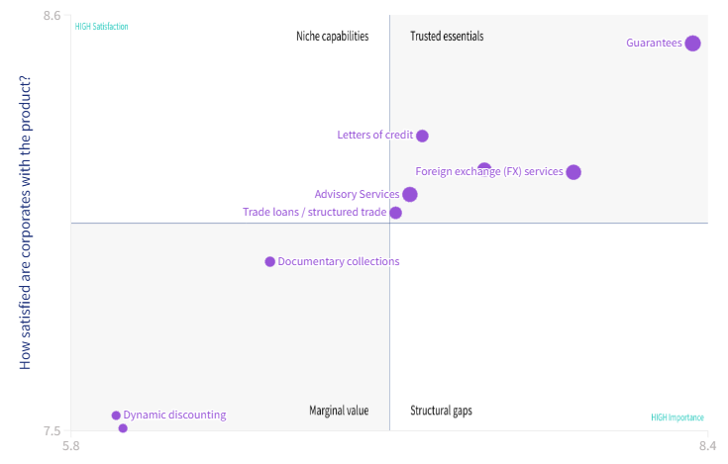
Trade Products: importance vs satisfaction for Corporates based in CEE(4/4)
Based on corporates’ assessment, Euromoney introduces the Importance vs Satisfaction Matrix, a visual framework that plots the perceived importance of individual trade products against clients’ satisfaction with current bank offerings, across regions. The matrix provides a clear lens on where banks are meeting expectations and where gaps remain.
Working Capital Solutions

