Slide 1
CRÉDIT AGRICOLE EGYPT
WORKING EVERYDAY IN THE INTEREST OF OUR CUSTOMERS & SOCIETY

Slide 2
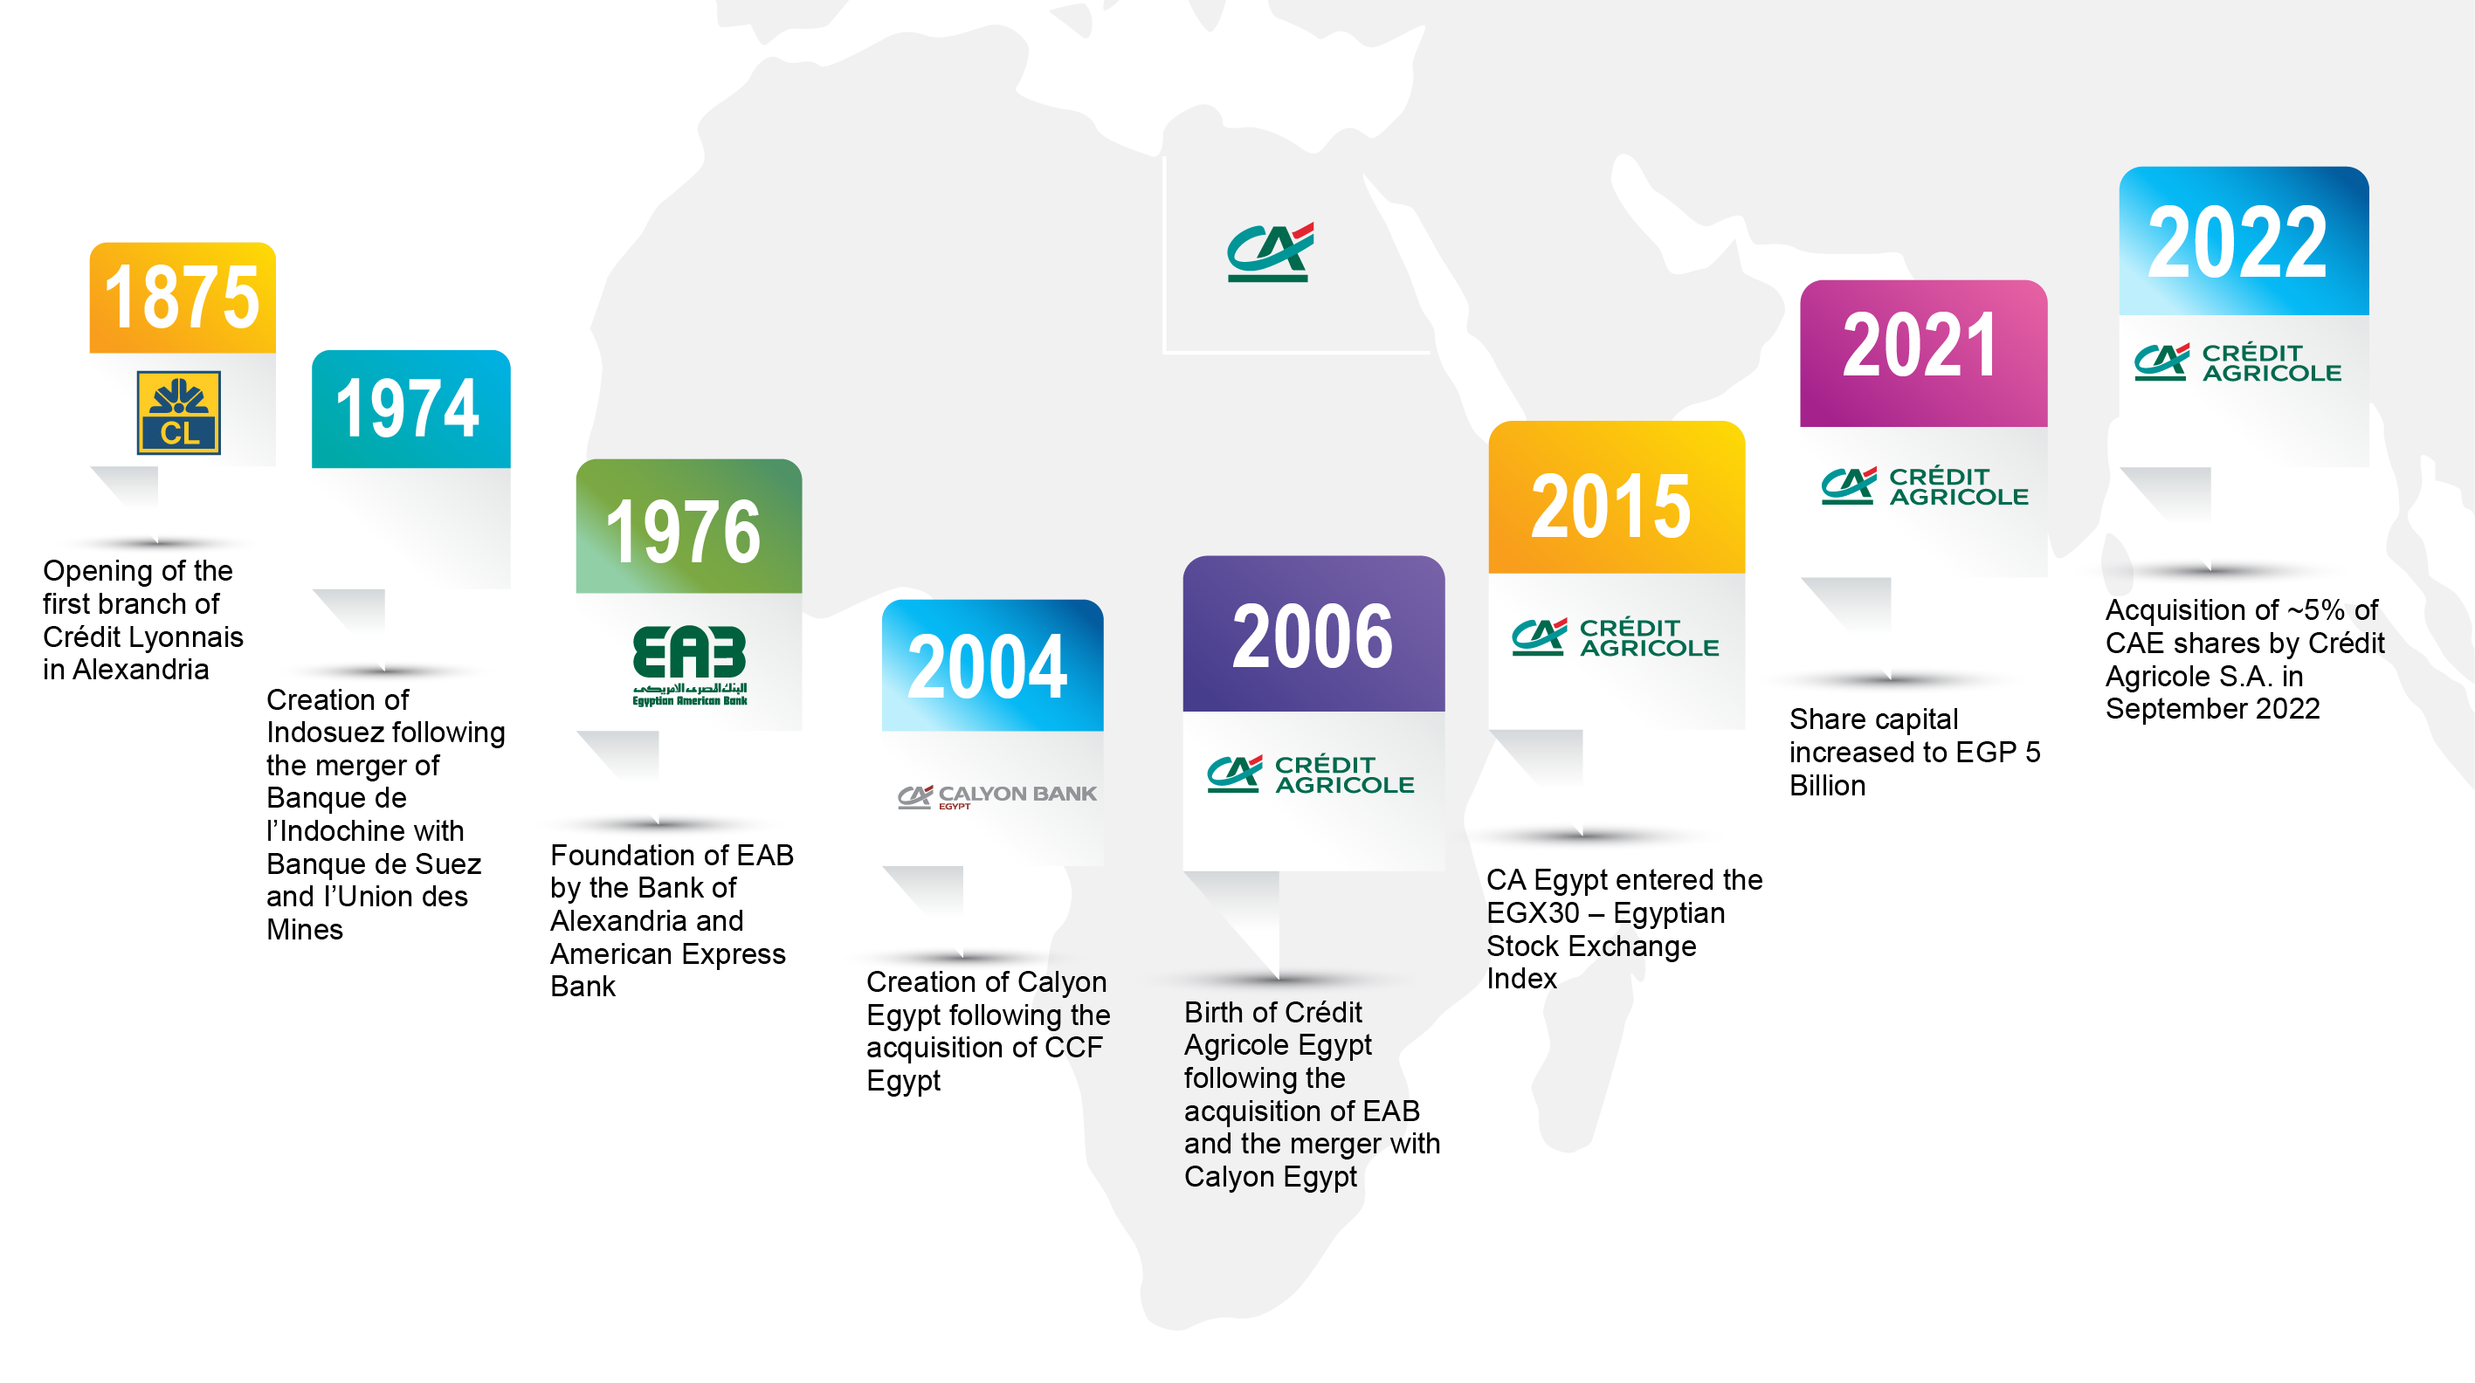

CRÉDIT AGRICOLE EGYPT Our history
The sole French bank in Egypt
Established in 2006
Long standing presence with deep
roots
This document is at the recipient attention only. Any duplication or diffusion is strictly forbidden.

Slide 3

CRÉDIT AGRICOLE EGYPT Fact sheet as of June 2025
Listed on
Egyptian stock exchange (EGX)
Innovative & award-winning,
fully-fledged digital platform
“banki Mobile”
CA Group owns
65.25% of CAE shares
(52,2% Crédit Agricole SA & 13,1% CACIB)
Network of
85 Branches and
817 ATMs
Market Capitalization
EGP 22 Billion
(USD 443.57 Million)
Specialized Hubs
for Business and
Private Banking customers
2,516
Employees
EGP 135 billion
Total Balance Sheet
~ 500,000
customers
~ 50% of our clients using our digital channels
This document is at the recipient attention only. Any duplication or diffusion is strictly forbidden.

Slide 4

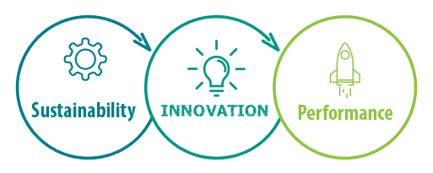
CRÉDIT AGRICOLE EGYPT Our Ambition
To be the bank of choice for our customers
Capitalizing on innovation and sustainability, we aim at offering excellence in customer relationship and create value for all our stakeholders.
This document is at the recipient attention only. Any duplication or diffusion is strictly forbidden.

Slide 5
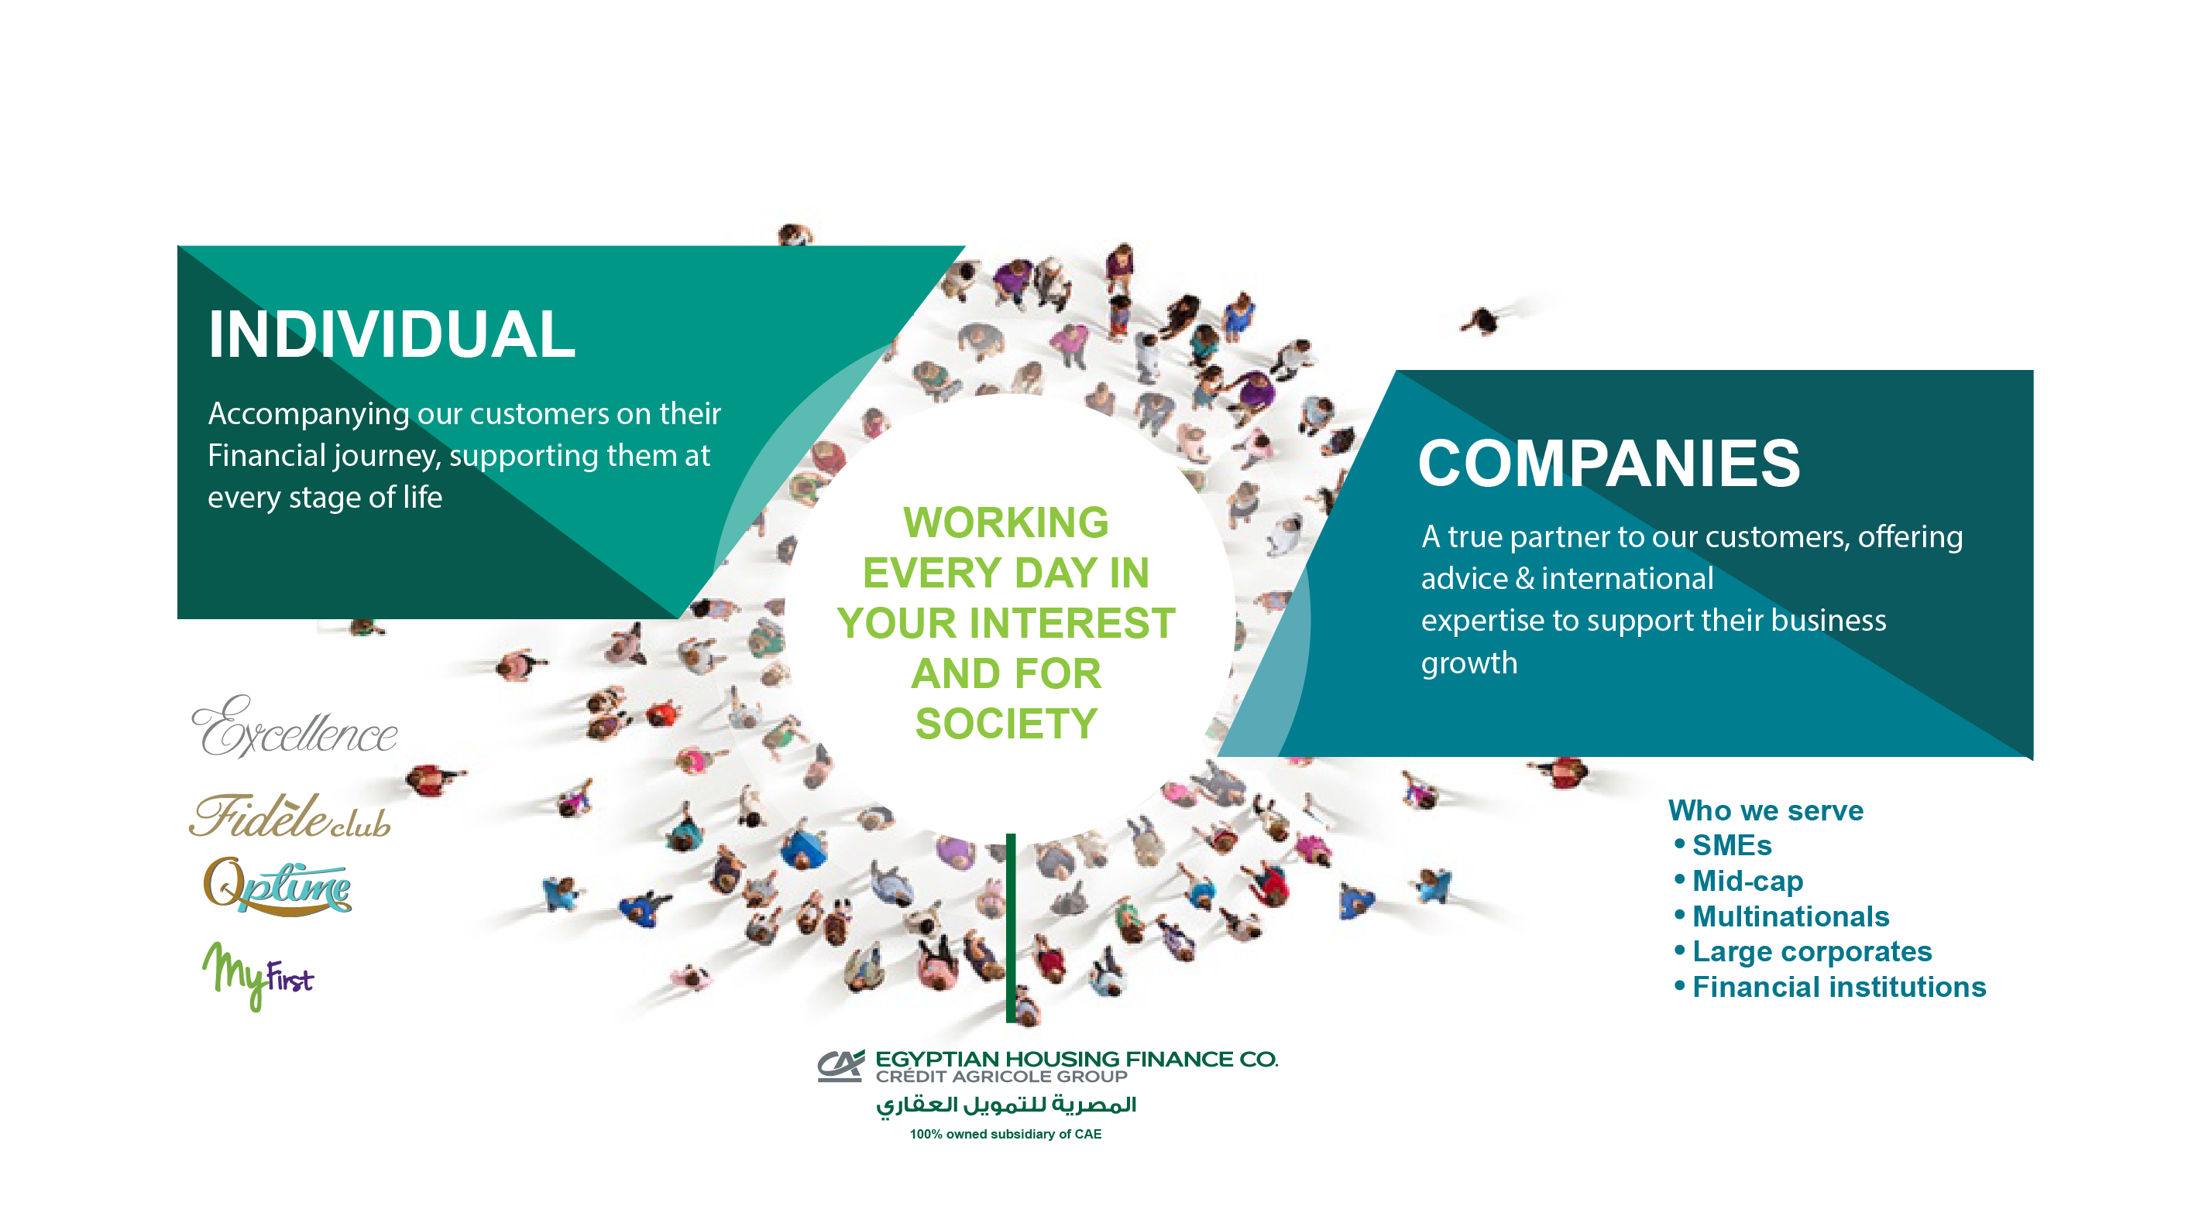
CRÉDIT AGRICOLE EGYPT A universal bank to match our customers’ needs
Specialized Segment Offerings
100% owned subsidiary of CAE
This document is at the recipient attention only. Any duplication or diffusion is strictly forbidden.

Slide 6
CRÉDIT AGRICOLE EGYPT A reliable banking partner to businesses in Egypt
A client-centric business model offering a comprehensive range of banking products & services.
Local knowledge backed by the international expertise & presence of CA group/ CACIB.
Serving nearly 8,000 SMEs, Corporate and Financial Institution clients.
A trusted partner to both the private & public sectors, and recognized as a leading bank for multinational companies operating in Egypt.
Solid expertise in trade finance and capital markets.
Strategic focus on syndicated loans and project finance.
Supporting customers’ energy transition through green finance solutions.
A fully fledged cash management offering that covers customers’ day-to-day banking needs.
GLOBAL
TRANSACTION
SERVICES
TRADE FINANCE
GLOBAL
TRANSACTION
SERVICES
PRIVATE
BANKING
COVERAGE
CLIENT
SYNDICATION
PROJECT &
GREEN
FINANCE
SYNDICATIONS, PROJECT & SUSTAINABLE FINANCE
CUSTODY SERVICE
CORPORATE
BANKING
SOLUTIONS
CAPITAL
MARKETS, FX & CUSTODY SERVICE
CRÉDIT AGRICOLE
CORPORATE & INVESTMENT
BANKING (CIB)
CAPITAL
MARKETS & FX
This document is at the recipient attention only. Any duplication or diffusion is strictly forbidden.

Slide 7
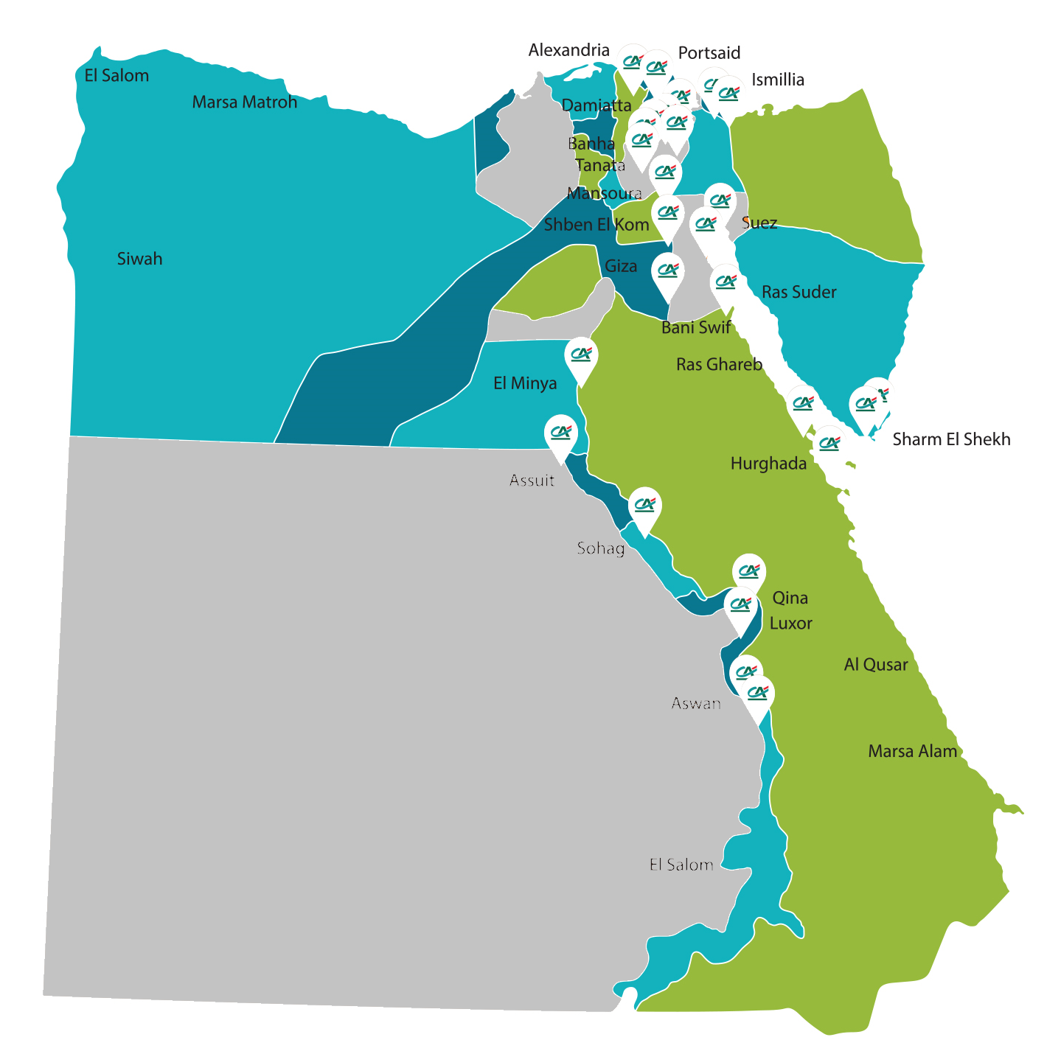
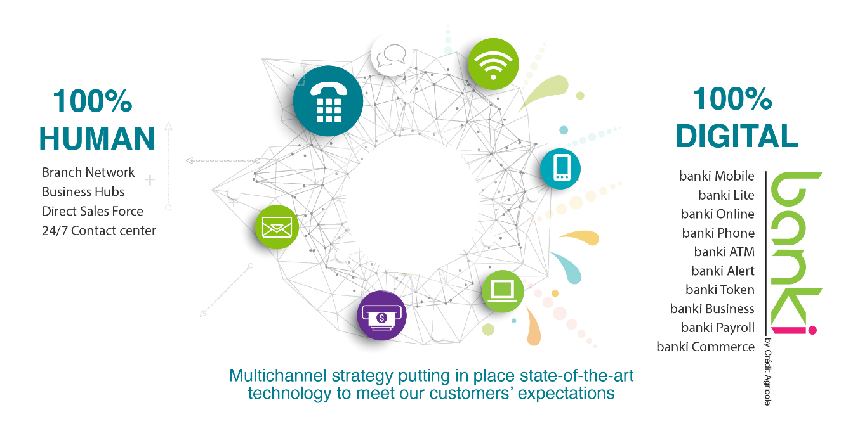
CRÉDIT AGRICOLE EGYPT A reliable banking partner to individual clients in Egypt
85
branches
Around 500,000 customers are served through 85 branches located in the main cities across the country.
Offering a wide range of value-added products, services as well as digital solutions designed to meet the evolving needs of a diversified clientele.
Crédit Agricole Private Banking provides wealth management services cater for sophisticated private investors.
Integrated digital services through “banki” platform comprising mobile application, online and phone banking in addition to a network of 817 ATMs, conveniently located across Egypt.
Ensuring customer satisfaction through relationship excellence and Customer centric approach.
Diversified banking channels for customers convenience
This document is at the recipient attention only. Any duplication or diffusion is strictly forbidden.

Slide 8
CRÉDIT AGRICOLE EGYPT Financial Information (figures are presented in Million EGP)
 | December 2021
Revenues | 3.87
Net Income | 1.59
Capital Adequacy Ratio | 20.87%
Tier 1 Capital | 7.51
December 2022
5.07
2.41
18.69%
7.45
December 2023
9.55
5.14
18.55%
9.82
December 2024
13.75
8.00
20.01%
13.87
December 2025
13.09
6.95
19.50%
16.95
STRICTLY CONFIDENTIAL
This document is at the recipient attention only. Any duplication or diffusion is strictly forbidden.

Slide 9




BPIs PROS NEW CLIENTS ACQUISITION Carrefour conquest Pros
March 2026
DBI - AAP

Slide 10
1) 2025 final acquisition results

Slide 11
Key figures acquisition / 2025 vs. 2024 full year
2024 full year
2025 full year
Net balance
Exceptional Growth: We achieved 109% increase in net new clients, growing from 656 in 2024 to 1,370 in 2025
Attrition decreased by 6%, dropping from 673 to 633, signaling improved client retention and satisfaction
This year represents a key milestone, as we’re gaining significantly more new clients than we’re losing, leading to sustainable growth in our professional client base
.
Acquisition
Loss
11

Slide 12
KEY FIGURES ACQUISITION REGIONAL DIRECTION level
The 2025 performance marks a crucial turnaround for the Regional Direction level. We have shifted from a negative net position in 2024 to a significant surplus, driven largely by a surge in new client acquisition
Acquisition rate doubled from 9% to 18%, signaling a highly effective sales strategy and improved market penetration
We successfully reversed a (22) client deficit in 2024 to a massive +721 net gain in 2025
Pros. Under the Retail LOB segment was the primary engine of our 2025 growth, with 82% acquisition rate
Negative figures in the lost Clients and net balance columns are a result of targeted portfolio cleanup missions and the offboarding of dormant accounts to improve overall SME portfolio health
12

Slide 13
ACQUISITION by Channel
+ 109%
Acquisition Channel | Year 2025 |  |  |  |  |  |  |  |  |  |  |  |  | Y2024 | Y2025 |  | 2025 Vs. 2024
 | Jan.25 | Feb.25 | Mar.25 | Apr.25 | May.25 | Jun.25 | Jul.25 | Aug.25 | Sep.25 | Oct.25 | Nov.25 | Dec.25 |  | Total | Total |  | Change no. | %
SMEs | 42 | 43 | 42 | 30 | 36 | 35 | 45 | 46 | 50 | 40 | 56 | 47 |  | 474 | 512 |  | 38 | 8%
Agri | 0 | 0 | 1 | 1 | 0 | 0 | 0 | 0 | 0 | 0 | 0 | 1 |  | 0 | 3 |  | 3 | #DIV/0!
Pros. Branches | 0 | 0 | 0 | 0 | 0 | 0 | 14 | 33 | 47 | 82 | 68 | 3 |  | 150 | 247 |  | 97 | 65%
Pros. Direct Sales | 0 | 0 | 0 | 0 | 0 | 0 | 48 | 92 | 154 | 166 | 143 | 5 |  | 32 | 608 |  | 576 | 1800%
Total | 42 | 43 | 43 | 31 | 36 | 35 | 107 | 171 | 251 | 288 | 267 | 56 |  | 656 | 1,370 |  | 714 | 109%
The acquisition landscape in 2025 demonstrates a breakthrough year, characterized by a 109% increase in total client acquisition compared to 2024
Our core SME segment maintained a sustained growth with an 8% YoY growth, providing a contribution of 512 NTB during Y25
Total monthly acquisition rate transformed from an average of 50 NTB in H1 to a high of 288 NTB by October 2025
Branches prospecting increased by 65%, contributing 247 new clients compared to 150 the previous year
13
Notes:
Robert

Slide 14
2) Equipment & profitability

Slide 15
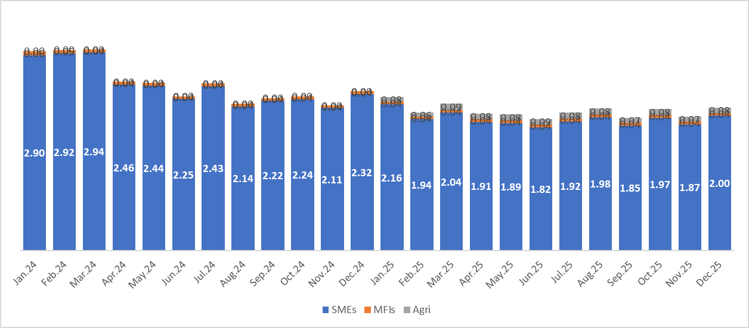
Total 2025 NBI, by client segments
SMEs remain the primary driver of Net Banking Income (NBI), consistently contributing over 90% of the total volume throughout the period, despite a slight normalization in 2025 compared to the peak seen in March 2024 (figures are in EUR)
A positive trend is observed in the Agri segment, which began showing measurable contributions in January 2025 and maintained steady growth to reach its highest levels during the second half of the year
The MFI segment has maintained a flat contribution across all years, acting as a reliable baseline for the overall portfolio
*NBI figures are in Mn EUR

Slide 16
Performances COMPARISONS
Performances COMPARISONS | 2024 | 2025 | ∆
NBI [ml in PL] | 1.64 | 1.83 | 11.6%
New clients / NET ACQUISITION * | 656 | 1,370 | 109%
Attrition** | 673 | 633 | -6%
client's profiles on the 2 reference periods
NEW client's profiles on the 2 reference periods
client's profiles on the 2 reference periods | 2024 | 2025 | ∆
NBI professionals*** [ml in PL] | 1.64 | 1.83 | 11.6%
Other NBI [ml in PL] | 26 | 24 | -9%
Professionals total loans [ml in PL] | 42 | 85 | 101%
Other total loans [ml in PL] | 54 | 75 | 39%
Professionals average loan amount [PL] | 44,474 | 50,317 | 13.2%
Other average loan amount [PL] | 179,954 | 204,287 | 13.5%
NEW Client's profiles on the 2 reference periods | 2024 | 2025 | ∆
NBI professionals*** [ml in PL] | 0.13 | 0.19 | 46%
Other NBI [ml in PL] | 0.3 | 0.5 | 66.6%
Professionals total loans [ml in PL] | 7 | 45 | 542%
Other total loans [ml in PL] | 2 | 8 | 276%
Professionals average loan amount [PL] | 44,474 | 50,317 | 13.2%
Other average loan amount [PL] | 179,954 | 204,287 | 13.5%
*NBI figures are in Mn EUR
16

Slide 17
Performances COMPARISONS
Net Acquisition has more than doubled (+109%), jumping from 656 to 1,370 clients. This momentum is directly reflected in the lending figures: New Client Professional Loans increased by 546%, indicating that our current marketing or product positioning is resonating intensely with professional profiles
The professional total loan volume across all clients grew by 114%, reaching nearly 4.75Bn EGP (82.2 M EUR). This suggests that while we are maintaining our base, our growth engine is now firmly powered by the Professional segment rather than other categories
Attrition has decreased by 6%, falling from 673 to 633. The simultaneous rise in new client acquisitions and reduction in attrition signals a stronger market position, supporting sustained profitability and greater stability in NBI over the long term
NBI Increased by 11.6% YOY to reach (1.83M EUR)
Other average loan amount shows all SMEs excluding Doctors and MFIs

Slide 18
3) Focus on Liberal Professions

Slide 19

The Egyptian Healthcare Landscape (2025–2026)
Egypt's medical device and healthcare equipment market is valued at approximately EGP 50-60 billion (USD 2.5 billion equivalent) as of 2024, driven by aggressive private sector modernization across all medical specialties
The nation's 65,000 clinic owners—comprising 30,000-45,000 general and specialized clinics plus 25,000-30,000 dental practices—represent a rapidly expanding ecosystem with significant capital needs and appetite for innovation
Key market drivers include:
High-frequency equipment replacement cycles in dentistry, dermatology
Competitive pressure to continuously upgrade facilities to attract and retain patients
Growing middle class and increased healthcare spending
Limited access to traditional financing for medical equipment purchases
With CAE currently holding around 5% market share, the expansion opportunity is substantial and largely untapped

Slide 20



Growth Drivers & CAE's Strategic Position
Equipment Replacement Cycles
Competitive Standards Pressure
CAE Market Share Opportunity
High-frequency turnover in dental chairs, X-ray systems, and aesthetic devices drives recurring investment needs across Egyptian private practices
Private clinics must continuously upgrade to retain patients in an increasingly quality-conscious healthcare market
CAE has a significant runway for expansion in specialized private practice financing

Slide 21
Priority Medical Specialties: Where to Win
TARGET SEGMENTS
Strategic focus on four high-potential segments balancing volume, ticket size
Dentists
Dermatology & Aesthetics
OB-GYN & IVF
Surgical Specialties
Up to 30,000 clinics
10,000–15,000 clinics
ENT, Ophthalmology, Orthopedics
Highest volume opportunity with equipment-intensive practices requiring chairs, X-rays, and Camera systems
8,000–12,000 clinics
Rapid modernization appetite for ultrasound systems and monitoring upgrades
Premium segment with ticket sizes reaching EGP 5M for laser and advanced imaging technology
High-margin opportunities in endoscopes and specialized surgical instruments
Our Target is EGP 1 billion in growth by adding 500 new clinic owners to our priority Doctor Program segments

Slide 22
The CAE Advantage: Purpose-Built for Medical Professionals
CBE-SME Initiative Compliance
Superior Risk Profile
Why Doctors Choose CAE
Doctor segment maintains exceptional portfolio quality with a cost of risk below 2%—well below industry averages
Highly competitive 5% subsidized interest rate exclusively for business-use medical equipment purchases
Flexible financing tailored to private medical practices, combining competitive rates with unmatched insight into the healthcare industry
Specialized understanding of doctors’ income patterns
Trusted relationship and preferential terms
Streamlined Digital Experience
Strategic Risk Partnerships
Fast Track approval programs paired with a seamless "Apply Now" digital journey via CAE website
Established Credit Guarantee Company (CGC) collaboration, expanding to IFC and EBRD in 2026

Slide 23
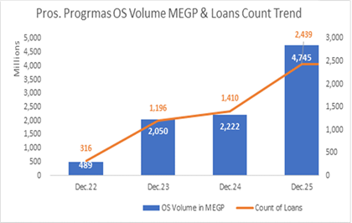
Performance Milestones: 2022–2025 Growth
Explosive Reactivation
After a strategic pause in 2024, the healthcare program re-launched back in July 2025, booking 1.17 billion EGP in just three months—demonstrating pent-up market demand and CAE's execution capability
Client Base Expansion
Active clients surged from 286 in 2022 to 2,437 by December 2025, reflecting strong market penetration and customer retention.
2025 Momentum
YTD results show 1054 cases booked totaling 2.9 billion EGP

Slide 24




Four Pillars of 2026 Growth Strategy
Portfolio Expansion
Market Diversification
Add EGP 1 billion to the Doctor Program portfolio by onboarding 500 new clinic owners across priority segments
Launch "Medical Entities Facility Program" targeting larger hospitals and medical labs with significantly higher ticket sizes
Digital Dominance
Organizational Focus
Heavy investment in targeted Facebook/Instagram campaigns and SMS outreach to drive digital-first customer acquisition
Establish a dedicated healthcare sub-unit within SME LOB to serve the unique needs of medical professionals

Slide 25
Cross-Selling Solutions: Comprehensive Financial Services for Medical Professionals
Debit & Credit Cards
Digital Banking
Mortgage Solutions
Corporate debit cards for clinic operational expenses
Premium credit cards
Cashless Payments
Rewards program (Happy points)
Contactless Payments
Online banking for clinic accounts
Real-time account balances and transaction history
Transfer funds in local or foreign currencies
E-Gov payments (social insurance,…)
Access the corporate credit card account and settle payments
Competitive mortgage rates 1% over the lending corridor
Flexible repayment terms up to 15 years
Fast-track approval process for doctors
Financing for residential, commercial, and administrative properties

Slide 26
4) Improvement proposals for 2026

Slide 27
SMEs / Pros’ Growth and Development
SME / Health sector : To continue the sustainable growth by providing quality advise to our clients, enriching our offers and investing in Digital.
Action Plan
Focus on SME (upper segment), Healthcare (doctors) : Aligning loan growth strategy with CBE SME initiative.
Develop specific campaigns in order to increase our commercial activities with Non borrowing clients
Push product Equipment, Cross Selling with SME / Pro clients
Start Equipping our RM’s with tablet to support working at client’s premises (Digital journey)
Achieve better equipment ratio by providing Trade Finance, Cash Management and e-commerce solutions
Evaluate possible synergies such as Blank, the CA digital App for SME which provide additional services like accounting or management control.
Equip existing customers under doctor programs with other bank products: investment products, Cards…
Develop new products/services (e.g. insurance product with our bancassurance partner)
Push for multiple cross-selling opportunities: Private Banking, Payroll or Leasing opportunities
KPIs
Annual client acquisition (borrowing and non borrowing) to reach 600 by end of 2026
Asset and Liabilities O/S to be increased by 50% by end of 2028
To reach 65% digitally active customers
Agri sector : To be recognized as a credible player for our expertise-based approach, dedicated offerings & quality advice
Action Plan
Develop CAE’s Agri Finance Business : targeting the upper segment (selected Agri sectors, exporters) as per recent approved strategy.
Increase the number of our dedicated front line team & develop, improve the specific agricultural knowledge of our RMs and other stakeholders
Start Equipping our RM’s with tablet to support working at client’s farms (Digital journey)
Built a communication plan directed to Farmers, Agri entities and Agri Professional Association (Including Fairs, Social Media, Event supported by Group experts)
Focus well structured Farms for lending and commercial activities
Leveraging on Group Expertise and Brand
Developing Green Finance solutions as a driver for loan growth & TF activities to support our exporters
Implement dedicated commercial campaigns in order to increase our client base and market awareness
Sign cooperation agreement with some partners [manufacturers or dealers of tractors, milking machine, irrigation and renewable energy equipment and Processing companies] in order to accelerate acquisition of the targeted customers.
Push on added value product equipment, Digital, PB, Leasing,
KPIs
Agri: reach a portfolio of 250 clients in the farming industry which will generate a total NBI > 300 Mio EGP

Slide 28
CAE Strategy:
Growing our Assets Portfolio capitalizing on our dedicated team and existing initiatives:
5% CBE and 15% MOF
EBRD and Leasing solutions
Update the existing 2 programs WC & TF with few amendments to be re-launches on Q2 2026
Working on 2 new programs which support the SME direction for financing E-Gov payment and E-Commerce.
Working on a specific program to start target the health sector from other angels which is the Medical Entities Facility Program (Hospital, Medical Labs,..etc.) with bigger tickets Size and different Parameters.
Capitalize on the restructuring of the Agri Team targeting large segment customers under Agri / Agro Business Line
Different partnerships that cover different customers needs as below:
EBRD partnership with CAE (GEEF) which aim to support the green finance lending for agri sector.
ADP (Agriculture development program) with a very competitive rates from (8.5% -11.5%)signed and live for agriculture sector that help us to serve our customers with competitive edge
.

Slide 29
CA Egypt – MFIs Portfolio
CA Egypt MFIs Portfolio managed by SME LOB, consists of 5 clients (borrowing) and contributing in total SME LOB deposits by 0.4%, assets by 25%, NBI by 2%, LCY inflows by 1%, FCY inflows by 0% and trade finance by 0% - while maintaining 0 active payroll agreements for 0 employees.
5 MFIs Clients
Deposits OS EGP 54Mln
Assets OS EGP 1.11Bln
2025 NBI EGP 28Mln
2025 LCY Inflows EGP 936Mln
2025 FCY Inflows US$ 0
2025 Trade Finance 0
0 Active Payroll Agreements

Slide 30
Microfinance Sector The main scope of the MFIs institutions is to finance the low -income individuals who used to depend on informal sources to finance their needs, either in form of group lending or individual lending and small and medium enterprises (SMEs). The MFIs are supervised by the financial regulatory authority (FRA) which is A public authority, regulating the MFIs sector, with number of regulations with its related published benchmarks.
Key Developments: | Challenges: | Opportunities:
The microfinance market in Egypt is experiencing significant growth and development, driven by government support, increasing financial inclusion efforts, and the rise of fintech solutions. As of 2025, the sector achieved continuous growth, as it reached 95.7Bn over 3.5M customers VS 75.4Bn over 3.7M as of 2024 as per FRA report bearing in mind that the number of microfinance companies in Egypt reached 1K companies (Associations, Companies, and Institutions). | Economic Instability: High inflation and economic volatility can lead to increased default rates among borrowers, posing risks to lenders. Financial Literacy: A significant portion of the population lacks adequate financial literacy, which can lead to poor financial decisions and higher default risks. Regulatory Compliance: Smaller institutions often struggle to meet stringent licensing and reporting requirements imposed by the CBE and FRA. | High standard of due diligence: in which institutions monitor the customer credit behaviors in terms of I scores, cash flow, early indicator and provided ticket sizes. Market Penetration: Wide geographic outreach, especially in rural and underserved areas. Flexible & Fast Credit Processes: Simplified documentation requirements. Faster turnaround time compared to traditional banks. Women Empowerment Focus: High percentage of female borrowers.
30

Slide 31

CAE Strategy: In 2022, CAE approached the market top ten microfinance institutions and got BPI approval on MFI envelop amounting 700mn EGP in which CAE targeted the biggest and well-established class A category, the limit was divided on 5 MFIs for 140Mn for each counterparty, then limits were increased annually reaching 1.1bn EGP on commercial approach basis. All the institutions are Tier A microfinance companies, ranked among the top 10 MFIs in the market, maintaining a high quality portfolio in terms of regular clients averaging 92% regular clients from total portfolios and have a diversified portfolio, however with higher percentage of financing commercial sectors. Below is a simplified Peer Analysis for the 5 entities from our side:
Indicator | Reefy | ABA | Tanmeyah | Tasaheel | DBACD
Total Loan Portfolio | 2.9Bn LE | 7.8Bn LE | 4.9Bn LE | 14.2Bn LE | 1.7Bn LE
#no of clients | 133K | 712K | 220K | 280.4K | 164K
% of regular clients | 85.8% | 91% | 87% | 97.8% | 98%
NPL% | 7.1% | 6.2% | 4% | 1.6% | 1.5%
Revenues (Interest Income) | LE 887.8M | LE 3.2Bn | LE 1.8Bn | LE 3.5Bn | LE 827M
Net Profit Margin | 7.9% | 41.26% | 8.5% | 29.36% | 45.4%
CAE profitability for 2025 | LE 3.2M | LE 8.6M | LE 4.5M | LE 4.2M | LE 3.7M

Slide 32
5) 2026 ambitions and acquisition plan

Slide 33
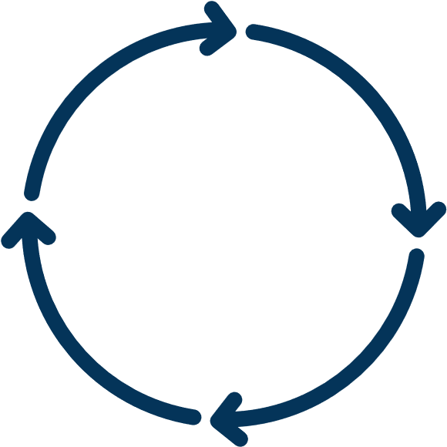
SMEs - 2026 ambitions
2026 Budget (EGP)
LCY Liability
3.5Bln
Assets
1.2Bln
NBI
1.3Bln
Acquisition
+600
Acceleration of New Customers Acquisition on SMEs upper segment and Agri as well as elevating the Active Customers Portfolio:
Key focusing to double our 2025 performance in LCY Liabilities
Align with our non-borrowing customers to grow FX, and TF Commissions
Growing our Assets Portfolio capitalizing on our dedicated team and existing initiatives:
5% CBE and 15% MOF
EBRD and Leasing solutions
Update the existing 2 programs WC & TF with few amendments to be re-launches on Q2 2026
Working on 2 new programs which support the SME direction for financing E-Gov payment and E-Commerce.
Working on a specific program to start target the health sector from other angels which is the Medical Entities Facility Program (Hospital, Medical Labs,..etc.) with bigger tickets Size and different Parameters.
Capitalize on the restructuring of the Agri Team targeting large segment customers under Agri / Agro Business Lines
Maintaining our stable low cost of risk
Maintaining our strategy to further equip our customers with Digital Services:
Such as E-Trade finance, E-Gov payment and E-Commerce
Action Plan

Slide 34

APPENDIX

Slide 35
2025 ACTION PLAN / Main actions for NEW CLIENTS ACQUISITION
Focus on S1 realizations (clinic owners)
Estimated contribution to 2026 target achievement (+ 500 new clients)
%
#Clients
MARKETING LEVERS
Executed SMS marketing blasts to both our current database and prospective leads, highlighting the 7-year term, 5% interest rate, and 5 million EGP cap
Direct Communication
30%
150
Deployed a specialized ad campaign across Facebook and Instagram, precision-targeted at physicians, dentists, and medical specialists
Social Media Outreach
20%
100
Integrated an "Apply Now" digital lead form alongside a comprehensive list of necessary documentation to streamline the user journey
Conversion Tools
10%
50
DISTRIBUTION LEVERS
Performance Incentives
Launched a high-impact sales contest for branch and direct sales staff to drive loan volume through rewards and public recognition
20%
100
Completed intensive training workshops for all Proximity front-line staff (SME, Branch, and Direct Sales) to ensure total mastery of the updated product workflow
Team Readiness
10%
50
Partnered with sales leadership to broadcast regular "Awareness Tips" and detailed internal briefings regarding program specs and documentation
Internal Engagement
10%
50

