Slide 1




BPIs PRO DAYS Carrefour Conquest Pro NEW CLIENTS ACQUISITION 2025 full vision & 2026 perspectives
March 11, 2026
DBI - AAP

Slide 2

Proximity results 2025
Avg UAH Deposits, bnUAH
Avg UAH Deposits, mUAH
NBI by segments
+6%
+20%
+1%
+16%
1 490
14.9
382
1 471
14.1
317
342
403 (27%)
418 (28%)
12.1
3.9
3.8
3.3
3.6
3.8
547 (37%)
508 (34%)
3.4
5.4
6.6
7.4
521 (35%)
563 (38%)
235
Dec-24
Dec-25
Dec-B26
Dec-24
Dec-25
Dec-B26
2024
2025
Professionals
PI
Premium
Proximity Active clients, ths
Premium & Professionals Active clients, ths
+23 (+10%)
2.1
+5 (+2%)
257
1.7
1.2
233
228
229
1.4
1.7
1.6
Dec-22
Dec-23
Dec-24
Dec-25
Dec-B26
Dec-23
Dec-24
Dec-25
Dec-B26
IT Premium
Non-IT Premium
IT PE
Non-IT Professionals

Slide 3
Key figures acquisition / 2025 full year
2024 full year
2025 full year
Net balance
Comments:
In 2025 our Net results decreased by 88% compared to 2024, with only clients 152 growth.
In 2025 attraction of new clients decreased by 7% while the level of reactivation decrease by 9%, so in total acquisition have drop by 8% in 2025.
In 2025 total level of attrition increased by 13% in comparison to 2024.
Customer growth 2025 (oct-dec.) promotions and acquisition companies
Deactivation 2025 (Aug-Sep):, customer inactivity, business closures due to economic conditions, regulatory and AML, fraud prevention
.
Acquisition
Loss

Slide 4
2025 AMBITION ADVISOR’S VISION
Segments | Outstanding 31/12/2024 (number) | Acquisition reminder 2024 | Total Acquisition target 2025 (number) | Active Acquisition target 2025 (number) | Outstanding 31/12/2025 | Active Acquisition 2025
Micro | 5 433 | 58 | 3 409 | 2 838 | 5 494 | 1 846
PE non IT | 7 664 | 841 | 2 257 | 1 801 | 7 820 | 3 177
PE IT | 1 699 | 332 | 4 681 | 3 698 | 1 592 | 473
Total | 14 766 | 1 231 | 10 347 | 8 337 | 14 906 | 5 496
*- we don’t have specific target per each branch and segment, just total target for branch for whole Professionals group.

Slide 5
Key figures acquisition / By region
31.12.2024
31.12.2025
Region | New Clients | Lost Clients | Acquisition rate | Attrition rate | NET Balance | # of Branches | Net per branch
Kyiv | 2102 | 1703 | 14.21% | 11.51% | 399 | 35 | 11
Kharkiv | 660 | 406 | 4.46% | 2.74% | 254 | 11 | 23
Lviv | 328 | 216 | 2.22% | 1.46% | 112 | 7 | 16
Dnipro | 298 | 200 | 2.01% | 1.35% | 98 | 11 | 9
Sumy | 229 | 180 | 1.55% | 1.22% | 49 | 5 | 10
Odesa | 221 | 154 | 1.49% | 1.04% | 67 | 5 | 13
Poltava | 309 | 284 | 2.09% | 1.92% | 25 | 14 | 2
Zakarpattia | 166 | 148 | 1.12% | 1.00% | 18 | 2 | 9
Ivano-Frankivsk | 181 | 145 | 1.22% | 0.98% | 36 | 4 | 9
Vinnytsia | 468 | 419 | 3.16% | 2.83% | 49 | 6 | 8
Volyn | 103 | 85 | 0.70% | 0.57% | 18 | 2 | 9
Kirovohrad | 94 | 74 | 0.64% | 0.50% | 20 | 2 | 10
Cherkasy | 118 | 98 | 0.80% | 0.66% | 20 | 3 | 7
Zaporizhzhya | 196 | 183 | 1.25% | 1.16% | 13 | 8 | 2
Chernivtsi | 54 | 37 | 0.36% | 0.25% | 17 | 1 | 17
Khmelnytskyi | 83 | 73 | 0.56% | 0.49% | 10 | 1 | 10
Mykolaiv | 93 | 84 | 0.63% | 0.57% | 9 | 3 | 3
Ternopil | 29 | 21 | 0.20% | 0.14% | 8 | 1 | 8
Chernihiv | 39 | 33 | 0.26% | 0.22% | 6 | 1 | 6
Kherson | 18 | 17 | 0.12% | 0.11% | 1 | 6 | 0
Zhytomyr | 148 | 151 | 1.00% | 1.02% | -3 | 4 | 1
Rivne | 28 | 31 | 0.19% | 0.21% | -3 | 1 | 3
Total | 5968 | 4747 | 40.34% | 32.08% | 1221 | 136 | 9
Region | New Clients | Lost Clients | Acquisition rate | Attrition rate | NET Balance
Kyiv | 1833 | 1769 | 12.30% | 11.87% | 64
Kharkiv | 481 | 576 | 3.23% | 3.86% | -95
Dnipro | 536 | 485 | 3.60% | 3.25% | 51
Poltava | 319 | 349 | 2.14% | 2.34% | -30
Vinnytsia | 275 | 272 | 1.84% | 1.82% | 3
Lviv | 245 | 250 | 1.64% | 1.68% | -5
Zaporizhzhya | 212 | 240 | 1.42% | 1.61% | -28
Cherkasy | 235 | 175 | 1.58% | 1.17% | 60
Ivano-Frankivsk | 228 | 172 | 1.53% | 1.15% | 56
Zakarpattia | 132 | 158 | 0.89% | 1.06% | -26
Sumy | 200 | 155 | 1.34% | 1.04% | 45
Odesa | 106 | 118 | 0.71% | 0.79% | -12
Zhytomyr | 114 | 111 | 0.76% | 0.74% | 3
Kirovohrad | 131 | 105 | 0.88% | 0.70% | 26
Mykolaiv | 137 | 89 | 0.92% | 0.60% | 48
Khmelnytsyi | 75 | 67 | 0.50% | 0.45% | 8
Chernivtsi | 63 | 65 | 0.42% | 0.44% | -2
Volyn | 71 | 65 | 0.48% | 0.44% | 6
Chernihiv | 36 | 53 | 0.24% | 0.36% | -17
Rivne | 31 | 33 | 0.21% | 0.22% | -2
Kherson | 8 | 19 | 0.05% | 0.13% | -11
Ternopil | 28 | 18 | 0.19% | 0.12% | 10
Total | 5 496 | 5 344 | 36.9% | 35.9% | 152

Slide 6
New Customer acquisition by channels 2025
Channels | Acquisition cumulative | Share of acquiaition
IT Hubs | 321 | 6%
Pure Digital | 531 | 10%
Digital+Contact Centre | 1 092 | 20%
Branches | 3 552 | 64%
Total | 5 496 | 100%

Slide 7
Total 2025 NBI, by clients segments (kEUR)
PE
Micro
PE IT

Slide 8
Performances comparisons kEUR
 | 2024 | 2025
NBI (kEUR) | 8 366 | 8 740
New clients | 5 978 | 5 496
Attrition | 4 747 | 5 344
NET ACQUISITION | 1 231 | 152
+4%
-8%
+13%
-88%
PE & PE IT
Micro
 | 2024 | 2025
NBI – NII | 1 725 | 1 779
NBI – Commissions | 695 | 763
NBI – Other NBI | 38 | 31
 | 2024 | 2025
NBI – NII | 4 449 | 4 560
NBI – Commissions | 1 322 | 1 466
NBI – Other NBI | 137 | 142
Professionals total loans | 3 177 | 3 722
Professionals average loan | 14 711 | 13 687
Outstanding | 1 590 | 1 960
+3%
+3%
+9%
+11%
-17%
+3%
+17%
-7%
+27%

Slide 9
3 ) Focus on Liberal Professions and other projects

Slide 10
HEALTHCARE | CA clients (LE + PE)
The most popular activity:
LE: general medical practice (27 clients)
PE: dental practice (41 clients)
Biggest Average NBI (monthly) are:
LE: 100 EUR in Hospital activities
PE: 27 EUR in Specialized medical practice
PI: 19 EUR in Hospital activities
Ukraine
CAU
Market Share
94 337
179
0.2%
Target 2026:
Launch pilot

Slide 11






HEALTHCARE | PILOT OVERVIEW
pilot period
TARGET AUDIENCE
04.2026 – 09.2026 (6 months)
LE: Medical Clinics with income up to 2 mEUR
PE: dentists and other doctors
pilot régions (10 Branches)
COMMUNICATION channels
Kyiv
Lviv
Web-site, social media
Phone calls and meetings by RM
press publications
CRM SUPPORT
SALES channels
New Professional clients who open an account during the promotion
Branches (RM)
Social media (incl. linkedin)
partnerships, events with associations (dentists, surgeons), partnerships with group clients,
Goals
BUDGET
Attraction of new LE & PE clients: new 200 clients in 2026
10k EUR
Customer acquisition cost
200 EUR (LE)

Slide 12

HEALTHCARE | complex pilot offer
Target segment
Pilot incentives
Medical Clinics
Annual income up to €2M
EcoFlow DELTA Pro × 3
Network incentives
60 EUR per new LE client
Dentists & other doctors
LE complex offer
PE+PI complex offer
Service & daily banking
3-month free service package (Salut)
Payroll projects - 0% fee
Acquiring – reduced fee for 3 months
FX - 0,1%
Financing
Working capital loans – 19% IR, 0% fee
Investment loans – 0% fee
Service & daily banking
3-month free service package (Début)
Acquiring – reduced fee for 3 months
FX - 0,1%
Additional
Premium packages for PI (La Force/Sommelier):
Free IBAN UAH payments (till 5kUAH per payment)
Buying currency online
Free withdrawal in Credit Agricole ATM’s in Ukraine
Free withdrawal abroad Ukraine
Special credit cards offers, cash loans
Discount through the “MC Bilshe program” on medic shoe stores
Car loans and partners offers
Additional
Overdrafts
Secured loans (incl. state program 5-7-9, solar energy and other)
Car loans, leasing and partners offers
Equipment leasing
Corporate cards
Individual rates for term deposits (mostly for state LE)

Slide 13

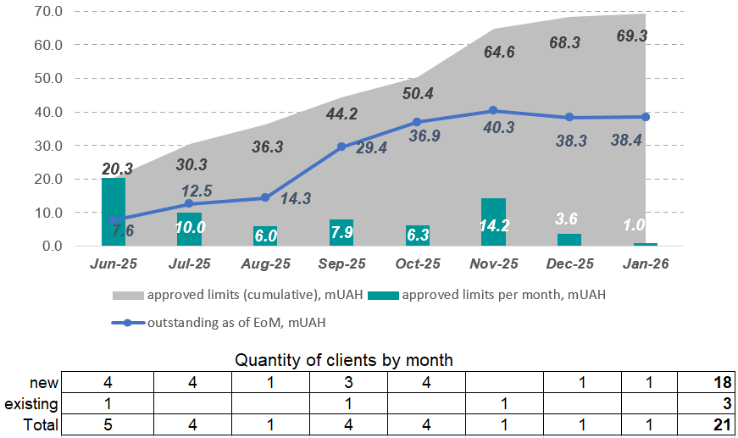



Small farmers financing project
SMALL FARMERS (100-500 ha). PILOT PROJECT
Project period June 2025 - January 2026
Pilot regions - Poltava (14 branches) and Kirovograd regions (2 branches)
Business lines – SME and Proximity
Identical credit process for both business lines
Simplified loan application - bridge model, based on 3 key cut-off criteria (FDE ≤100%, ER ≥30%, DSCR ≥1,2) + max. WC limit for all FD – up to 60% of forecasted production costs
Targeted TTY – 2 days
Results of the project for small farmers, Jun.25-Jan.26
Key figures of the project
 | Plan | Fact
Сlients’ base for processing | 1 104 | 1 060
New clients | 70 | 48
Loan portfolio, mUAH (WC + Invest) | 100 | 69.3
TTY | 2 | 6

Slide 14

Small farmers financing project
NEXT STEPS:
Define clear criteria for distributing the client base between the two business lines (responsibility of Proximity and SME)
Train Proximity stuff (seminars and trainings on Agri issues and analysis, financing process, Bank’s products, partnership programs, etc.)
Review cut-off criteria for blank limit
Simplification of the loan disbursement process
Step by step expand the project throughout Ukraine (active sowing season). As a 1st stage – expand on West and Central part of Ukraine (Kyiv region (12 outlets in regions), Zhytomyr (4 outlets), Cherkasy (3 outlets), Vinnytsya (6 outlets), Khmelnytskyi (1 outlet), Ternopil (1 outlet)
Individual delegations for Heads of SME&Proximity + Agroexpert in regions (after 6 months with Risks).
Automatization of credit application and approval process

Slide 15




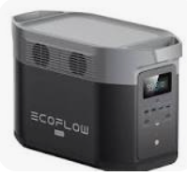
Happy days
Targets:
Increase number of new clients
Increase customer coverage with banking products
Increase loyalty of current customers
Increase of NBI
Promo period:
23.02.2026 – 20.03.2026 (4 weeks)
Promo mechanics:
1) Visit to branch during the promo
2) Buy one of the listed promo-products
3) Participate in the drawing of 2 charge station EcoFlow (1 station for all buyers for separately each promo-products)
Focus products
Promotional offers
Main gifts
Unsecured loans for Professional segment
One-time issuance commission 0,5% / 0% (instead 0,9%)
Packages Professionals for new clients PE
7% charge on account balance for new clients for 6 months

Slide 16
5 ) 2026 ambitions and acquisition plan

Slide 17
PROFESSIONALS MARKET CONTEXT
MAIN POINT:
In ukraine’s competitive banking environment (segment professionals) the winners are banks that offer a simple, digital and reliable banking experience with transparent pricing and fast access to financing – without bureaucracy or wasted time.
TRENDS:
KEY EXPECTATIONS FROM BANKS:
Rapid digitalization of banking services and full shift to online banking processes.
Growing demand for remote account opening and online servicing.
Strong competition between banks on pricing and bundled offers.
Growing need for accessible business lending, especially via government-backed programs and financing energy independence, efficiency, and recovery projects.
Stricter financial monitoring, KYC and automated risk controls.
Widespread adoption of AI for scoring, personalization, and process automation.
Expansion of open banking, APIs
Convenient and reliable digital banking.
Transparent and competitive pricing.
Fast and simple access to financing with minimal bureaucracy.
High bank reliability, strong reputation, and stability.
Quick, high-quality support incl. AI-assisted chat
Personalized offers based on client data.
Seamless integration with governments services (Diia, tax tools)
Dedicated products and programs supporting energy independence and recovery

Slide 18
Professionals segment: Pro CUSTOMERs
Micro
PE
6,5k
+3 000
6k
ACTIVE PRO
12,5k
10k
19k
2025
B26
16k

Slide 19
Professionals: TARGETS & OBJECTIVES
7k
GROSS NEW ACTIVE
19 000 (+ 3 000 net)
7 000
3k
REACTIVATION
ACTIVE CLIENTS
GROSS NEW CLIENTS
7k
ATTRITION
3k
NET ACTIVE CUSTOMERS

Slide 20
ACTION PLAN 2026 - Main actions for NEW CLIENTS ACQUISITION
ONLINE Onboarding LE
Credit process for LE
loans PE UNFREEZE
Development new automation process
in front (web) / back (iOpday, BPM)
PURPOSE: New clients acquisition
Automatization of loan process: development new process, Procedure approval
PURPOSE: increase credit portfolio
Approval with risk-management
Automatization of loan process: development new process, changes to Standard and procedure
PURPOSE: increase credit portfolio
1000
50
100
small agro
Acquiring
HEALTHCARE
Small agro pilot results and full regions rollout: NAP, Standard changes, new procedure
PURPOSE: New clients acquisition, increase credit portfolio
New acquiring partner
Development new process and procedure
PURPOSE: New clients acquisition, Clients retention
Development Healthcare strategy for attracting new clients
PURPOSE: New clients acquisition
100
150
200
referral program
overdraft for le
Attracting customers through a referral program
PURPOSE: New clients acquisition
Development changes to procedure and Standard
PURPOSE: New clients acquisition
300
50

Slide 21
6 ) 2026 innovations within the BPIs

Slide 22
User activity in ca+pro
Nb active users
Nb active users
+35%
2909
2158
Dec ‘25
Dec ‘24
Nb transactions
Nb transactions
+73%
21 901
12 670
Dec ‘25
Dec ‘24

Slide 23
Delivery in CA+PRO 2025
Q1
Q2
Q3
Q4
Jan | Feb | Mar | Apr | May | Jun | Jul | Aug | Sep | Oct | Nov | Dec
AutoFX
Interface Logic Update
BA A2C
Domestic instant payments
Import of payment PE
PE account access history (Admin console)
BA FX
ВА A2FR
Feedback forms
Instant payment
ВА Tax
Requisites sharing by QR
QR sharing update
Import currency sale payments (TP)

Slide 24
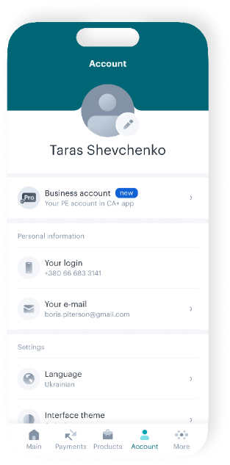
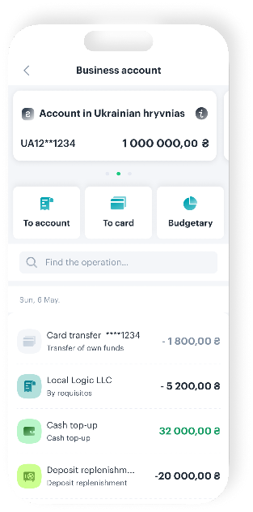
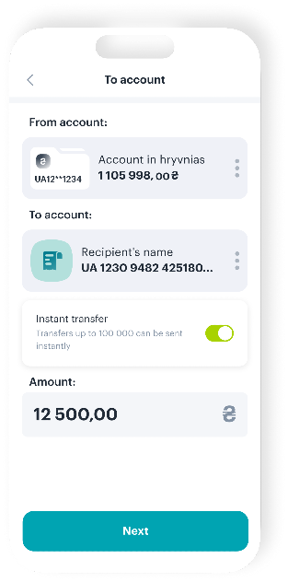
Business Account - СА+Pro inside CA+
May ‘24
Sep ‘25
Dec ‘25
View transaction history and details
View and edit PEs account names
Share PEs account details
Generate and email account statements
Creating and saving a account-to-card payments
FX transactions (selling currency)
Signing payments using Diia.Signature or File QES
Creating and saving a SEP payments and instant payments
Creating and saving a tax payments and instant payments
A2C in mobile
+18%
12%
30%
Sep ‘25
Dec ‘25
FX in mobile
+22%
11%
33%
Sep ‘25
Dec ‘25

Slide 25
FOCUS ON CA+ PRO 2026
Q1
Q2
Q3
Q4
Jan | Feb | Mar | Apr | May | Jun | Jul | Aug | Sep | Oct | Nov | Dec
Cloud QES
Limit for PE
Simplified registration
ReKYC PE
Account additional opening
Bank ID PE
Deposits
FX 24/7
Tracking SEP
Open Banking
Electronic document management
Simplified registration
Payment Templates
Sign payments without funds
Multishering DIIA
SEPA
Accessibility
Integration of QES with external services
Automated data exchange via API
2026 priorities
Customer growth
Payments & liquidity
Digital identify & compliance
Integration & automation

Slide 26
Credit process for le
2 weeks
AS IS
7 days
MVP delivered
2 days
Full scope
Initiation
Filling in the loan application form
Enrichment
Obtaining data from EDR, Vkursi, iOpday, financial reporting for automatic filling of some forms
Verification of loan application by respective user roles
Verification
Application
Approval
Documents Signing
Implement
Agreement
Review of loan application and saving documents in E-archive
Approval of loan application by respective user roles
Documents signing by the client
Actions in iOpday for creation of the loan agreement & tranches
Tracking tools included

Slide 27
PROJECT PHASE SCHEDULE STATUS
Work package Name | 2025
 | Feb | Mar | Apr | May | Jun | Jul | Aug | Sep | Oct | Nov | Dec | Jan | Status
Requirements analysis |  |  |  |  |  |  |  |  |  |  |  |  | In progress
Analysis & Development BPM, role model |  |  |  |  |  |  |  |  |  |  |  |  | In progress
Analysis & Development ESB |  |  |  |  |  |  |  |  |  |  |  |  | In progress
Analysis & Development e-Archive |  |  |  |  |  |  |  |  |  |  |  |  | API integration has been done. CR is planed for adding new process docs
Analysis & Development BI |  |  |  |  |  |  |  |  |  |  |  |  | In progress, delay due to forced changes to loan applications forms
Functional Testing |  |  |  |  |  |  |  |  |  |  |  |  | In progress
UAT |  |  |  |  |  |  |  |  |  |  |  |  | In progress
Analysis & Development iOpday |  |  |  |  |  |  |  |  |  |  |  |  | Planned
Go Live (pilot) |  |  |  |  |  |  |  |  |  |  |  |  | Delay, propose moving the MVP start date, limited only U-loan for MVP
Preparing manual and transfer to support |  |  |  |  |  |  |  |  |  |  |  |  | Planned
Analysis on Scoring model |  |  |  |  |  |  |  |  |  |  |  |  | In progress (preparing requirements)

Slide 28
KYC PROJECT

Slide 29
10 minutes onboarding process
onboarding
New
OLD
Full online 24%
Branches
58%
Branches
18%
3 min
2 min
2 min
2 min
1 min
1 PROVIDING DATA
2 KYC
3 ACCOUNTS
4 DOCUMENTS
5 ACTIVATION
On this stage customer gives to the Bank tax number and phone number for verification. Bank fulfill customer’s quest from Diya, prefill all necessary questions both PE & PI
Automatic Checking of customer and creating customer in iopday
Bank opens prebooked accounts after approving KYC from customer
Customer signs all documents remotely with EDS in web-cabinet
Bank activates customer and accounts after receiving all signed documents

Slide 30
Start of the project: rekyc PE
35 min
30 min
3 min
15 min
5 min
2 min
2 min
1 min
1. Providing data
2. reKYC
3. Documents
4 Activation
Customer gives to the Bank tax number, phone number for verification. Bank fulfill customer’s quest from Diya, prefill all necessary questions
Automatic checking of customer and updating customer in iopday
Customer signs questionnaire remotely with EDS in web-cabinet
Bank activates changes after receiving questionnaire
ReKYC PE | 2026
 | Q3 2025 | Mar | Q4 ’25-Q1 ‘26 | Apr | May | Jun | Jul | Aug | Sep | Oct | Nov | Dec
BRD
Analysis
Development

