Slide 1


AGRI/PRO DAYS
CREDIT AGRICOLE BANK POLSKA S.A.

Slide 2
Insurances /discussion
(30 min)

Slide 3







Insurances: crop, equipment, and farm insurances as the main sources of revenues. Under discussion renumeration for insurance sales to Advisors.
2025 results
B2026
Product | Premium gross 2025 | Income CABP 2025 | Commission for CABP% | Policy (New) | Policy (Existing) | Premium gross 2026 | Income CABP 2026 | Policy (New) | Policy (Existing)
Thinking About Renewable Energy Sources (AGRI/SME) | 10 462 | 3 005 | 29% | 12 | 12 | 17 405 | 5 048 | 30 | 31
Credit Life Insurance (AGRI/SME) | 31 410 | 31 712 | 45% | 14 | 76 | 43 442 | 8 669 | 128 | 182
AGRI Business (AGRI) | 527 462 | 114 216 | 25% | 307 | 335 | 503 621 | 130 941 | 310 | 343
Crop Insurance (AGRI) | 6 456 853 | 626 609 | 13% | 1 087 | 491 | 7 931 626 | 1 324 723 | 1 404 | 599
Livestock Insurance (AGRI) | 3 727 | 169 | 30% | 1 | - | - | - | - | -
AGRI Expert / Farming Equipment in the Generali Package (AGRI) | 2 263 194 | 645 648 | 31% | 2 025 | 2 394 | 2 449 316 | 678 244 | 3 174 | 3 097
Total | 9 293 108 | 1 421 359 |  | 3 446 | 3 308 | 10 945 410 | 2 147 625 | 5 046 | 4 252
+17%
+51%
+46%
+28%
AGRI 2025 - REVENUES TOTAL – 1.4 M
AGRI 2026 - REVENUES TOTAL – 2.1 M

Slide 4
Insurances: current agri insurance model and process in CABP
Tools – RUBINET.
Agri Advisors are using external system, developed by Generali (RUBINET). RUBINET is a workflow system including offering (customers needs verification, simulation) & sales processes. Each Agri Advisor has his own portfolio of customers. CABP as a agent is doing only sales. Advisor is generating link and send to customers via e-mail or paper version and next customer is paying insurances to Generali directly.
All after sales processes are maintain and manage by Generali workers, including losses, recovery. Generali deploys its own employees during claims settlement. Advisors are not involved in the process.
Bank doesn’t incur any costs linked with claims.
Cooperation between CABP Agri advisors and Generali Team.
GENERALI has a sales structure that roughly mirrors of CABP Sales Network.
Regional Generali coordinators are available to the bank's advisors by phone & e-mail and provide support for individual policies & sales. They prepare client policy renewal lists. Regular team meetings, training sessions, and so on, are held. CABP invites Generali to its sales meetings to educate farmers locally and build joint sales.
Certification.
Due to regulatory requirements (KNF), each Agri Advisor must pass a certification exam for a person performing agency activities (OFWCA). The OFWCA certification is perpetual. AGRO advisors must complete annual professional training to maintain certification. Learning platform belongs to Generali.

Slide 5
Machines & equipment financing
with multi-brand dealers
(15 min)

Slide 6
Executive summary (1/2)
CA Group is cooperating with John Deere in Poland by EFL and the Bank cannot cooperate with tractor vendors due to the exclusivity list, but CABP can cooperate with multi-brand dealers other than JD dealers.
Our goal is to gain a new customers also on machinery market with using gov. support in the form of subsidies from preferential loans (ARiMR – State Agency) and BGK guarantees - available only for banking sector.
Financing of machinery and equipment is carried out by leasing companies as part of vendor programs. The market is divided between tractor manufacturers and leasing companies:
BNP Leasing: Same Deutz Fahr Group, CNH (New Holland), Class
Santander: Kubota, Farmtrac
DLL: AGCO Group: (Fendt, Massey Fergusson, Valtra)
EFL: John Deere
In 2024 leasing companies financed the purchase of agricultural machinery and equipment worth 6.5 bPLN, including ~ 5 bPLN in lease loan (farmers) and 1.5 bPLN in leasing (companies). In 2024, banking sector financed agribusiness customers in the amount of 2.5 bPLN in investment loan including (real estate, machines & equipment, usable land).
The efficiency of leasing companies results from a quick process and simplified procedures (w/o KNF).

Slide 7
Executive summary (2/2)
We are opening new opportunities on the market in „non-vendor” model and establish direct cooperation with local multi-brand dealers. CABP is entering into the market by selected PRONAR dealers network with banking offer supported by gov. subsidies – „foot in the door”.
PRONAR belongs to a segment of companies that are not manufacturers of tractors, but mainly agriculture trailers, machines for harvesting green fodder. PRONAR is also Corpo Division customer. We treat PRONAR as a „door opener”.
Thanks partnerships with gov. & financial institutions ARiMR and BGK, CABP can distribute products that leasing companies don't offer, including preferential loans and guarantees. The attractiveness of the offer may be noticed by dealers and manufacturers of machinery & equipment.
To enter into the market of machines & equipment and compete with lease companies, we implemented:
simplified process of granting loans,
effective multi-brand dealers penetration (thanks partnerships like PRONAR and Sales Network business plan)
promotional offer in the form of investment loan with gov. subsidies (BGK, ARiMR) - missing among leasing companies, including costs of acquisition – commission for dealers.

Slide 8


Product perspective: ARiMR & BGK support for machines & equipment financing
AgroMax guarantee (limit 20 mPLN)
a) Young Farmers (up-to 40 years)
subsidies: 100% for interest for 2 years
interest rate: 0% for 2 years
up-front fee: 2%
b) Other Farmers & machines contributing to environmental and climate protection
subsidies: 50% for interest for 2 years
interest rate: 3.11% for 2 years
up-front fee: 2%
Preferential loan: RR line
Subsidies level:
The interest rate is payable by:
a) the farmer in the amount of 0.67% of the total loan interest rate
not less than 3%
if the interest rate is below 3%, in the amount of this interest rate,
b) the Agency in the remaining part
Min. down-payment: 20%
Max duration: 15Y
machines contributing to environmental and climate protection
Forage harvesting trailers with drum mowers (forage cutters), universal and specialized trailers (i.e., bale platforms (platform trailers) for transporting bales of hay and forage, volume trailers for transporting forage from permanent grassland).
Forage harvesting machines: rotary tedders, rakes (rotor, comb, pick-up belt), tedder-rakers (rotor, belt, wheel), which, depending on the setting, can tedder or rake the forage.
Agricultural tractors powered by electricity, hybrids, biofuels, or those meeting the emission standards specified in Regulation (EU) 2016/1628 of the European Parliament and of the Council of 14 September 2016. Vehicles equipped with wide tracks or tires with low ground pressure (<70 kPa).

Slide 9

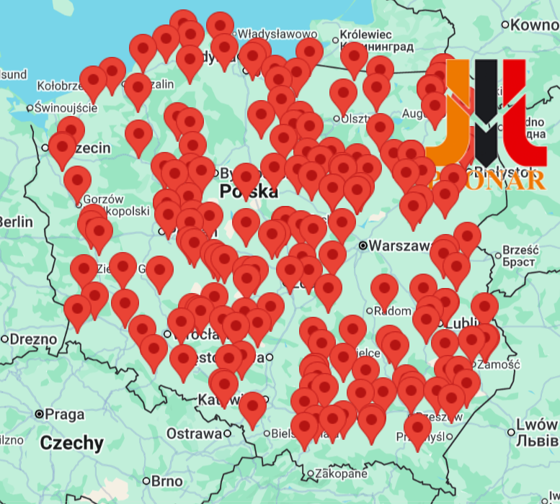
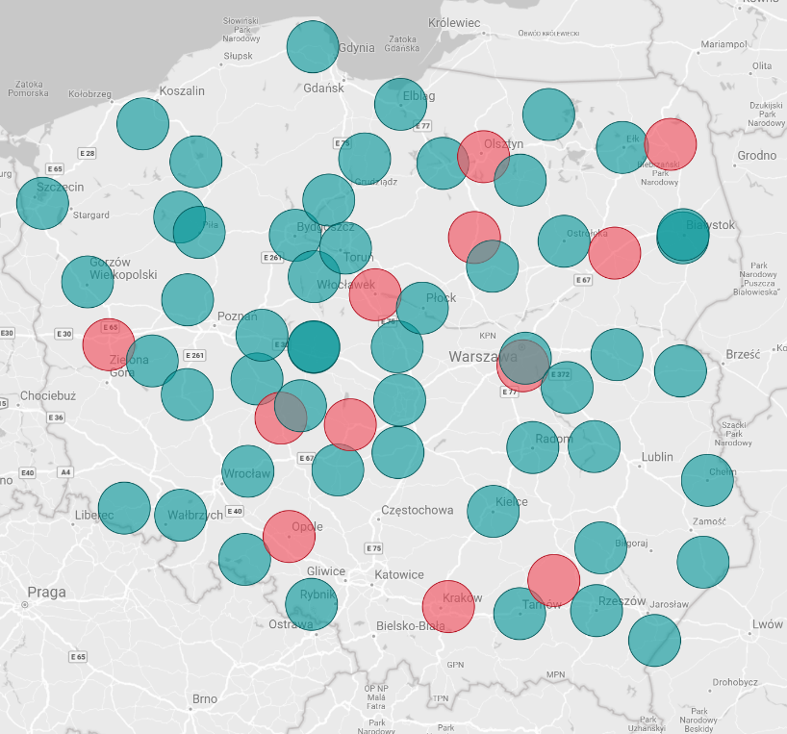
PRONAR – „door opener”
PRONAR dealers network
Information (polish company founded 1988):
CABP Corpo customer
Cooperation with Santander: (~25-30 mPLN yearly sales, estimation)
9 factories, 2.500 employees,
2024: revenues of 0.7 bPLN
manufacturer of rims for trucks and steel products,
processes 120k tons of steel per year,
the largest manufacturer of agricultural trailers in Poland (25% of the market share)
Yearly sales (approx.):
trailers: 110 mPLN (1 400 units), avg = 80 kPLN,
greenery machines: 20 mPLN,
municipal machines (JST - local government units).
Dealers network:
7 own points (Podlasie – 4 points),
108 of multi-brans-dealers sales points
CABP network , Red – 12 new Agri Advisors
CABP focus
young farmers & green assets

Slide 10



Multi-brand dealers characteristics – examples
HQ | Łęczyca | Poznań | Legnica
Yearly turnover | 12 mPLN | 130 mPLN | 650 mPLN
# of emplyees | 8 | 20 | 200
Scope of sales | sales of machinery, parts & service | sales of machinery, parts & service, fertilizers & crop protectiom | sales of machinery, fertilizers & crop protection, transport, service & parts, grain purchase
Leading tractor brands | FARMTRAC, LANDINI | Same Deutz Fahr, Lamborghini | Case IH, Steyr
Brands | SHAFFER, SHMIDT, AGROMASZ, AKPLI, SIPMA, MROL, PRONAR | KVERNELAND, VEDERSTAD, PRONAR, HARDI, STOLL, WEIDEMAN, AGRISEM, PICHON, SaMASZ, SIPMA, UNIA, KONGSKILDE | PRONAR, LEMKEN, HARDI, POTTINGER, VADERSTAD, KONGSKILDE, ZASŁAW, AKPIL, MANDAM, METALTECH
Cooperating leasing companies | BNP, Santander, PKO Leasing | Santander, BNP, PKO Leasing | Santander, BNP, PKO Leasing
Notes:
To

Slide 11
Business plan for multi-brand dealers acquisition
Signing 60 contracts with Dealers (6 dedicated Coordinators in Sales Network with plan to sign 10 contracts for each region). Each dealer will be approved by Business Units and Risk Team before entering to cooperation with CABP. Animation by coordinators and support teams.
Sales targets for trial period:
Investment Loan sales : 40 mPLN, including 30 mPLN in promotional offer
# of new customers: 246
Dealers acquisition plan (by yearly sales):
6 big dealers (above >100 mPLN)
24 average dealers (50-100 mPLN)
33 small dealers (< 50 mPLN)
Year | Type of assets | Sales [mPLN] , { # of customers }
Year | Multi-Brand dealers | BGK – AgroMax | ARiMR | w/o gov. support
2025 | PRONAR assets | 2 {25} | - | -
 | Other assets | 3 {10} | 1 {3} | -
2026 | PRONAR assets | 6 {75} | 1 {12} | 5 {50}
 | Other assets | 15 {50} | 2 {6} | 5 {15}
Total |  | 26 {160} | 4 {21} | 10 {65}
Promotional offer 30 mPLN

Slide 12
Customer journey (1/2)
For customers purchasing asset from LRD-listed dealers:
Documents:
basic list of farmer's documents: payment order and direct payments
for transactions with BGK or ARiMR, depending on the formal and legal situation of the farmer, the list includes additional documents for ARiMR and BGK, which are collected by the Advisor during the farm visit
Collateral:
for new assets , w/o collateral assessment, amount of invoice as initial value of collateral
for used machines, each time machines will be verified by Collateral Bureau.
Process & decision:
simplified process with decision at farm with automatic decision at Advisor level (forecasted 40% positive decision ratio at this level) at Agrodik within 1h
the maximum credit exposure for which the Advisor may issue a decision during a single visit is 0.5 mPLN (1 mPLN under consideration by Risk)

Slide 13



Customer journey (2/2)
Information about the offer & pricing
DEALER
Submission of required documents
Signing a loan agreement
FARMER
SIMPLIFIED PROCESS
60 min
LRD
Automatic decision (40%)
Verification of the complete set of documents including ARiMR & ARIMR
Contact with customer and arranging a meeting
Submitting the application for full credit analysis in Risk
Credit analysis
Positive decision
STANDARD PROCESS

Slide 14
The process of approving dealers to cooperate with the Bank
Selected dealers will be approved on a "dealers approval committee" by Adam Krawczyk and Arkadiusz Krygier.
After Business approval, the dealer will also be referred to the Risk Department for approval (similar to the current practice for local intermediaries).
Each file will be assessed based on its sales potential, represented manufacturers of machinery and equipment.
Dealers will be selected to optimally match their operating areas to AGRI Advisor locations.
Sales Coordinators will be responsible for dealers acquisition and dealers agreement signing.
Each dealer will be assessed as part of annual monitoring, based on risk and sales.
AGRI line manages LRD (List of Reliable Dealers).
Dealers approval process under preparation between Risk & Business.

Slide 15

Promotional offer for investment loan, 0% up-front fee

Slide 16
Partnerships program acquistion
(15 min)

Slide 17
Evolution of portfolio structure / products: synergy of Sales Network, Commercial and Gov. Partners (ARiMR, BGK).
69% of sales thanks to gov. partners ARiMR & BGK and +93% (Y/Y).
Commercial Partners in 2025 with growth + 42% (Y/Y), 40% of total sales.
584
510
399
229
TOTAL SALES
Y/Y +14%
GOV. PARTNERS
Y/Y +93%
ARiMR (7%)
161
+42%
BGK:
AGROMAX (10%)
BGK
FGR 5-7% (52%)
ARiMR (40%)
399 mPLN of sales thanks to gov. lines (BGK & ARiMR). FGR guarantees (5%, 7% subsidies for interest rate & 80% of collateral exposure): 302 mPLN of sales (agri loan, overdraft, revolving loan). Agromax as a support for Investment Loan.
Systematically growing sales with Commercial Partners: 229 mPLN in 2025 (including: Revolving loan 205 mPLN , Investment Loan 24 mPLN )

Slide 18























Commercial Partnerships by sectors and brands. Sales in 2025: 229 mPLN, 40% of total sales, +18 new Partners in 2025.
57 %
21 %
15 %
7 %
PIGS
FERTILIZERS
BEEF
POTATOES
BIOGAS
POULTRY
13 Partners
Rev: 117 mPLN
IL: 16 mPLN
28 Partners
Rev: 42 mPLN
12 Partners
Rev: 31 mPLN
IL: 2,2 mPLN
1 Partner
IL: 1,2 mPLN
1 Partner
Rev: 15 mPLN
3 Partners
IL: 4,6 mPLN
Agri Partner / Corpo client: Smithfield/Agriplus, Osadkowski, FarmFrites, Drosed, Timac, Souflet

Slide 19
Commercial Partners with visible diversification of production 2025 vs 2024
 | # of leads | % | # of credits | % | credit sales [mPLN] | %
REVOLVING SALES IN 2025 | 1369 | 100% | 658 | 100% | 205 | 100
Fertilizers & crops | 687 | 50% | 292 | 44% | 42 | 21
Beef | 411 | 30% | 164 | 25% | 31 | 15
Pigs | 231 | 17% | 169 | 26% | 117 | 57
Potato | 40 | 3% | 33 | 5% | 15 | 7
INVESTMENT LOAN | 20 | - | 20 | - | 24 | -
PLANTS
20% > 28%
ANIMALS
80% > 72%
The biggest # of leads from the beginning of agri in CABP.
Significant source of new customers thanks revolving loan and unique model on the market, with no competition in terms of financing agricultural production costs (invoices from partners).
Investment loans for big tickets, for specialized facilities, require coordination between the partner, the investment contractor, and the client, as well as close cooperation on credit risk. Often, these solutions are tailored made to the needs of the partner and their technology, as well as commitment in the form of subsidies for the client.
19

Slide 20
Commercial Partnerships: maintaining and dev. a strong source of leads and new customers, supported by automated decisions in AgriFlow and new sectors.
+13%
1650
Leads from Commercial Partners
1460
Leads from Commercil Partners
+12%/+23%
1000 / 800
Contracts / Clients
890 / 648
Contracts / Clients
2025
2026
336
New customers
+11%
365
New customers
+23%
205 mPLN of sales revolving
253 mPLN of sales revolving
+23%
25 mPLN of sales investment loan
40 mPLN of sales investment loan
+ 72,5 mPLN in 2025
up-sell on customers from Partners
(investment loan, overdraft, business loan, preferential loans)
+23%
+ 80 mPLN in 2026
up-sell on customers from Partners
(investment loan, overdraft, business loan, preferential loans)
total impact on agri-sales:
ab. 305 mPLN
ab. 370 mPLN

Slide 21
Commercial Partnerships: growth in the numbers of commercial partnerships (+18) thanks new strategy sectors adjustment
1003
Leads from Commercil Partners
+46%
1460
Leads from Commercial Partners
2025
+33% / +47%
890 / 648
Contracts / Clients
669 / 440
Contracts / Clients
250
New customers
+34%
336
New customers
2024
+38%
148.2 mPLN of sales
204,5 mPLN of sales
+80%
18 New Partnerships
10 New Partnerships
+38%
+ 72,5 mPLN
up-sell on customers from Partners
(investment loan, overdraft, business loan, preferential loans)
+ 52,3 mPLN in 2024
up-sell on customers from Partners
(investment loan, overdraft, business loan, preferential loans)

Slide 22
Back-up

