Slide 1

Current KYC PROCESS FOR Non-individual customers
An overview of time-consuming manual KYC updates for non-individual customers
The current KYC process for non-individual customers involves extensive manual data entry and multiple validation steps. Customer Account Executives and operations teams must fill over 200 fields per update, leading to significant delays, data inconsistency, and an increased risk of errors, ultimately hindering operational efficiency.

Slide 2


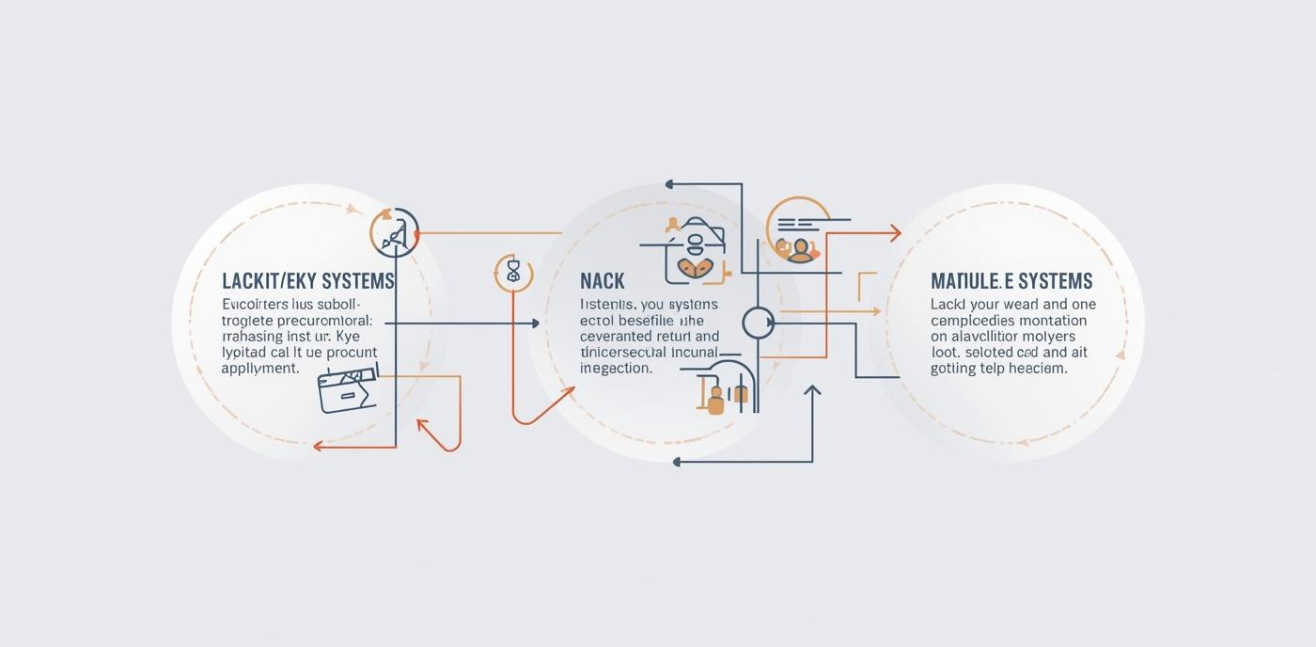




Current KYC PROCESS FOR Non-individual customers
Manual Data Entry (by Front-Liners)
Lack of Automation
Multiple Manual Validation
Repetitive input of existing data
Involves various teams and steps
Over 200 fields input per update
Manual Reporting
High Workload
Long Turnaround Times
Delays due to human error risk
Increased pressure on Front-Liners & Backoffice teams
Slow responses for customer updates

Slide 3

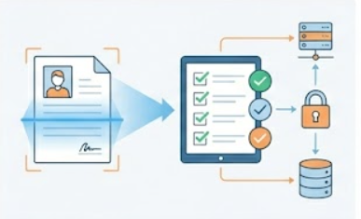

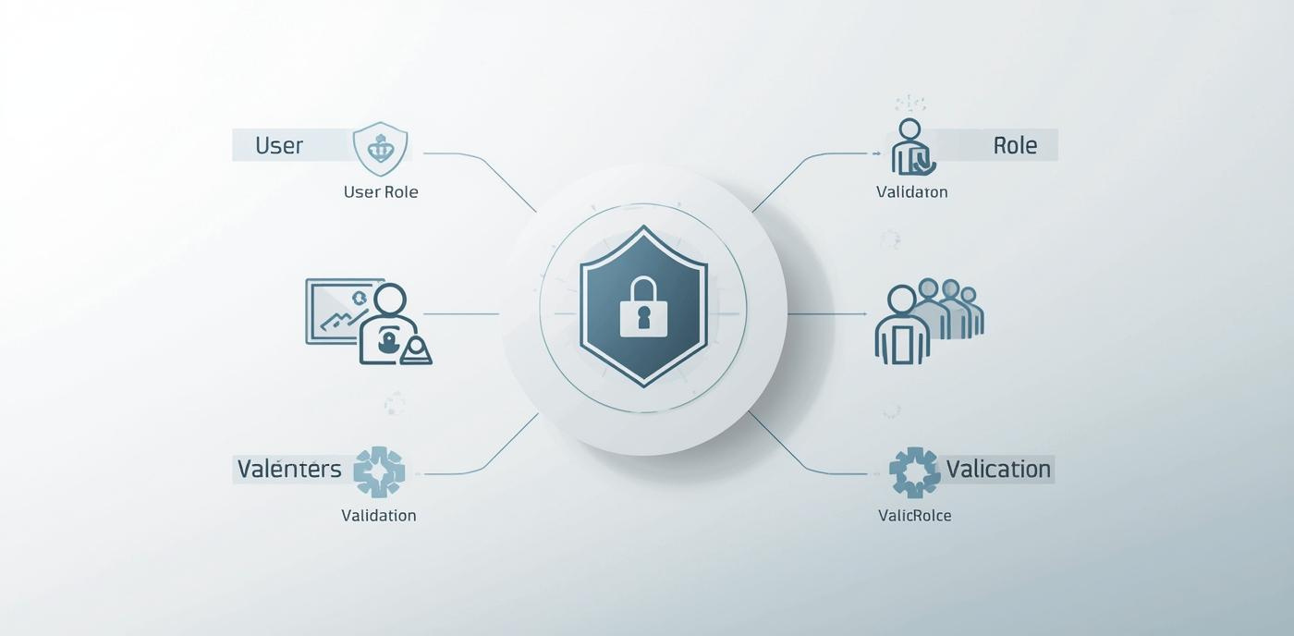
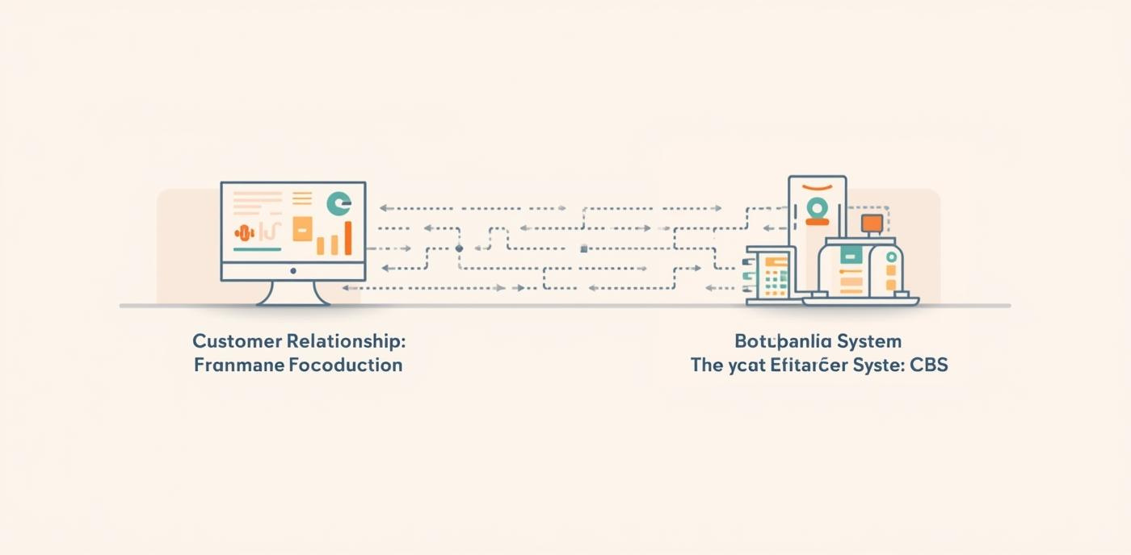
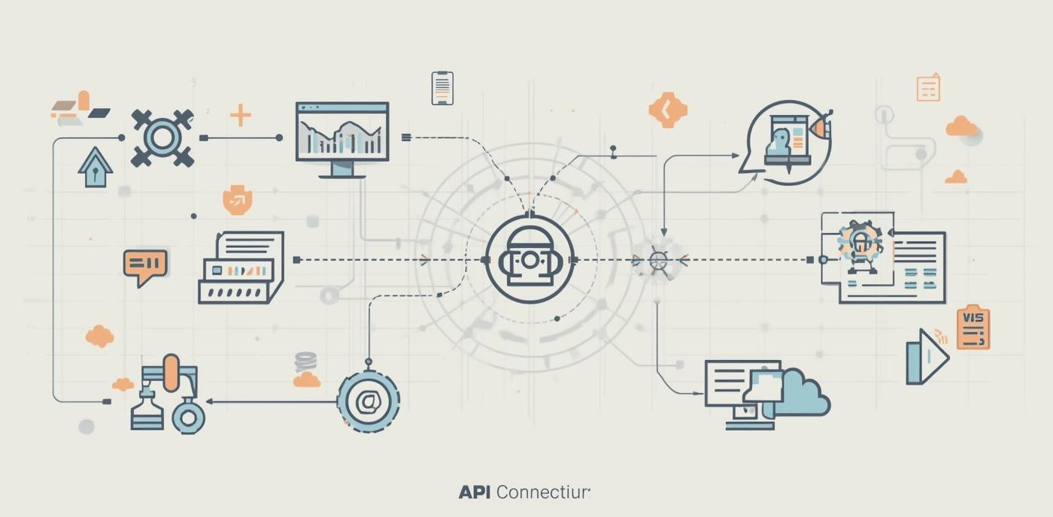
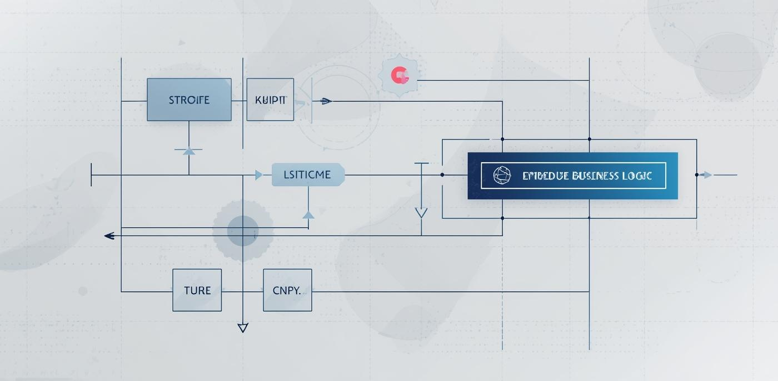
KYC Update for non-Individuals Customers - STP Workflow
Automatic KYC Form Generation
Centralize Compliance Follow up
Clear Responsibility & Process Visibility
KYC forms are automatically generated when printed from the system which eliminates manual form filling, ensures accuracy, and guarantees alignment with the latest customer data.
Compliance follow-up will be handled centrally by Proximity instead of Relationship Managers
Each employee can only view or update what they are authorized for
One Source of Customer Information
Automatic Information Transfer
Fields validations
Customer data moves automatically without manual handling
The system prevents incomplete or incorrect customer data
Avoids duplication, mismatches, and repeated data entry.

Slide 4



Key Benefits for KYC Update for non-Individuals Customers - STP Workflow
Efficiency
Accuracy
Compliance
Decrease manual intervention for Corporate Update KYC For an average 280 request per month by using STP methodology , reducing TAT by:
15 Min per request for CIOC staff ➔ 1FTE
40 Min at Frontline level ➔ 2FTE
Approximately total 3 FTE
· Enhanced Accuracy: Automated data validation minimizes errors and inconsistencies, ensuring higher accuracy in customer identity verification.
· Significant Reduction in Rework: Aims to decrease RTS (Route to Source) rates by 50%, leading to greater operational efficiency.
Enhanced regulatory adherence through audit trails that support industry regulations.

Slide 5


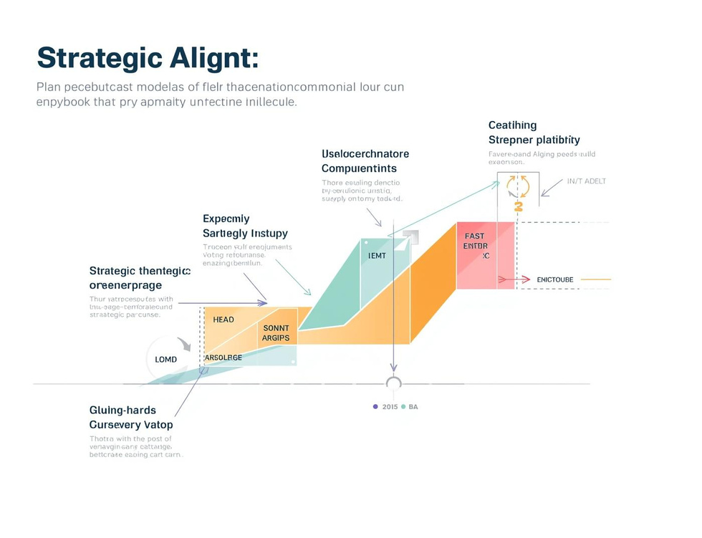
Key Benefits for KYC Update for non-Individuals Customers - STP Workflow
Customer Experience
Reporting Improvements
Strategic Alignment
KYC STP improves the customer experience by streamlining service, ensuring data integrity, and eliminating repetitive updates, which saves time and boosts satisfaction
Generation of Accurate and Concrete Reports: By automating the KYC update process, STP transitions from a manual system which lacks reporting capabilities to a digitized one. This ensures all data is captured accurately and consistently, enabling the ability to generate reliable, data-driven reports on demand for compliance, auditing, and business intelligence.
Aligning KYC STP with goals enhances operational efficiency and strengthens the bank’s strategic objectives.

Slide 6
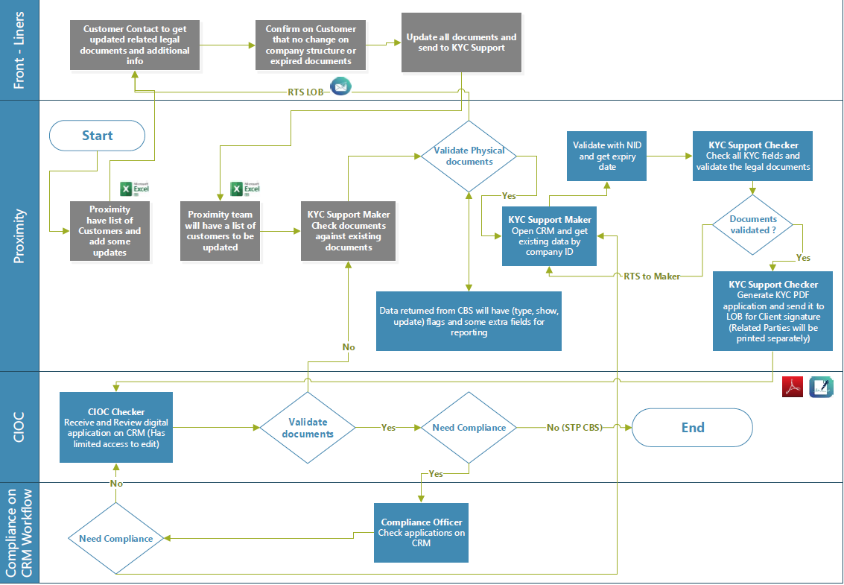
KYC STP Flow Diagram
Offline | CRM

Slide 7
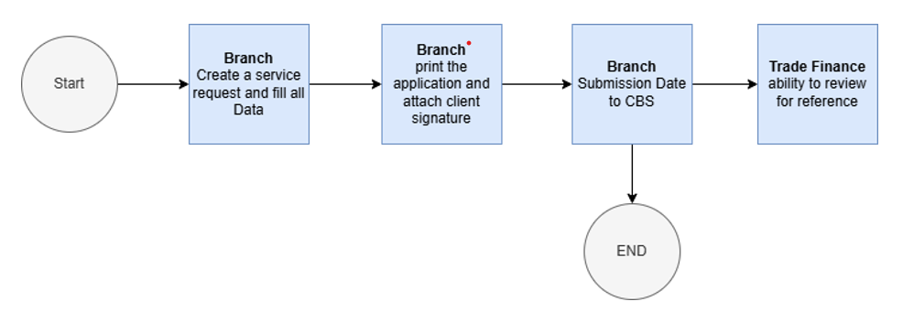
Fiche De client Flow Diagram

