Slide 1




Omnichannel FOCUS
Wrocław, March 2026

Slide 2

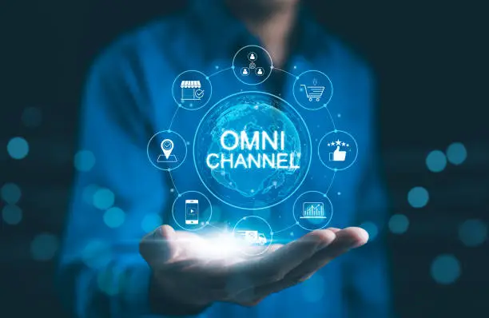
CONTACT CHANNELS STRATEGY
Omnichannel customer relations department

Slide 3
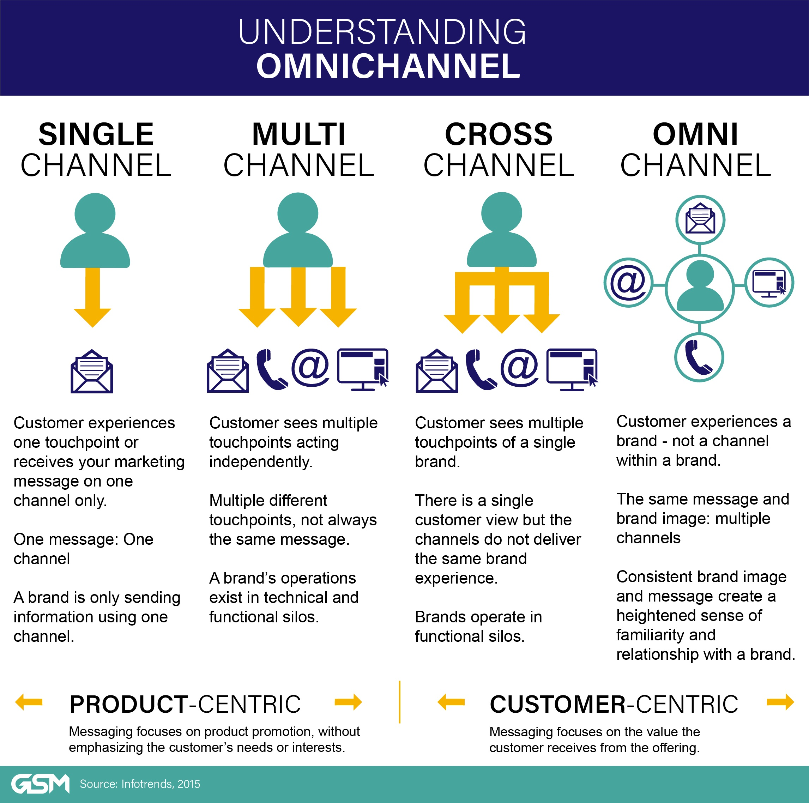

Where we are and where we need to be ?
THE CUSTOMER SEEING MULTIPLE CHANNELS AND CONTACTING EACH OF THEM SEPARATELY
THE CUSTOMER SEEING MULTIPLE CHANNELS, but ONE BRAND
MULTIPLE CHANNELS = NOT ALWAYS THE SAME MESSAGE
CUSTOMER EXPERIENCE COULD BE DIFFERENT IN EACH CONTACT CHANNEL
THE CUSTOMER CONTACTS WITH THE BANK, NOT WITH THE CONTACT CHANNEL
PRODUCT CENTRIC
CUSTOMER CENTRIC

Slide 4


Inbound boost– activities & connections
2025
2026
Customer needs changing
Process / products digitisation
Contact channels / omnichannel strategy
LUMI for CC
Projects / initiatives based on contact channels / omnichannel strategy
As is
Strategic goals
Traffic orchestration
TOP 10 CC operations out of the scope in the future
Inbound sales
New organisational structure – phase 2
New organisational structure – phase 3
Advisors universalism
New efficiency model
Advisors’ tools + calls routing changes

Slide 5




Inbound traffic orchestration – the first step
CC Advisors
Hybrid branch
Branches
CA24mobile

Slide 6








Our future: every contact channel, but one advisor
proactive contact
branch
phone
email
chat & social media
video

Slide 7
Advisor of the future
360° Financial Expert
Digital and Tech Skills
Know banking, investment, insurance & retirement products
Tailoring solutions to clients’ life moments
Conducting financial planning based on data
Keeping up with trends: ESG, digital assets, gig/shared economy
Proficient in CRM, AI assistants, and financial planning tools
Uses behavioral scoring and cash-flow analysis
Operates fluently across channels: video, mobile, social media, branches
Supports customers in navigating digital banking ecosystems
01
02
Relational and Empathetic Advisor
CX Architect
03
04
Understands customer journey across all channels
Ensures consistent experience regardless of contact point
Supports customers in automated processes (e.g., online onboarding)
Follows the principle: Be where the client wants to meet you
Practices active listening and trust-building
Understands customer emotions and adjusts communication
Prioritizes “customer-first” over “product-first”
Focuses on long-term relationships rather than single transactions
05
06
Self-Reliant but AI-Assisted
Ethical and Socially Conscious
Makes decisions based on data and AI suggestions
Interprets machine-generated recommendations critically
Embraces machine learning in daily work
07
Committed to fair advice, avoids misselling
Aligns financial solutions with clients' values (e.g., sustainability)
Keeps up with regulations on consumer protection and data privacy
Lifelong Learner
Continuously learns and earns certifications (including microcredentials)
Adapts to new models of work, technology, and client generations (Gen Z, Alpha)
Applies knowledge practically – not just knowing products, but solving problems

Slide 8



Which type of advisors do we need?
Contact Channel | Individual Advisor (Retail) | Premium Advisor | SME Advisor (Business Clients)
Branch / In-person | Basic service, onboarding, transactional support | Strategic sessions, wealth planning, trust-building | Business consulting, credit decisions, in-depth financial needs
Video meetings | Cost-effective alternative to branch visits | Primary advisory channel for convenience and discretion | Regular check-ins, remote business reviews
Chat | Digital-first service, AI/chatbot assisted | Digital-first service, AI/chatbot assisted | Digital-first service, AI/chatbot assisted
Phone (Call center) | Standard inquiries and issue resolution | Dedicated hotline or priority routing | Account manager access, immediate issue escalation
Email / Secure messaging | Follow-ups, formal offers, and documentation | Financial plans, investment proposals | Contracts, payment terms, credit documentation
Social media | Financial education, basic engagement | Brand interaction, digital personal brand of advisor | Thought leadership, B2B community presence
Proactive contact | Trigger-based (e.g., salary deposit, product renewal) | Life event-based, investment opportunities | Based on business cycles, cash-flow patterns

Slide 9

ORGANISATIONAL CHANGES
& results
FROM CONTACT CENTER TO OMNICHANNEL CENTER

Slide 10

Contact Center our structure before 2025
inbound
outbound
inbound & outbound
Contact Center Department
Customer Service Center
Sales Center
Standards Management
AFTER SALES service
SECURITY actions
PRIME Clients
MORTGAGES
SOHO Clients
CHATS
SALES
RETENTION campaigns
FOREIGN LANGUAGES customers
EMAILS
REMOTE Branch
SOCIAL MEDIA

Slide 11
New structure – phase 1 start January 2025
Department of Omnichannel Customer Relations
Customer Contact
Center
Customer Sales & Service
Specialised Center
Automation & Remote Customer Service Center
Customer Experience Management Center
AFTER SALES service
PRIME Clients
CHATS
Cooperation with Tribes
SALES
RETENTION campaigns
EMAILS
Projects related to clients’ feedback
SECURITY actions
SOHO Clients
SOCIAL MEDIA
Projects related to improving employee satisfaction
MORTGAGES
Survays
FOREIGN LANGUAGES customers
Recommending adjustments related to clients’ feedback

Slide 12
New structure – phase 2 start October 2025
Department of Omnichannel Customer Relations
Customer Service
Center
Customer Sales & Service
Specialised Center
New employees
0 < 12 months
sales & aftersales
Onboarding Team
PRIME
TEAM
Transformation Team
MORTGAGE
TEAM
Multi-contact Team
SOHO
TEAM
Chat/email/social media
REMOTE CUSTOMERS
TEAM
SAFETY
TEAM

Slide 13
New structure – phase 3 start February 2026
Department of Omnichannel Customer Relations
Customer Service
Center
Customer Sales & Service
Specialised Center
Operational Support Center
New employees
0 < 12 months
sales & aftersales
Onboarding Team
PRIME
TEAM
HOT LINE
Transformation Team
MORTGAGE
TEAM
RTM
Multi-contact Team
SOHO
TEAM
Business Process TEAM
Chat/email/social media
REMOTE CUSTOMERS
TEAM
SAFETY
TEAM

Slide 14
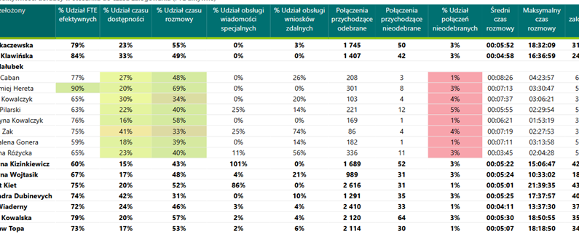

Efficiency model
Base model of inbound & outbound advisors implementation
  Breaks management
  Training & meeting time management
Employee rotation reduction
New advisors’ schedule management
Absence management
77%
71% of customers believe that a quick resolution of the case can radically change their opinion about the company
71%
72%
71%
55%
high increase in the Service Level throughout 2025
Y 2024
1Q 2025
2Q 2025
3Q 2025
4Q 2025
c
Service Level SOHO
average waiting time in 2025:
00:01:08 vs. 00:02:06 in 2024

Slide 15

CRI result
confirmation that we are going in the right direction
high increase in the CRI result (2025 vs. 2024):
+11 pp

Slide 16
Incoming calls (2025)
Business Zone - connections related to platform operation and offered products (VAS)
Sales of Business Accounts in Branches - presentation of the offer, preparation of the account agreement and transfer to branches for signatures by the client
Service and offer
Click to call – service calls from the mobile app
Main call topics:
26% - general information (balance, payments, account’s history, card debit)
18% - remote access (changing the limits, unlockking eBank or mobile access, providing a one-time telecode)
13% bailiffs’ seizures
5% transfers
5% offer
4% help in opening an account through the mobile app

Slide 17
Incoming non voice (2025)
chat eBank - 3362 chats
Main topics:
35% Bailiffs' seizures
36% Account information
4% Account statement
chat www - 190 chats
Main topics:
50% Account information
19% Credit products
chat Mobile – 16 773 chats
e-mail - 2788 e-mails
Main topics :
47% Business account/service
16% Bailiffs' seizures
15% eBank service
Main topics :
50% Bailiffs' seizures
24% Account information
chat Business Zone - 1305 chats
Main topics :
35% Account information, service
32% Bailiffs' seizures

Slide 18
Outbound calls (2025)
Customer Voice Question
Customer recommendationd, experience
Supporting the sale of business offers
Outbound actions that help the customer go through the process of opening a Business Account, Business Zone, Company Setup
Business Account 73% - 2720 closed connections
Business Zone 17% - 650 closed connections
Company Setup 10 % - 358 closed connections
Business account retention
Retention activities to maintain relations with customers

Slide 19
Pain points
Bailiffs’ seizures
AML topics
Change limits on company card
Transfers to high risk countries
no view in e-bank and mobile application
need to unlock funds manually
in the sales process - long waiting time for consent to enter into relations
in the after-sales process - blocking accounts and transfers - lack of a smart process of handling blockages, difficult communication with AML
change available only in branches and CC
no change on-line as in the case of a retail client (the limit applies from the next day)
available only in branches and CC (are not available in e-bank and mobile app) due to the need to collect additional data for Compliance

Slide 20

soho remote advisors rafał trojanowski soho remote sales netowrk
Paris, 11.03.2026

Slide 21
Why do we want to further develop the SOHO remote advisor model?
Small businesses are increasingly less likely to need a bank branch.
  86% of over 2 million companies are sole entrepreneurs
  Currently, approximately 50% - 60% of small companies choose fully automated processes, another 20% - 30% prefer a remote consulting model with a live expert, and another 10% - 20% prefer visits to branches
There are more and more „Generation Z” business owners on the market
  for them, new technologies, processes and remote consulting are commonplace
Lower costs
  the advisor does not have to travel, for example, 100 km to the client for a meeting to discuss the bank's offer, sign a loan agreement, order a payment terminal, etc.
Better business efficiency
  instead of 3-4 physical meetings per day, Remote Advisor will conduct 10-40 telephone aquisition and meetings with his portfolio clients, depending on the clients' availability
  Today, Remote Advisor acquires an average of 12 business accounts per month, compared to 2-4 for a traditional advisor.

Slide 22

Main projects and development activities
increasing the acquisition of new customers
LUMI / Virtual Agent AI
even more leads from digital
new EFL leasing offer combined with a business account (cheaper leasing if you pay it from your CABP account)
activation of customers from the Business Zone
effective notes and their structure after a conversation with a SOHO portfolio client
automatic detection and planning of client business projects after the conversation
effectively reaching the customer at the moment of real need for the bank's product or service
The next stage is AI synthesis based on internal and external data about the customer (e.g. customer behavior on the business account, customer opinions from our client's business card in Google Maps; information from the client's websites) [MVP1 – June 2026]
01
02
credit processes
06
developing the ProCA system for business products
building a process of simulating the company's Credit capacity for the prospect
effective remote sale of credit with an account
continuation in 2026 of the happy days campaign for the sale of pre-approved loans.
0
04
improving processes and standards for advisors
05
increasing upsells and customer activity, especially in the first 3 months after opening the Biznes Account
based on customer research - customer offers by phone, email communication with the customer, relationship management, standards, addressing and managing difficult customer issues
training and coaching of advisors, effective conversations
strengthening communication with new customers within 3 months after opening the account - highlighting the benefits of active use of the Account

Slide 23
Remote Advisors ACQUISITION
SALE OF SOHO ACCOUNTS
 |  | 2025
 |  | jan'25 | feb'25 | mar'25 | apr'25 | may'25 | jun'25 | jul'25 | aug'25 | sep'25 | oct'25 | nov'25 | dec'25 | TOTAL
 | New Accounts | 15 | 24 | 111 | 114 | 127 | 110 | 106 | 100 | 97 | 95 | 96 | 122 | 1117
8 FTE | Avr per 1 FTE | 1,8 | 3 | 13,8 | 14,2 | 15,8 | 13,7 | 13,2 | 12,5 | 12,1 | 11,8 | 12 | 15,2
 | cumulative | 15 | 39 | 150 | 264 | 391 | 501 | 607 | 707 | 804 | 899 | 995 | 1117
 |  | 2026
 |  | jan'26 | feb'26 | mar'26 | apr'26 | may'26 | jun'26 | jul'26 | aug'26 | sep'26 | oct'26 | nov'26 | dec'26 | TOTAL
 | New Accounts | 193 | 177 |  |  |  |  |  |  |  |  |  |  | 370
8 FTE | Avr per 1 FTE | 24,1 | 22,1
 | cumulative | 193 | 370
+ 625%
1117
370
154
2024
2025
02.2026
Remote Adv Team started in 2024
has now gained full sales power for new accounts;
over 20 new accounts per month per person
10% share of sales vs 2% share of sales channel „size” – very good channel efficiency vs other channels
Notes:
Robert

Slide 24
Remote Advisors: Loans
 |  | 2025
 |  | jan'25 | feb'25 | mar'25 | apr'25 | may'25 | jun'25 | jul'25 | aug'25 | sep'25 | oct'25 | nov'25 | dec'25 | TOTAL
 | # Loans | 1 | 10 | 9 | 3 | 5 | 7 | 6 | 9 | 7 | 6 | 14 | 5 | 82
8 FTE | Avr per 1 FTE | 0,1 | 1,2 | 1,1 | 0,3 | 0,6 | 0,8 | 0,7 | 1,1 | 0,8 | 0,7 | 1,7 | 0,6
 | cumulative | 1 | 11 | 20 | 23 | 28 | 35 | 41 | 50 | 57 | 63 | 77 | 82
 |  | 2026
 |  | jan'26 | feb'26 | mar'26 | apr'26 | may'26 | jun'26 | jul'26 | aug'26 | sep'26 | oct'26 | nov'26 | dec'26 | TOTAL
 | # Loans | 4 | 15 |  |  |  |  |  |  |  |  |  |  | 19
8 FTE | Avr per 1 FTE | 0,5 | 1,8
 | cumulative | 4 | 19
+ 74%
82
47
19
2024
2025
02.2026
The area of ​​loans is currently the weakest for us.
This year, we've increased our focus on pre-approved loans, which are the best for phone sales. Customers sign the agreement themselves in online banking while being assisted by a credit advisor over the phone.
our current operational goal is to sell 2 loans per month per advisor
Notes:
Robert

Slide 25
Remote Advisors: POS Terminals
 |  | 2025
 |  | jan'25 | feb'25 | mar'25 | apr'25 | may'25 | jun'25 | jul'25 | aug'25 | sep'25 | oct'25 | nov'25 | dec'25 | TOTAL
 | # POS Terminals | 4 | 4 | 10 | 15 | 13 | 14 | 10 | 7 | 6 | 12 | 9 | 6 | 110
8 FTE | Avr per 1 FTE | 0,5 | 0,5 | 1,2 | 1,8 | 1,6 | 1,7 | 1,2 | 0,8 | 0,7 | 1,5 | 1,1 | 0,7
 | cumulative | 4 | 8 | 18 | 33 | 46 | 60 | 70 | 77 | 83 | 95 | 104 | 110
 |  | 2026
 |  | jan'26 | feb'26 | mar'26 | apr'26 | may'26 | jun'26 | jul'26 | aug'26 | sep'26 | oct'26 | nov'26 | dec'26 | TOTAL
 | # POS Terminals | 10 | 7 |  |  |  |  |  |  |  |  |  |  | 17
8 FTE | Avr per 1 FTE | 1,2 | 0,8
 | cumulative | 10 | 17
+ 111%
110
52
17
2024
2025
02.2026
we still lack systematic sales
we plan to support this through dedicated campaigns per segment, e.g. physiotherapists using direct communication to clients via SMS and push
working on the effectiveness of remote advisors' conversations
8% share of sales vs 2% share of sales channel „size” – good channel efficiency vs other channels
Notes:
Robert

Slide 26
CRM
CLV Tribe, March 2026

Slide 27










Communication channels with clients
DIRECT TO THE CUSTOMER
INTERNAL AND EXTERNAL
CONTACT CENTRE
PUSH
(PUSH NOTIFICATION & MESSAGE IN THE MOBILE APPLICATION)
SMS
EMAIL
NOTIFICATIONS IN EBANK
NOTIFICATIONS IN STREFA BIZNESU
ADVISOR
FROM A BANK BRANCH
PASSIVE CHANNELS
TASKS
SALES PRETEXT
ADDITIONAL DATA
HIGHLY PERSONALIZED SALES HINT REFERRING TOCUSTOMER PROFILE OR EVENT THAT HAS OCCURED
USEFUL INFORMATION / INDICATORS ABOUT CUSTOMERS OR HIS PRODUCTS (PROMO OFFERS, PRCE LEVEL, MAIN BANK)

Slide 28

Classic CRM SME
DIRECT TO THE CUSTOMER
PASSIVE CHANNELS
AVG MONTHLY VOLUME
EXPORT
TYPE
PERSONA-LIZATION
UPDATE OF CONTENT
AUDIENCE
AVG MONTHLY VOLUME
EXPORT
TYPE
PERSONA-LIZATION
UPDATE OF CONTENT
AUDIENCE
SMS
70 522
REAL TIME
NCT - Tasks
14 456
NEAR
REAL TIME
eMail
37 779
NEAR
REAL TIME
NSS - Pretexts
292 349
NEAR
REAL TIME
CC Genesys
529
NEAR
REAL TIME
NSS – Additional data
1 689 939
NEAR
REAL TIME
CC external
2 591
BATCH
PUSH
51 255
NEAR
REAL TIME
eBank Mailbox
21 566
NEAR
REAL TIME

Slide 29


Classic CRM - events
Sales campaings
Activation campaignes
Onboarding campaign
campaign to activate new inactive customers Communication encouraging users to log in to the Strefa Biznesu
Passive event on customers without consent with an agreed meeting – the aim of the campaign is to collect marketing consents by a client advisor during the meeting
Customer Retention - the campaign aimed at customers from the BVIP portfolio who have requested to close their accounts.
Business Acoount, Business Account in Company set-up proces
Pre Approved credit
Overdraft renewals - end of contract
Cross sell VASes, e.g. POS
Transfer to advance/pro form – the aim of the campaign is to identify the client’s needs and propose financing at CA
Collapsing Credit - the campaign aimed at customers whose credit is about to expire
Projects - an action initiated by an advisor at a bank branch, based on a conversation with a customer and identification of their needs. At the appropriate time, a task is issued to the advisor
Mandatory communication
Mandatory social security payment - Customers who have a BGK de minimis guarantee- sent 5 days before the anniversary date of the BGK guarantee establishment
SWO Process - campaign dedicated to customers referred for full monitoring. The purpose of contact is to obtain financial documents, BIK reports and a completed START_MSP form
Real time events
PRE APP (click on the banner) - The campaign is aimed at customers who clicked on the PRE APP banner in the Strefa Biznesu
Contact forms - handling contact forms from the Strefa Biznesu and eBank
Large outgoing account transfer - campaign aimed at customers with large transfers, the aim is to identify the customer's needs and suggest an alternative source of financing
Green Investment Loan - campaign dedicated to customers who clicked on the banner in digital channels for Green Credit
Currency exhange – action dedicated to customers who use currency exchange services outside the bank
Accountancy (click on the banner) - The campaign is aimed at customers who clicked on the accountancy offer in the Strefa Biznesu
Informational
Margin increase - the campaign covers SME customers who did not achieve the minimum monthly revenue in the previous month, to inform customers about the margin increase
Loan installment - reminder about an upcoming loan installment
Changes to regulations, tables of fees and commissions
Relational
Newsletter with recommended economic reports, invitations to webinars
18
regular events
6
real time events

Slide 30
DIGITAL CHANNELS DEVELOPMENT
SOHO Tribe

Slide 31
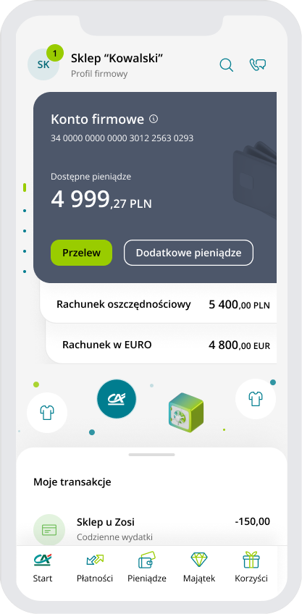
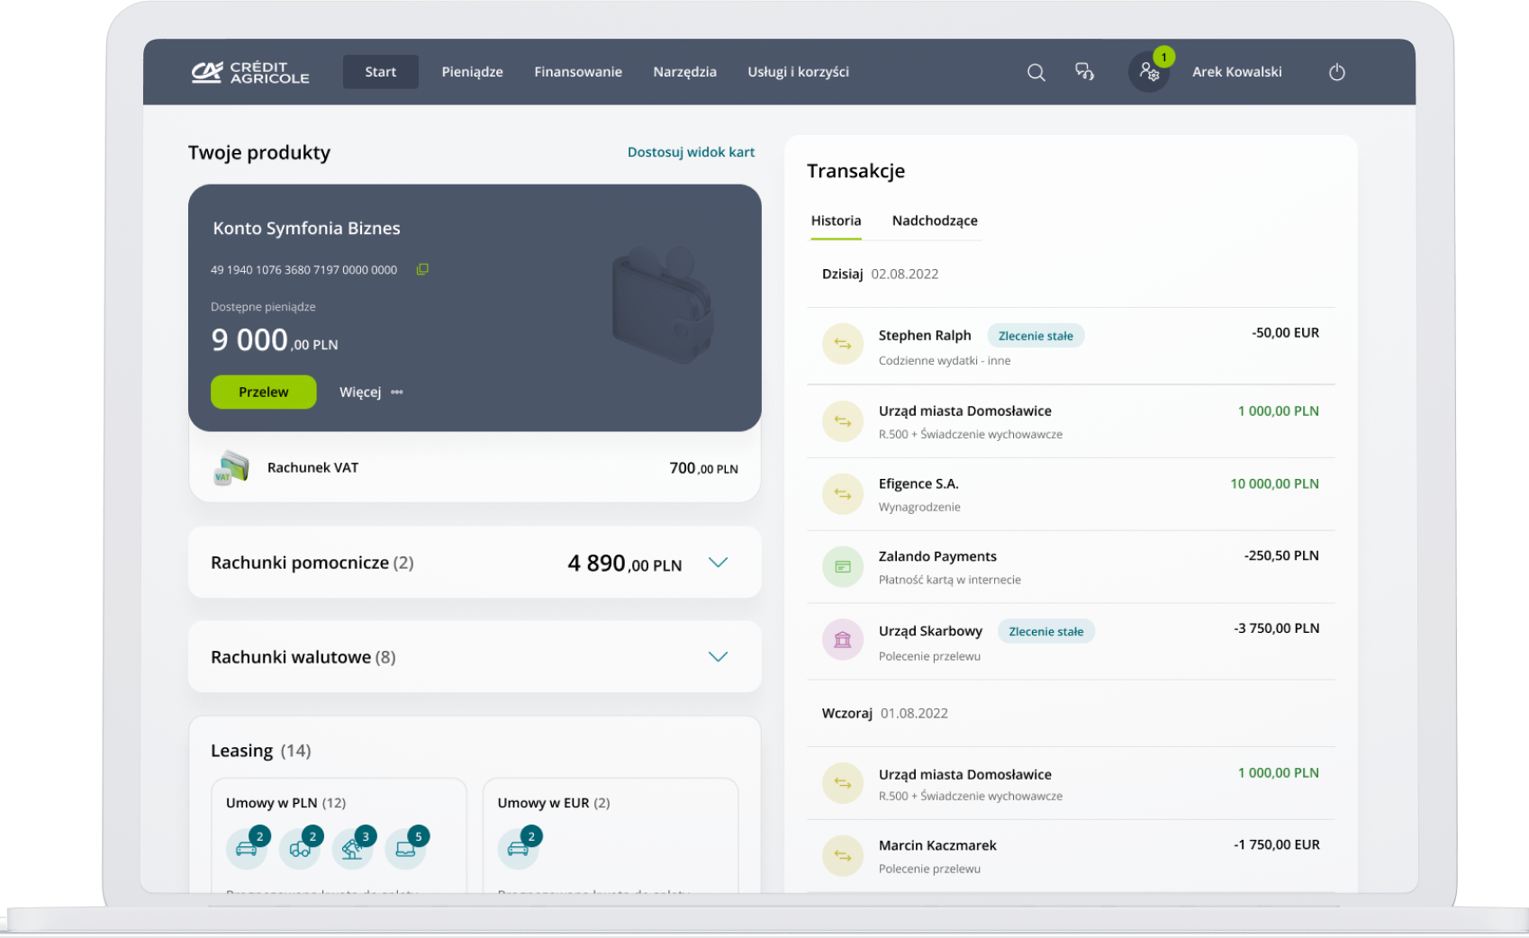
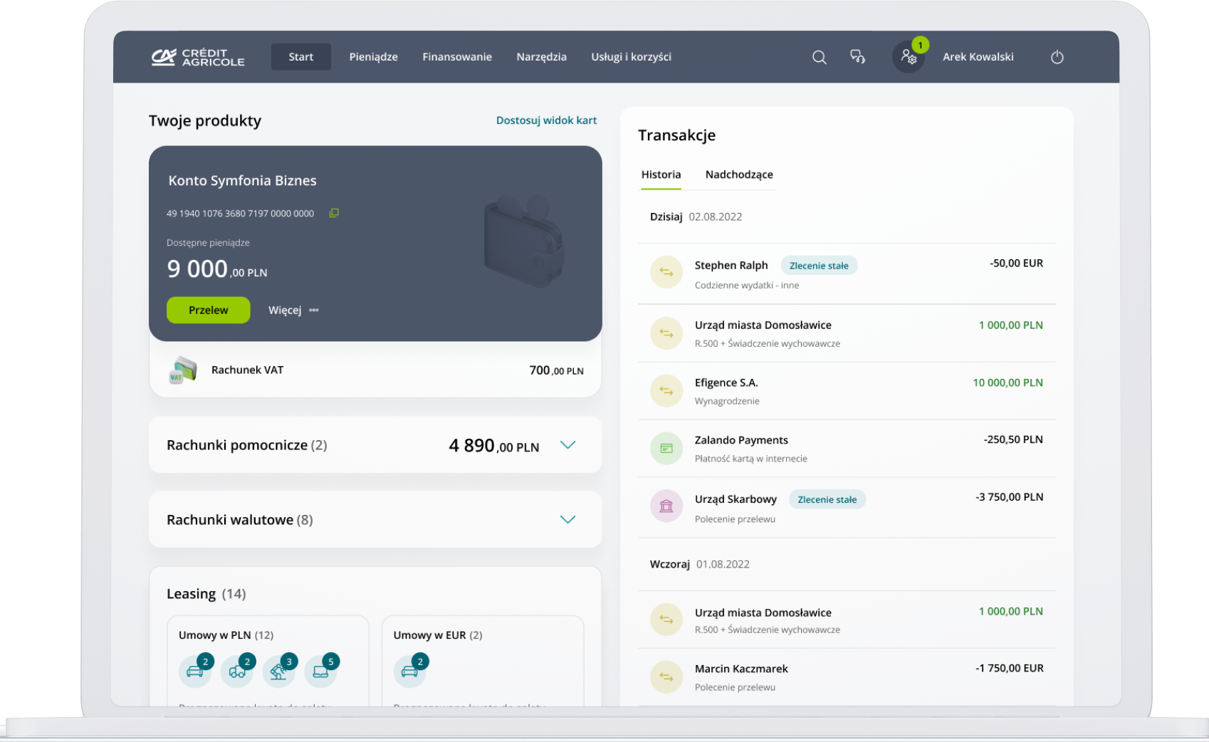
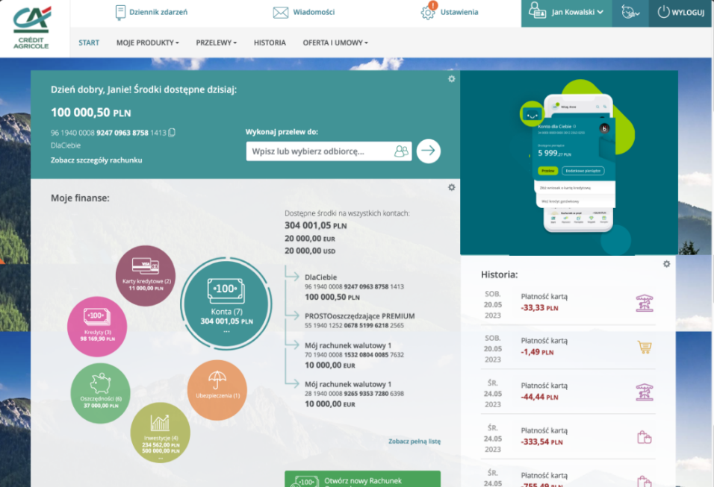




SOHO/AGRO customers in digital channels
CA24 Mobile
CA24 eBank
Business Zone
CA24 Mobile*
No. Of customers with logins
42 498
(63% of all customers)
No. Of marketing strategies
31
CA24 eBank*
No. Of customers with logins
34 140
(51% of all customers)
No. Of marketing strategies
10
Business Zone*
No. Of customers with logins
19 724
(49% of all customers with the access)
No. Of marketing strategies
36

Slide 32
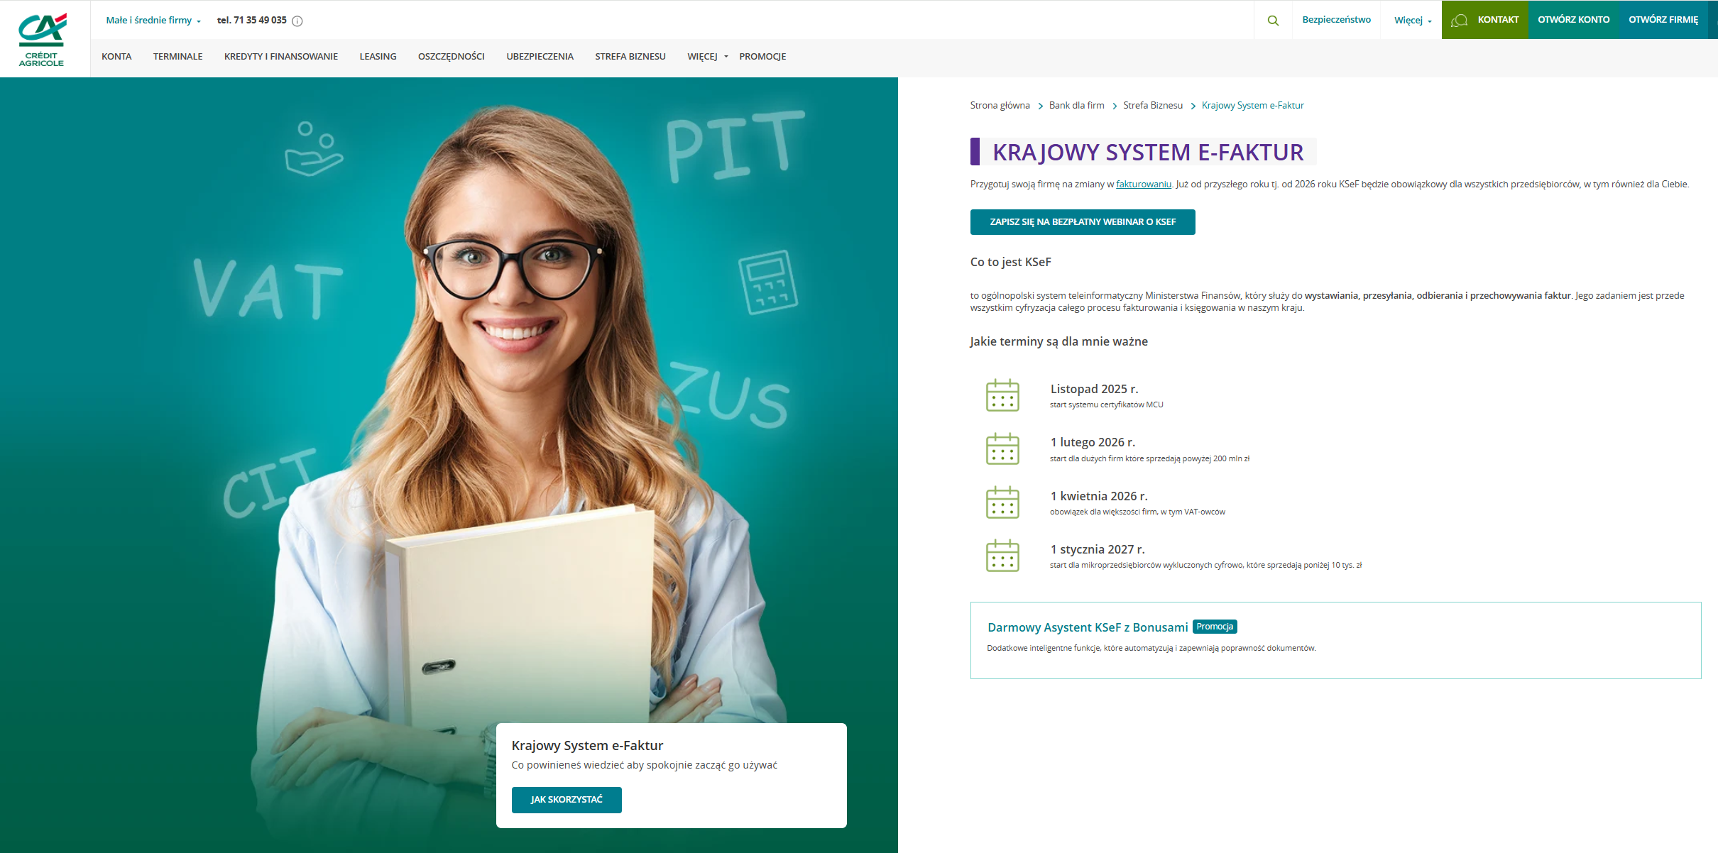
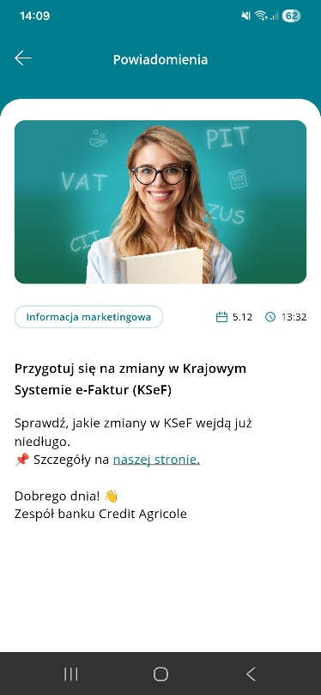

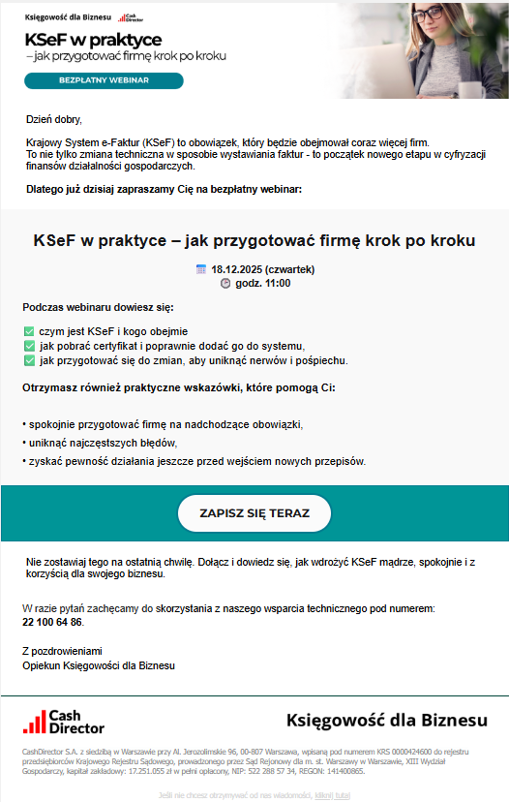
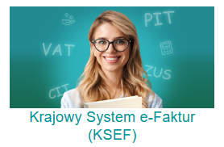

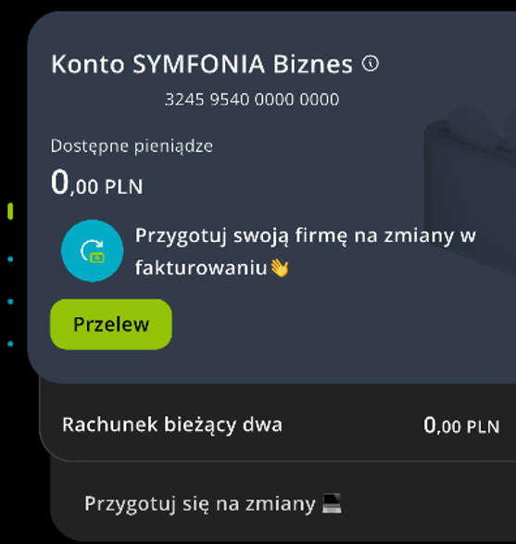
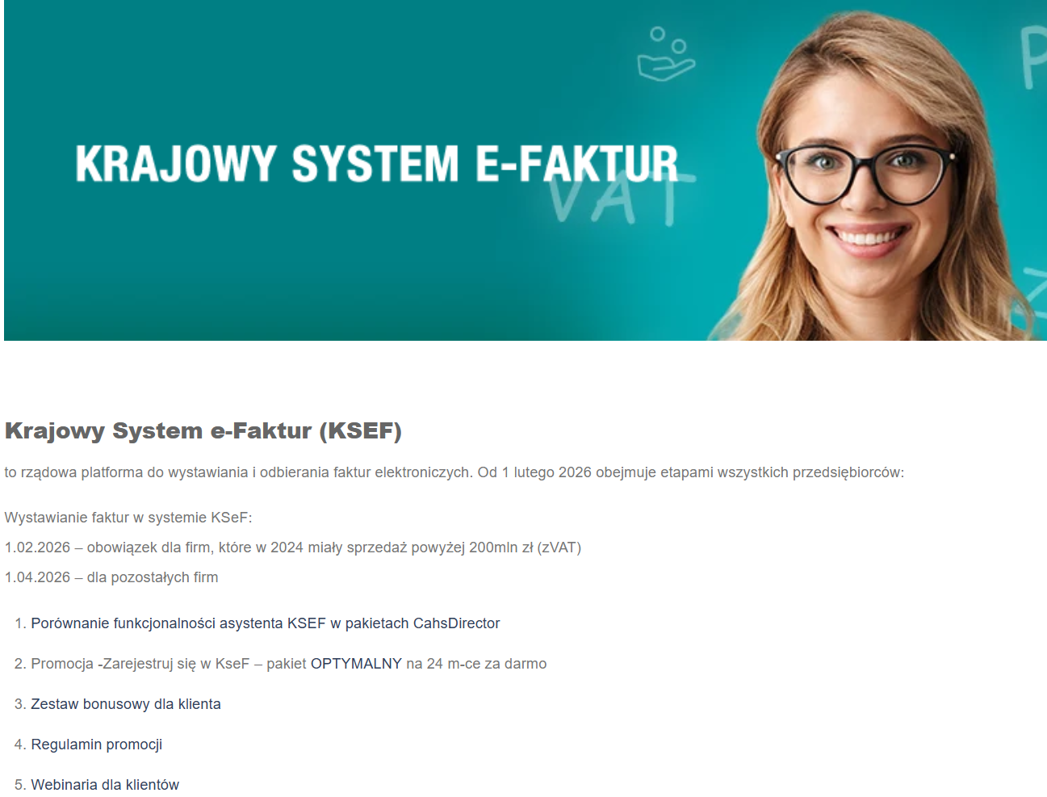
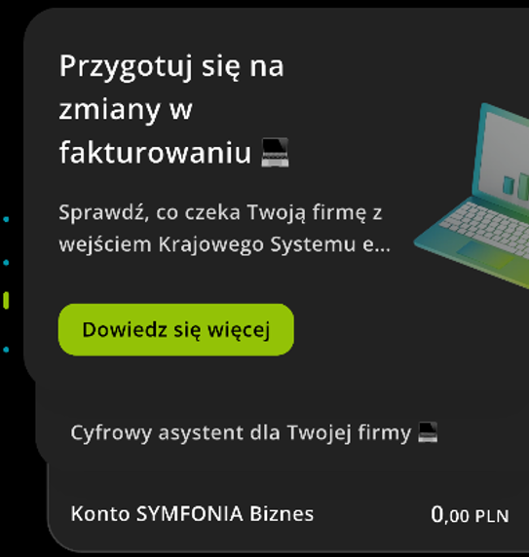
Holistic aproach to marketing communication with SOHO/AGRO customers
Business case - communication about changes in the invoicing system for KSEF
Goal: sales accounts with an accounting package, upselling accounting to existing clients, customer activation
Marketing campaigns supported by:
information on the bank's website
PR: press articles, social media
digital marketing: on-going banners, online video campaign, google search
Internal communication, workshops, kick off meetings, internal website, E-mail communication to the sales network
communication in cooperation with a partner
  Target group:
WWW
  Company customers
  Customers with potential for a business account
  Customer with potential to start a business
Text message
CA24 Mobile - PUSH
Dzien dobry, przygotuj swoja firme na zmiany w fakturowaniu. Dowiedz sie wiecej o Krajowym Systemie e-Faktur (KSeF). Wejdz na nasza strone, kliknij w lupke na gorze strony i wpisz KSeF. Pozdrawiamy, bank Credit Agricole
Dedicated webinar
Banners in Strefa Biznesu
Communication in cooperation with a partner (e-mail)
Internal communicatiion
Banners in CA24 Mobile

Slide 33
Digital channels development for SOHO – 2026 roadmap
2026
Q1
Q2
Q3
Q4
BLIK for SOHO/SME
Opening banking account from active CA24 mobile
Virtual card for SOHO
CA24 MOBILE
Promotion management in CA24mobile
Debit card limit management
eBank
R3.2026
MT940 extension (all accounts, extended format)
Strategy for eBank upgrade for SOHO companies
FE adv
LUMI – syntesis before meeting
ATM
Extenstion of Cash in & cash out in ATM’s
Google map profile positioning MVP
FX exchange rate presentation
Google positioning – API integration
Information about rental product
Accounting packages with KSeF
Certificate of account ownership
AI asistant for company MPV
AI asistant for company - API integration
New solution for EFL consents
Credit offer for EFL clients without banking account (tbc)
Medical packages activation
Information about medical package
STREFA BIZNESU
Accounting packages offer upgrade
Strefa Biznesu & VAS reporting (EDW)
Credit application
Springboot update
Angular update
Integration with new PKL (tbc)
New banking product/ VAS
New functionality
EFL product /functionality
Technical upgrade / maintenance activity
TO BE CONFIRMED
Pain point elimination

Slide 34
Credit process development for SOHO and SME – 2026 Roadmap
SME
SOHO
SME SALES NETWORK
SOLO/SOHO MIX
Delivery of full scope for SOHO
REMOTE ADVISORS
2025
2026
2027
2028
20%
80%
100%
OVD renewal and increase
Business Loan for SME (capital corporations) and flow for SMEs
Overdraft JDG
100%
OVD for SME (capital corporations)
and flow for SMEs
Business loan JDG
OVD for SME (civil and personal copartnerships)
Known customer JDG on KPiR
Additional income
New Customer in ProCA
Business Loan for SME (civil and personal copartnerships)
Investment Loan
(secured loans) - MVP
Refinancing
Other forms of accounting
Financing for 1 day
Seasoning
Professionalists
Pre-approved for investment loan
Revenues-based assessment
Disbursement automation in ProCA
Integration with CEIDG
Price negotiation
Credit simulation in ProCA
Integration with Nuxeo
BBC OVD for Preapproved in mobile
BBC BL for Preapproved in mobile
Pre-approved limit managments
Signing of credit application in eBank
PB and OVD in Strefa Biznesu
Credit simulation
Signing of credit agreement with spouse in eBank/mobile
New product coverage in ProCA
Automation in ProCA
Digitalization for client
New tools

