Slide 1


‘Hub Conseiller’
presentation
A new sales support tool for CAWL’s
‘Offre Intégrale’
More information: www.cawl.fr

Slide 2
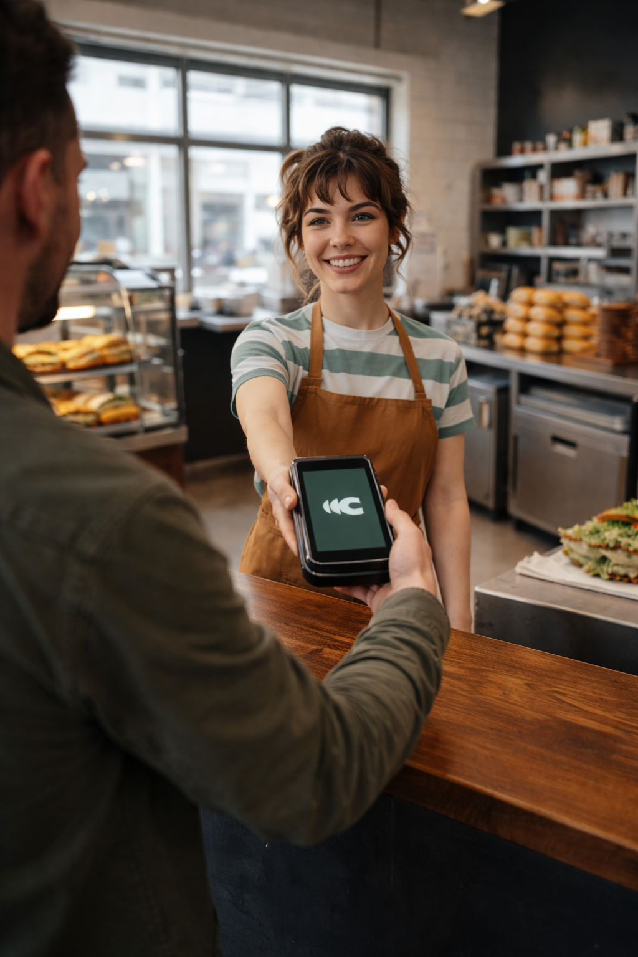

What is CAWL?
Your payment expert
and partner for growth
CAWL was born from a strategic partnership between Worldline, Europe’s leader in payment services, and Crédit Agricole, France’s leading banking group.
This joint venture addresses merchants’ growing demand for innovative and secure payment solutions.
By combining their expertise, they have created a unique brand at the heart of the payments ecosystem: CAWL.

Slide 3
CAWL’s current offering
Available since May 2025
Available from September 2026
CAWL’s
‘Offre e-Commerce’
A payment solution designed to boost online sales and simplify payments.
CAWL’s
‘Offre intégrale’
A unified payment solution to
accept payments anywhere, anytime: in-store, on the go and online.
E-commerce
Pay by Link
In-person payments
Vertical services
Pay by Link
E-commerce

Slide 4












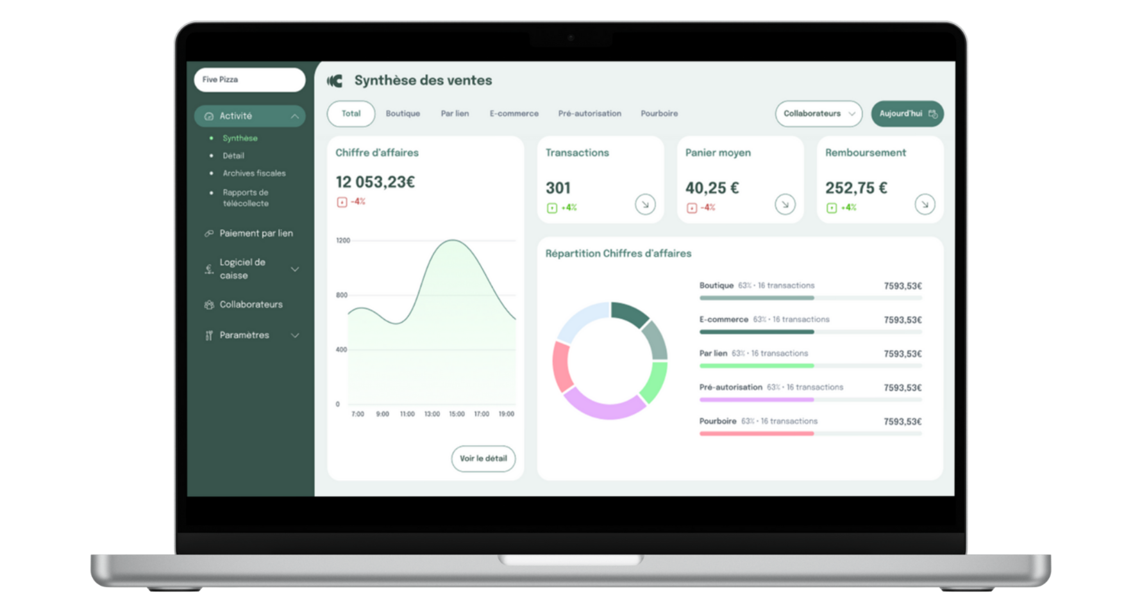
CAWL’s 'Offre intégrale’
A unified solution
To accept payments and manage your business in real time, wherever and whenever.
All the payment methods you need
Différé Santé
A single solution to take payments anywhere: at the counter, at the table, on the terrace, on the go, by phone, and online.
A full range of Android POS terminals
Unified real-time analytics
Tips, cash register, bill splitting,…
Pay by link via the POS terminal and merchant portal
E-commerce

Slide 5
Great customer experience begins
with the bank advisor
Turn every bank advisor into an ambassador
Equip sales teams
to compete with fintechs
Facilitate sales by the bank advisor
Establish CAWL’s credibility as an innovative payment provider

Slide 6
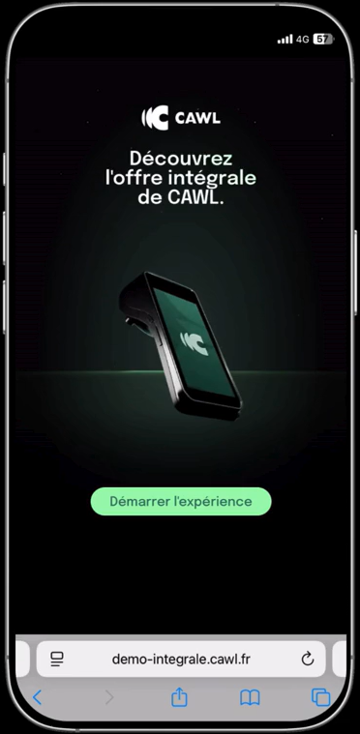
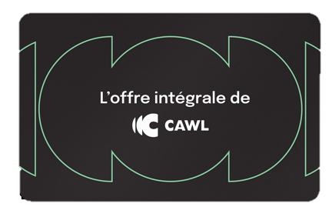

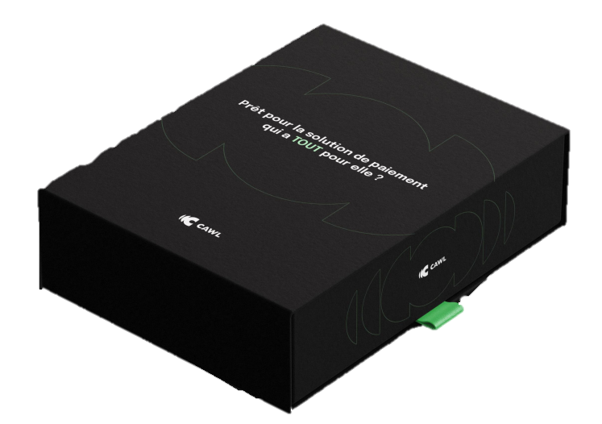
MVP Version
A digital solution
for bank advisors
right at your fingertips
3D POS terminal
Merchant portal demo
Digital brochure
Demo to test the app
Mobile and desktop versions

Slide 7
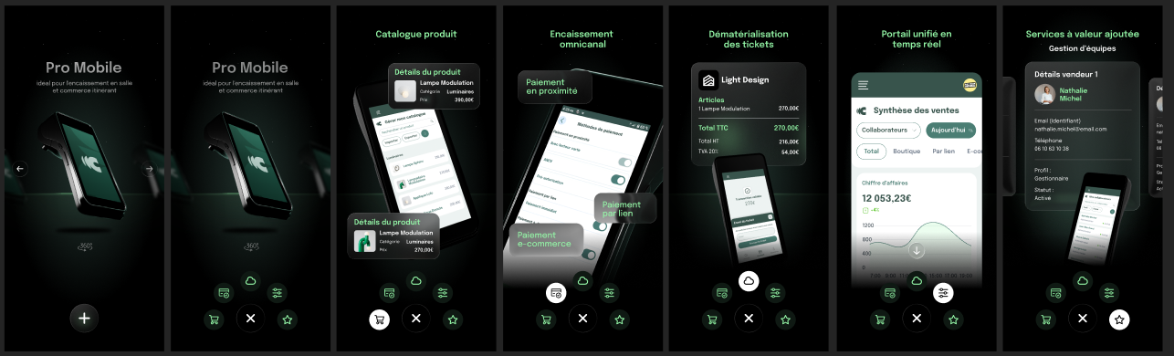

Slide 8
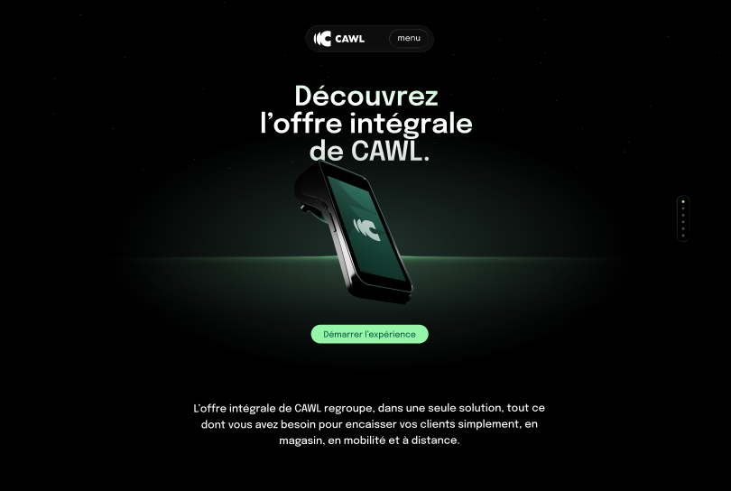
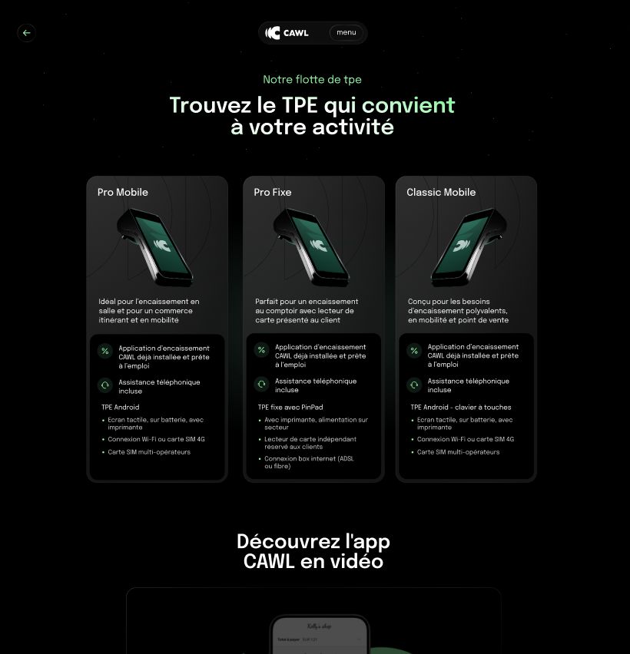

Slide 9
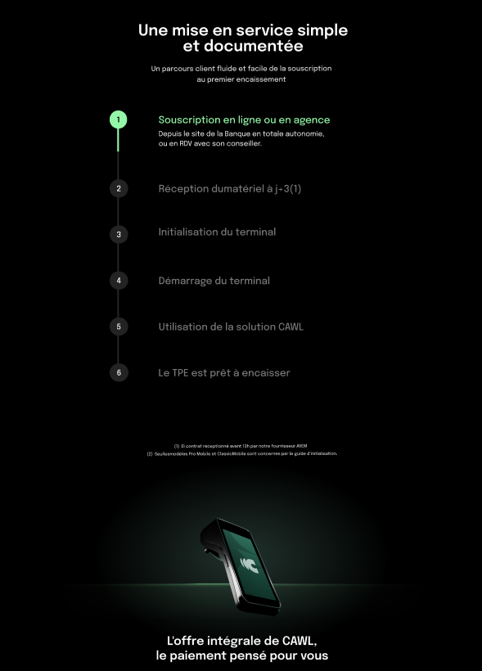
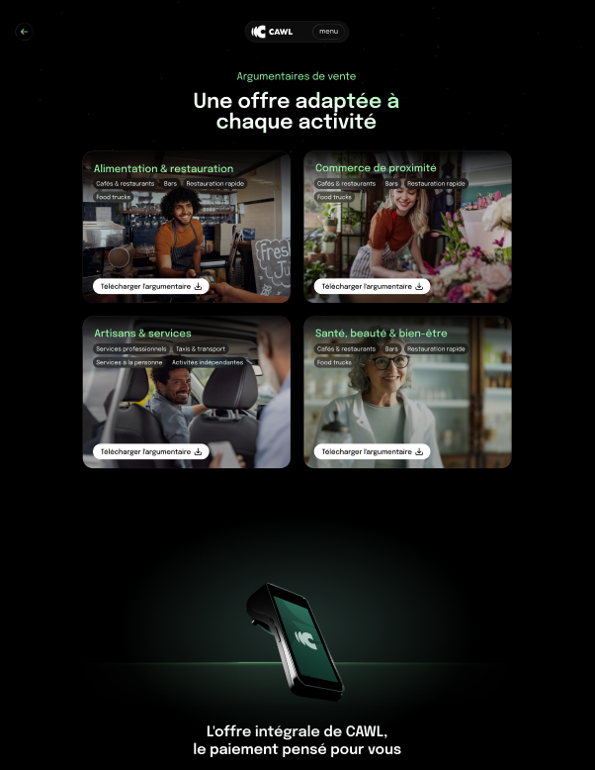

Slide 10
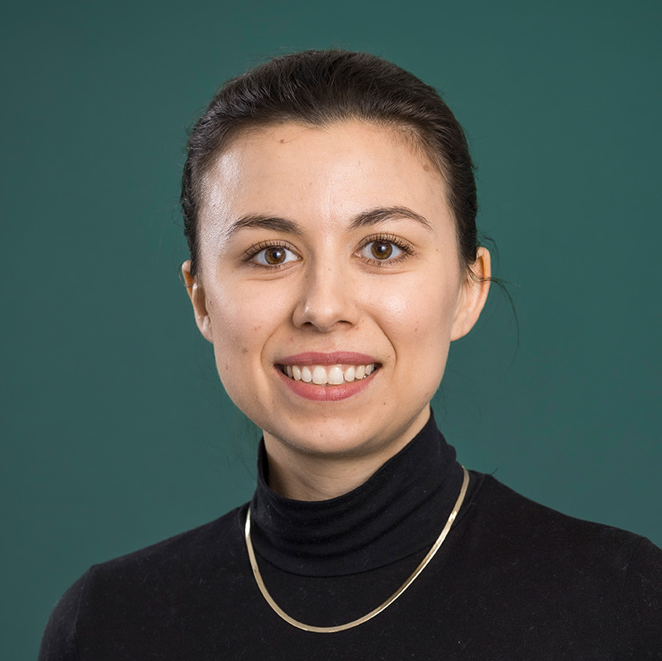
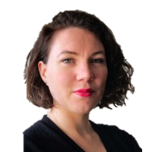
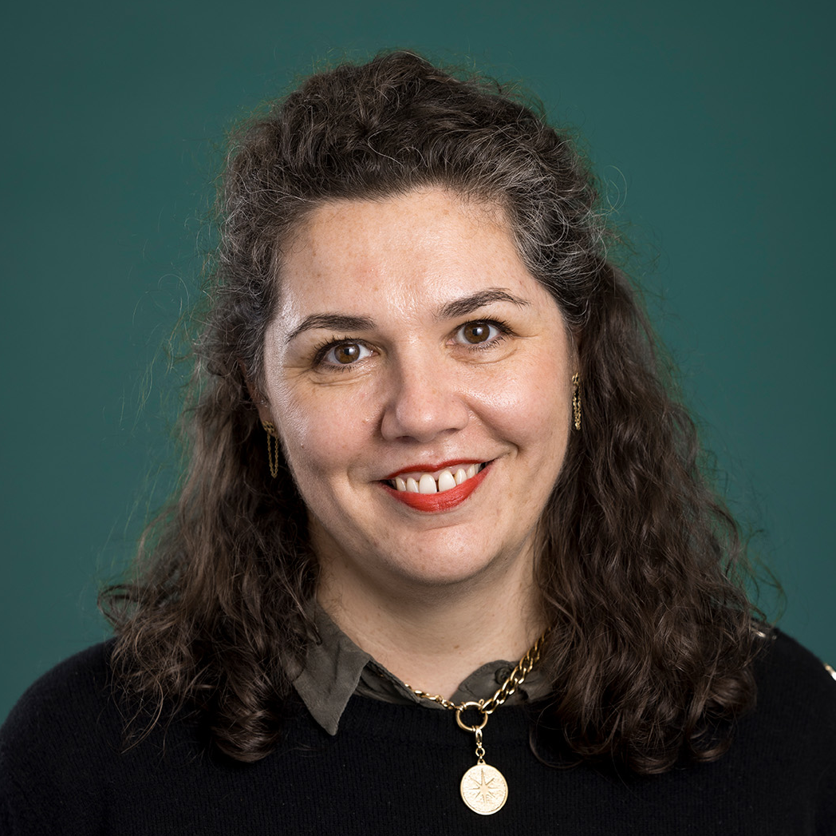
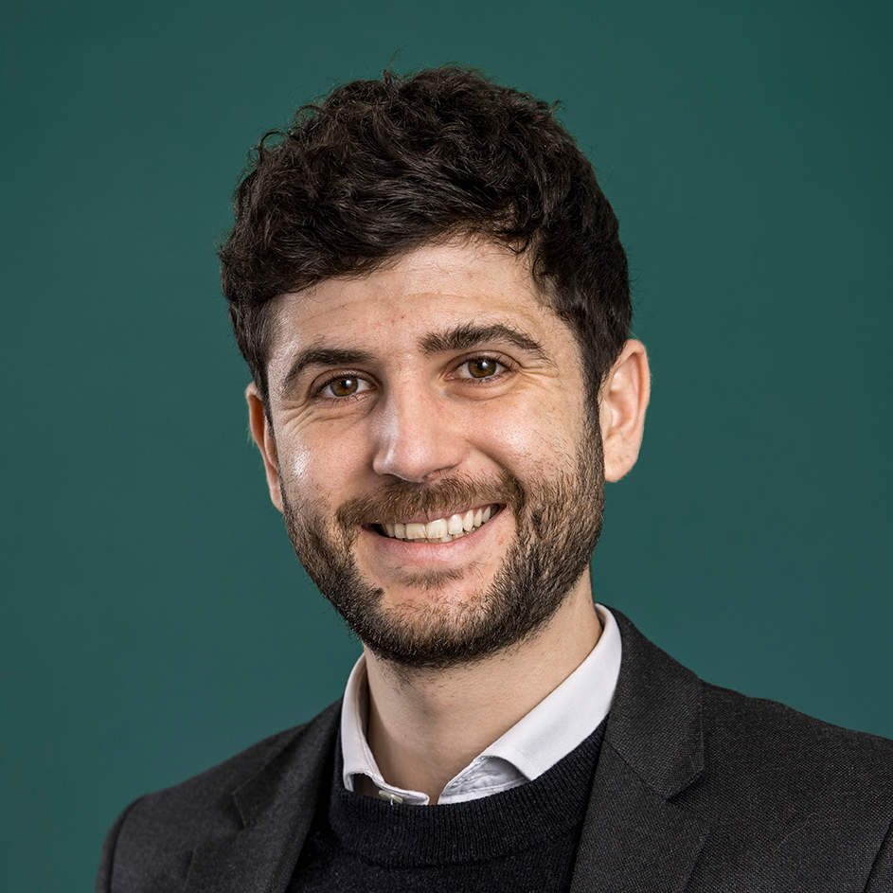
The team behind the project
Eva Lawrence
Camille Reul Lecryt
SMB Marketing Manager
Communication Manager
eva.lawrence@cawl.fr
camille.reullecryt@cawl.fr
Céline Dugas
Leo Bovet
SMB Channel Activation Manager
Communication Specialist
celine.dugas@cawl.fr
leo.bovet@cawl.fr

