Slide 1
Human Resources Bank
Entrepreneur Market
Silhame REKIA

Slide 2




Expanding the Human Resources Bankto the Entrepreneur market is fully in line with the ambition of the PMT ACT 2028 and the Regional Banks' 10-year ambitions
Developing the
GNP of RCs
Equipping and retaining our customers in specialized markets
Regulatory context
Favorable
Innovative approach
which brings together the expertise of the Group's businesses
Law of Value Sharing
-> Pro from 11 to 49 employees
Lever of conquest
Winning over the employees of our Entrepreneur customers
Strengthening the CSR policy of our Entrepreneurs
Attracting and retaining employees
Attractiveness of employers
High
ESR :
CAA : 160 € / year
WKL : 5€/salary
value-added solutions:
365 €/Contract
... allowing us to reduce our competitive gap
From our Entrepreneur customers equipped with Employee Savings and Retirement solutions
(vs. BPCE = 17.7%, CIC = 21%)
9,5%
1,6%
From our Contractor clients equipped with Group Insurance solutions ((vs. BNP/BPCE = 8%, traditional insurers = 36%)
0
-> Solution not yet deployed in the Contractor market
A global approach implemented in the Enterprise market since March 2025
with 1st results that demonstrate all its effectiveness and relevance

Slide 3










Adapting the Human Resources Bank to the Entrepreneur market by capitalizing on the experience of the Corporate market: a success to be replicated!!
A global approach based on 3 Pillars:
A strengthened and dedicated distributive organization
+ 40%
Resizing of sales teams in CR
90 Social Engineering Experts
1,100 new customers equipped with employee savings plans
(+€65 million in inflows)
v
v
v
+
+ 36%
Health
Pension
Insurance pension
End-of-career allowances
Budget for 45 additional BRH experts
(co-financed by the business lines over 4 years, possible use in the 2 markets)
36 recruited*
Group bonuses
Employee savings
Retirement Savings
Meal vouchers
Mobility package
CSE Benefits
Happy Holidays
New customers equipped with group health/prev
(+ €49.3 million in turnover)
=
+15 000
Pillar 1
Pillar 2
Pillar 3
122 BRH Chargé d'affaires
BUILDING AND LOYALTY
PROTECTING EVERY DAY
BOOST PURCHASING POWER
Employees equipped with CB WKL
(450 companies)
NB: All of these offers are open to marketing on the Entrepreneur market (NAP Ok)
* 26 BRH Officers recruited from the co-financed budget, the delta financed 100% either by Amundi ESR or by CAA
41,000 clients in our portfolios (11 to 49 employees) who have not yet been addressed by the BRH, and who are nevertheless looking for solutions to attract and retain their employees
Let's be the 1st to exploit the subject of "Human Resources" with our Entrepreneur clients

Slide 4

The success of this deployment depends on an efficient distributive organization to generate maximum business
Today, on the Entrepreneur market, 3 players can intervene to market 2 offers
Employee Savings & Retirement
Pro Advisors
(if autonomous)
Experts ELS
(if prescribed by the Cpro)
Health and group protection
Assur' Pro
Social Engineering Experts
Les nouveaux Assur pro seront désormais formés dans le socle dispensé par L’IFCAM à partir d’Avril 2026. Jusqu’à aujourd’hui : formation en distanciel
By capitalizing on CR initiatives and feedback on Entrepreneurs, we recommend
a coupled approach between the PRO Advisor (identification of needs) and a BRH manager/facilitator dedicated to the market, and according to the potential of the Regional Bank:
Dedicate an additional BRH Chargé d'affaires for the Entrepreneurs market (Via the BRH or CR budget)
Name a
BRH referent / facilitator
Contractors' Market
We are capitalising on the support system created on the BRH (training, Elearning, OAV, etc.) to support these employees with the support of the BRH Referents already in place and the complementary professions.

Slide 5
In view of the very promising initiatives already launched in the Regional Banks since 2025, there are 3 different distribution schemes depending on the potential
BRH experts housed at the PRO Market:
5 BRH experts dedicated to the Entrepreneurs market
Independent advisors on the SLE on small structures
1st CR in Employee Savings on Pro (440 contracts), production *4 in 2025
They are launching Group Insurance in 2026 (Abs Ass pro)
867 - Nord de France
883
Normandie Seine
887
Brie Picardie
802 – Nord Est
866 - Normandie
882
Ile de France
861 - Lorraine
CR with BRH Account Manager dedicated to the professional market, but attached to the Business Department (salesperson) or Insurance sector (Atlantique Vendée)
829
Finistère
822 – Cotes d’Armor
844
Val de France
872 – Alsace-Vosges
836
Ille et Vilaine
810
Champagne-Bourgogne
1 BRH Animator attached to the Marché des Pro (End of 2025)
Independent advisors on the SLE on small structures
Assists advisors on complex cases, and direct sales on Worklife
860
Morbihan
879
Anjou Maine
848
Centre Loire
825
Franche Comté
CR with BRH Expert set up on the pros, and attached to the PRO Market (seller)
847
Atlantique Vendée
894
Touraine Poitou
895
Centre Ouest
878
Centre Est
817
Charente Maritime
Deux Sèvres
868
Centre France
CR with BRH facilitator set up and attached to the PRO Market (facilitator)
881
Des Savoie
900 - Guadeloupe
824
Charente Périgord
845
Loire Haute Loire
902 - Martinique
839
Sud Rhône Alpes
813
Alpes Provence
833
Aquitaine
812
Nord Midi Pyrénées
These initiatives are accompanied by
Good commercial performance
on the offers of the BRH Pro
903
Réunion
835
Languedoc
813
Alpes Provence
891
Provence
Côte d’Azur
869
Pyrénées-Gascogne
831
Toulouse 31
820
Corse
871 Sud Méditerranée
BRH housed in the Business Department:
5 BRH Managers, including 1 dedicated to the Entrepreneurs market
Independent advisors on the SLE on small structures
3rd CR in Employee Savings on Pro
1st RC in Group Insurance
CR with deployment in progress for 2026

Slide 6
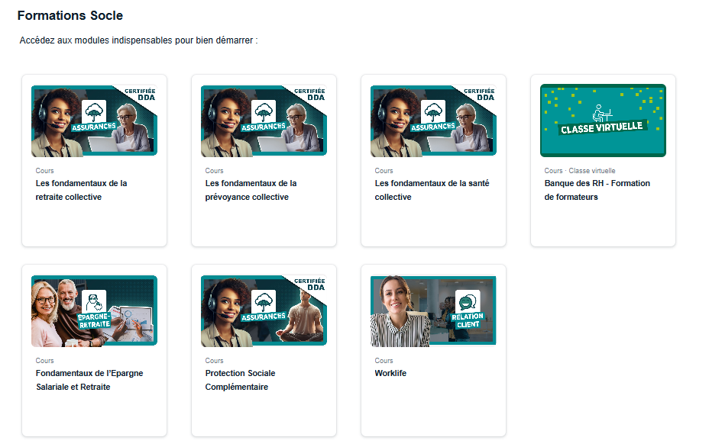

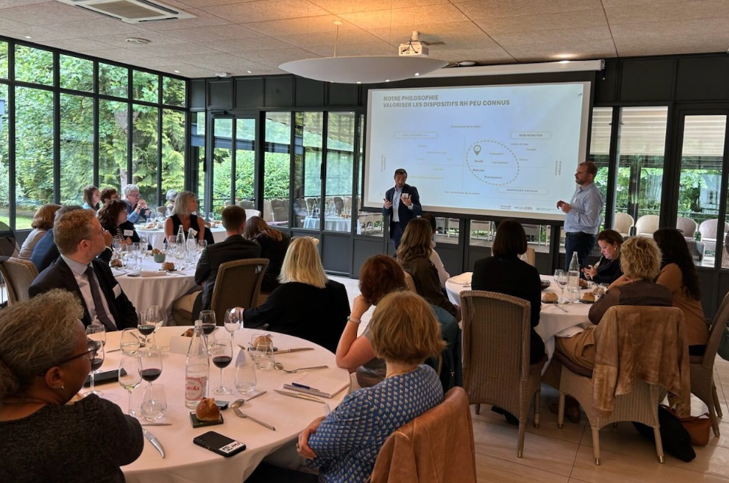
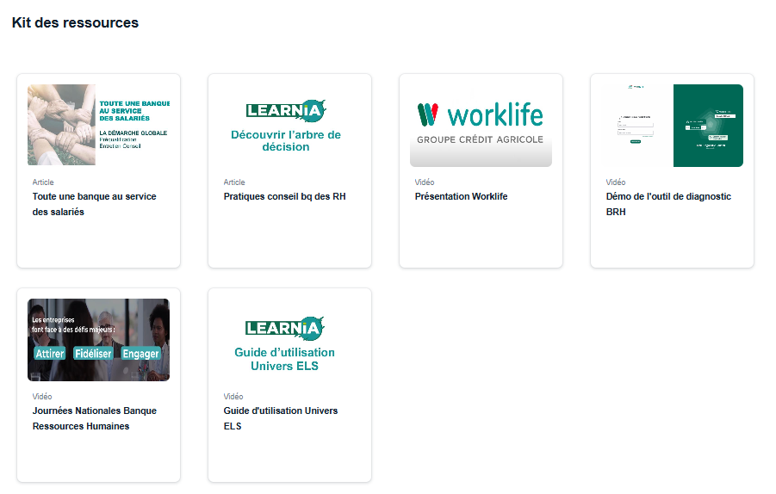
A comprehensive support offered by IFCAM and the business lines and on which we can capitalize
Portail univers - Banque des Ressources Humaines
Business Support
TRAINING + CO APPROACH
ANIMATION

Slide 7
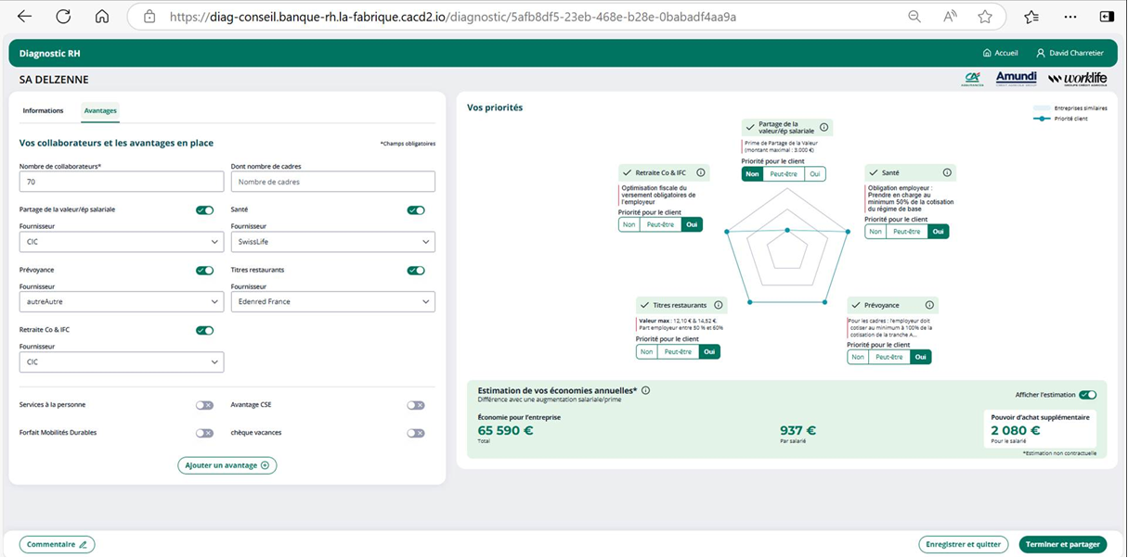

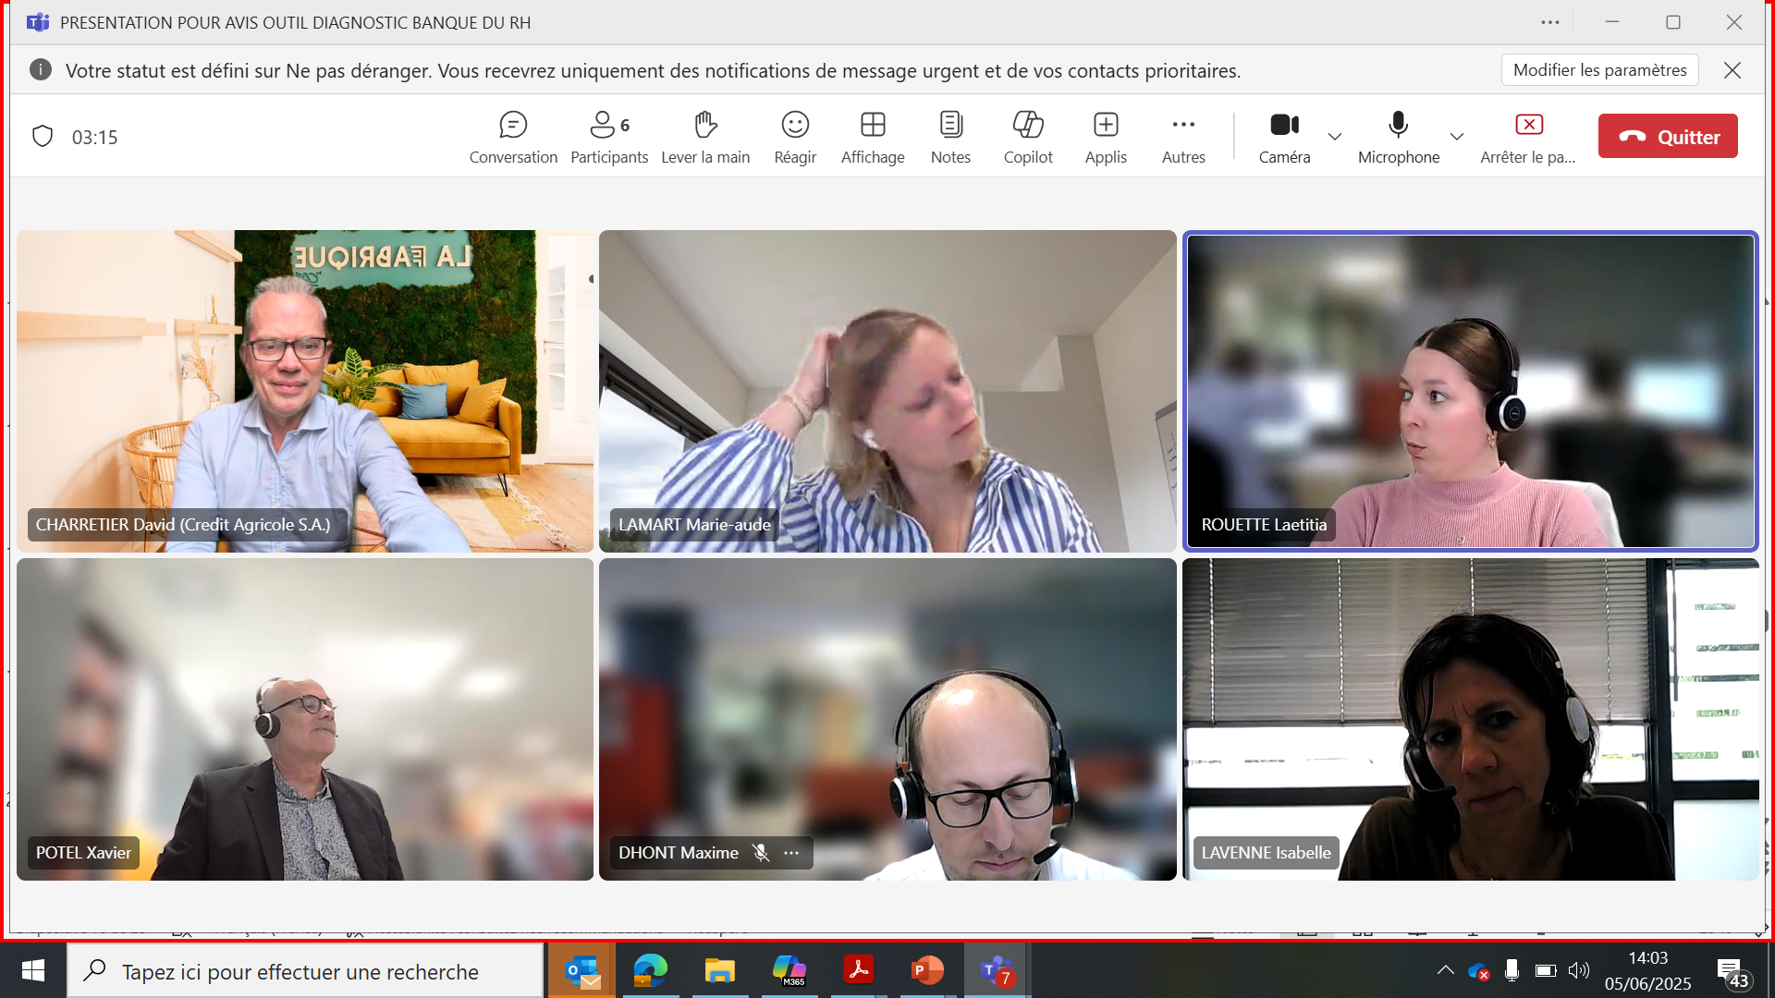
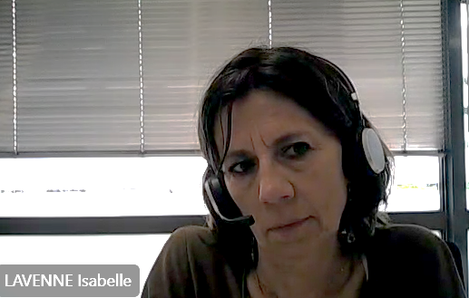
HR BANK CONSULTING DIAGNOSTIC TOOL
Promising results
A 360° STRUCTURED approach to guide you and make your life easier
Exemple - cas concret : entreprise de 70 salariés (CR NORD DE FRANCE)
VIDEO DEMO OUTIL
https://bcove.video/4l4a9sA
In our example
Detection of 2 opportunities:
HEALTH and PROTECTION: currently at SWISSLIFE but willing to switch to the CAA
EMPLOYEE BENEFITS: meal vouchers, gift vouchers and fuel vouchers for passage to WORKLIFE
VALUE SHARING/EMPLOYEE SAVINGS: the client wishes to stay at the CIC
What the project managers think
Vidéo: OUTIL DIAG CONSEIL BRH novembre 2025
It provides a synthetic vision of the BANQUE DES RH offer
A tool to collect customer data and provide it to experts
A simple and practical tool to support a consulting approach

Slide 8


Ambitious objectives to strengthen our position as a leading player in the Entrepreneurs market and to differentiate ourselves from the competition
Generate €22 million in additional NBI by 2030
Strengthening our positioning
Double our rate of employee savings and retirement savings (Reach 20%, i.e. 7,000 contracts/year)
Leading banking player in the Entrepreneur market
Earn 3 equipment points/year in Health & Group Prev
(Reach 10%)
CSR support and
Salary policy
Launch Worklife solutions on the priority target
(-> Encryption in progress)
Differentiation from our competitors
Time 2 in the Medium Term:
Industrialize the approach in digital territories and the field of embedded finance to extend the approach to all pro-employers
Carry out a reflection with the business lines to industrialize the BRH Pro by creating progressive packaged offers to meet the needs of our 242,000 entrepreneurs from 1 to 10 employees in an industrial way (digitalization, capitalizing on digital tools that are still little used such as the ELS)

Slide 9
ANNEXES

Slide 10
Identify the company's segment and industry
What offers should be offered?
à privilégier
23 INDUSTRY OFFERINGS
STANDARD/MODULAR OFFERINGS
Legal compliance
Targets: Professional branches
Open to as many people as possible
Targets: Companies outside the binding branch agreement
  From 1 employee
  From 1 to 200 employees

Slide 11







Identifier le segment et le secteur d’activité de l’entreprise
Cartographie des offres de brancheMapping of branch offers
Health
Pension
Salary maintenance
Health
Pension
SYNTEC
1486
CODENA
1517
RESTO RAPIDE (franchises)
1501
HOTEL CAFE RESTAURANT
1979
CLOTHING
1483
MCD
Offre exclusive McDonald’s
HAIRDRESSING
2596
REAL ESTATE
1527
Pour la prévoyance, l’accord du délégué régional est obligatoire
DENTAL OFFICE
1619
WINE AND SPIRITS
493
Prévoyance à partir de juillet 2026
PHARMACY
1996
Santé et Prévoyance à partir de juillet 2026

Slide 12
Identify the company's segment and industry
Mapping of branch offers
Health
Health
(without branch agreement)
Pension
AUTOMOBILE
1090
FRUIT AND VEGETABLES
1505
GMS
2216
Construction
See list
METALLURGY
See list
WHOLESALE TRADE
573
AGRICULTURAL MACHINERY
1404
CAVES COOP VINICOLES
7005
MEDICAL PRACTICES
1147
COOP AGRI – IAA
Cf liste
SPORT
2511
COSMETIC AESTHETICS
3032

